Slide 1
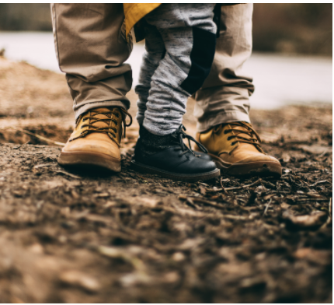
A Home That Glorifies God

Slide 2
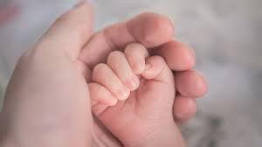
A Parent’s Prayer
Then Manoah prayed to the Lord, and said, “O my Lord, please let the Man of God whom You sent come to us again and teach us what we shall do for the child who will be born.”
Judges 13:8

Slide 3
“Bring him up in the way he should go”
Procreation is the general path one will take in life (Matthew 19,28)
Proverbs describes 2 paths for a child (Proverbs 10:1)
-love will cause parents to correct (3:12)
-an undisciplined child will bring shame to the parents (17:21)
-setting them up for ruin? (Matthew 18)

Slide 4
“Bring him up in the way he should go”
Honorable parents raise their children for the Lord (Ephesians 6:1-4)
Show them their earthly roles (1 Timothy 4,5:8/ Titus 2:4-5)
Avoid discouraging them (Colossians 3:19-20)

