Slide 1
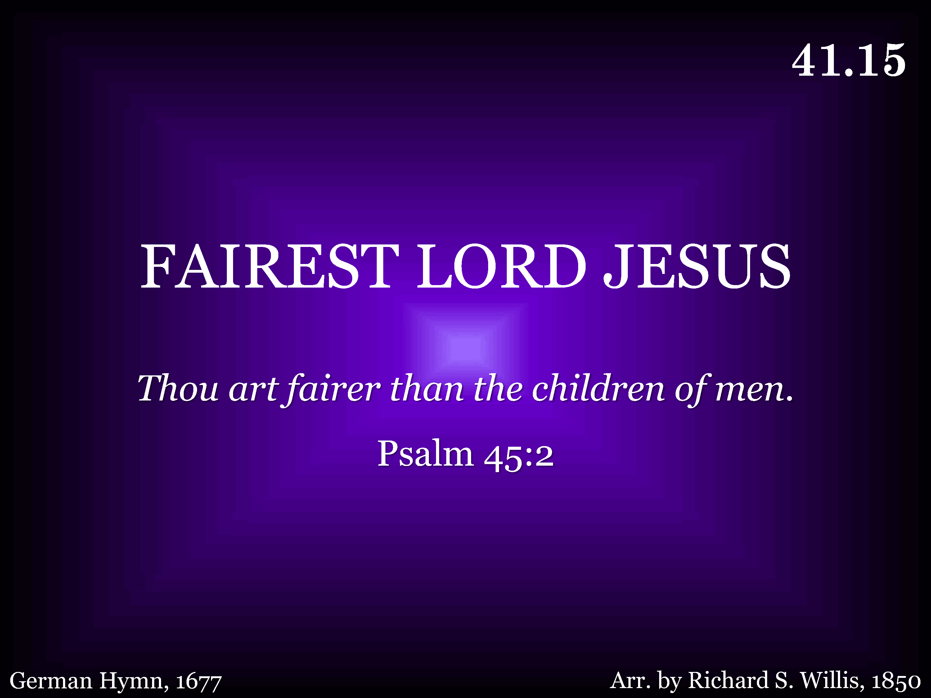
041.15 - Fairest Lord Jesus - Title

Slide 2
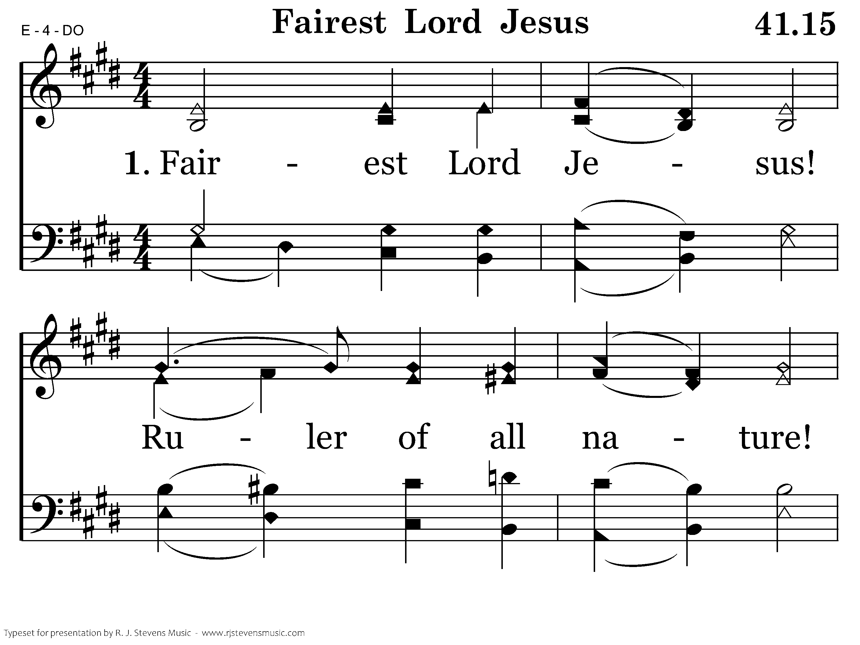
041.15 - Fairest Lord Jesus - 1.1

Slide 3
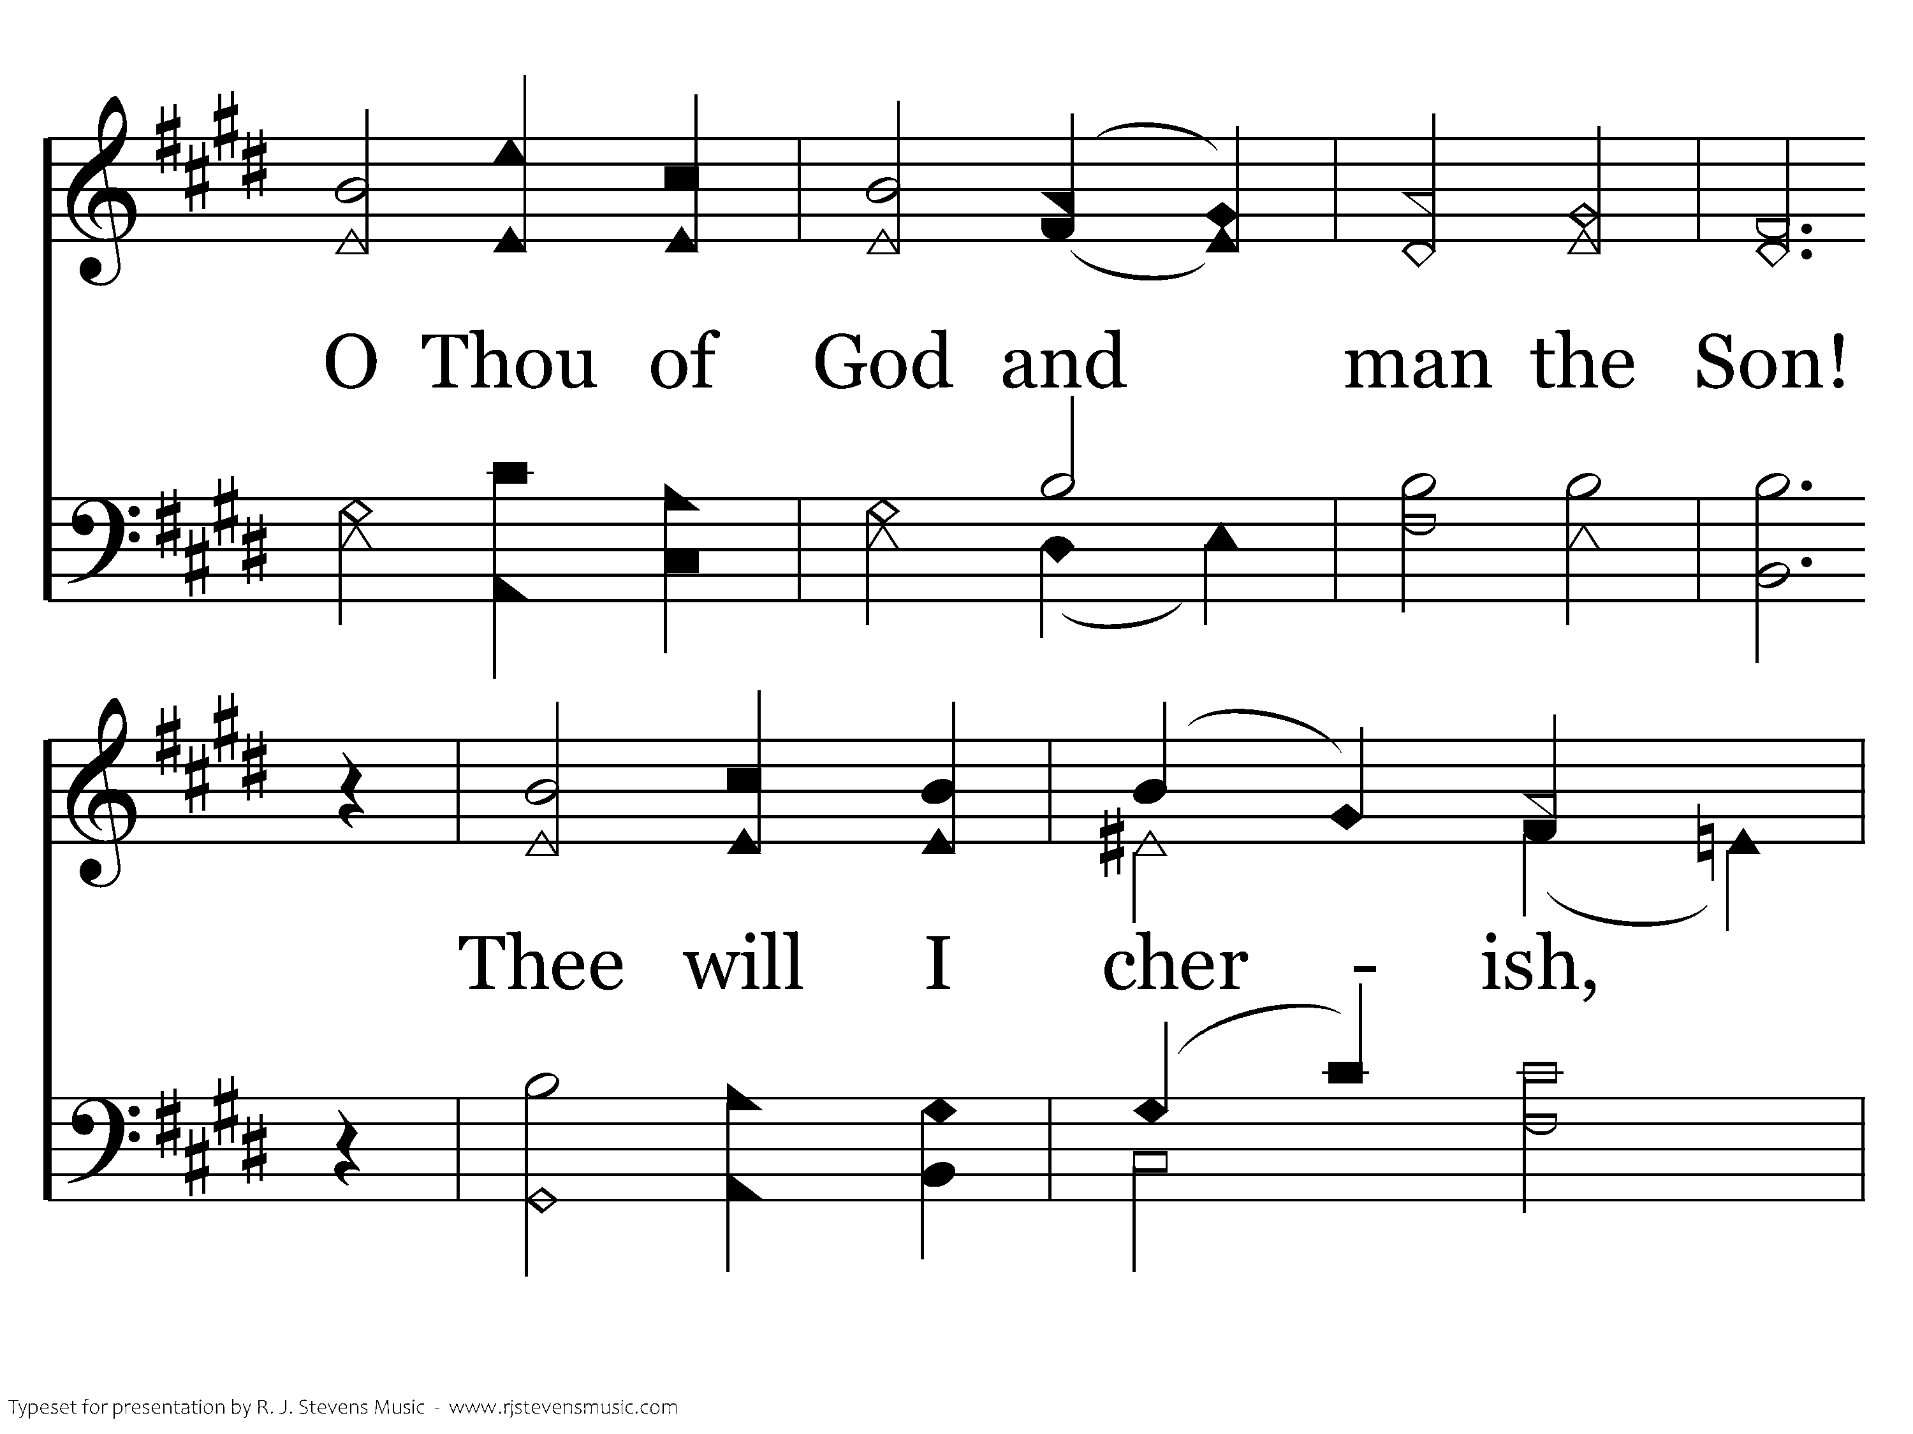
041.15 - Fairest Lord Jesus - 1.2

Slide 4
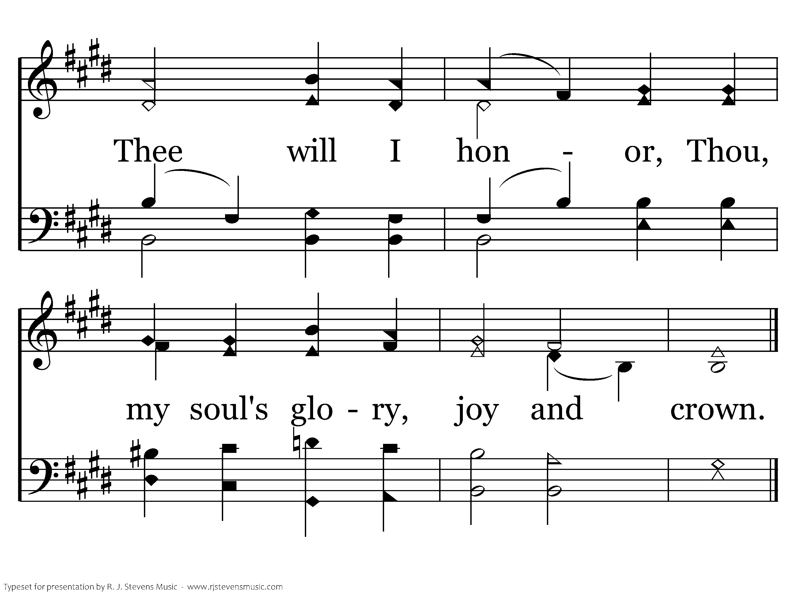
041.15 - Fairest Lord Jesus - 1.3
End of Verse 1

Slide 5
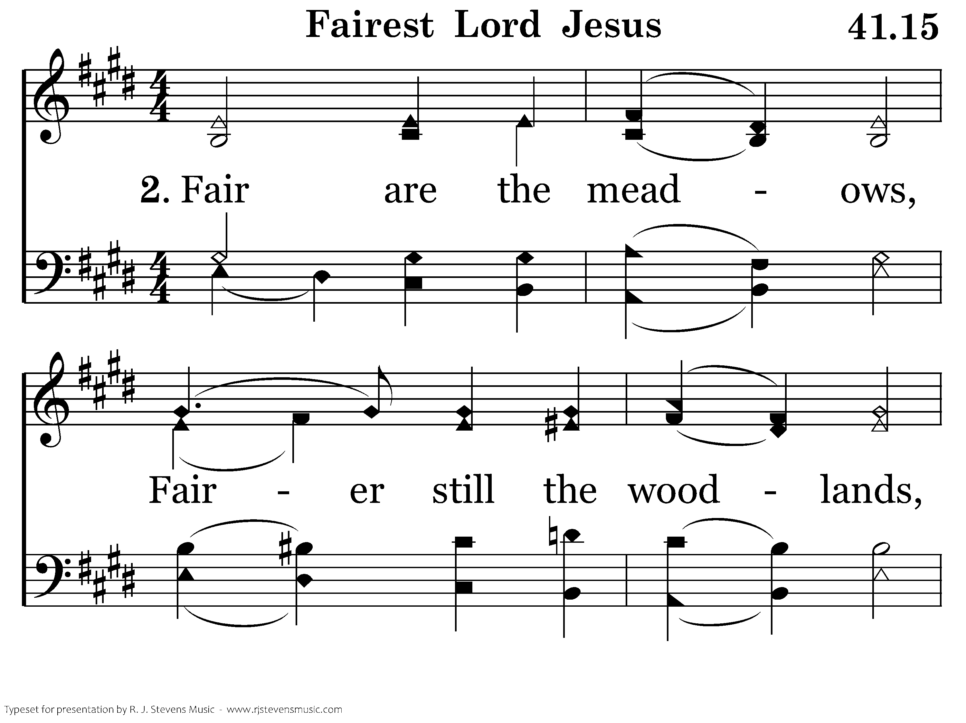
041.15 - Fairest Lord Jesus - 2.1

Slide 6
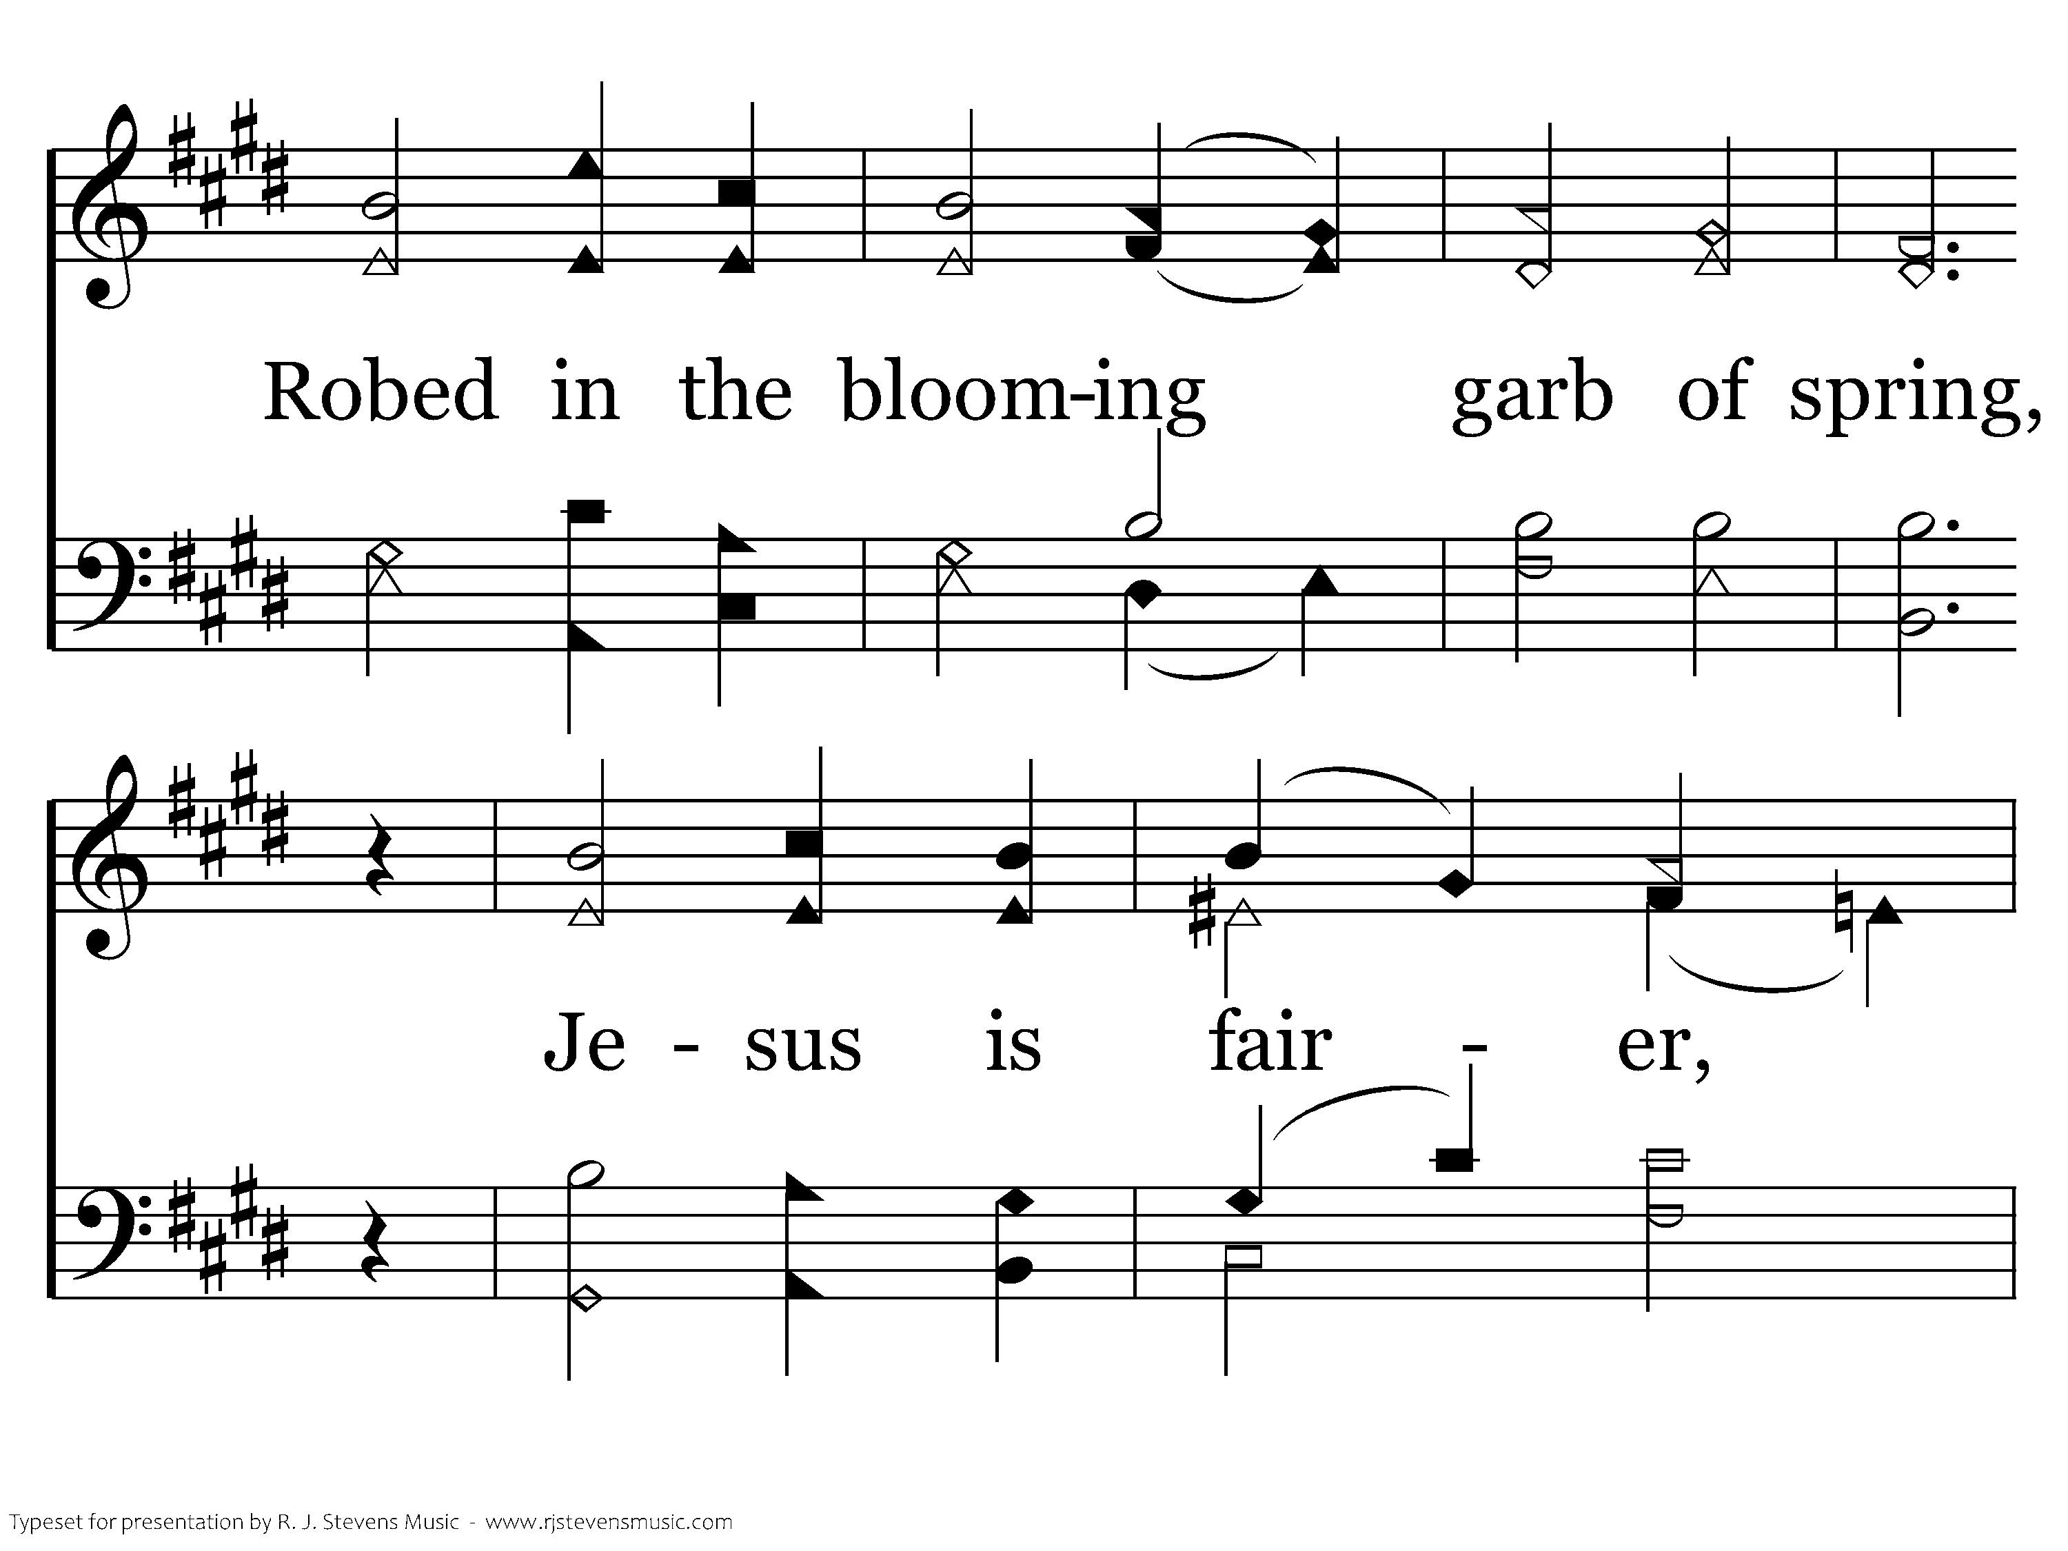
041.15 - Fairest Lord Jesus - 2.2

Slide 7
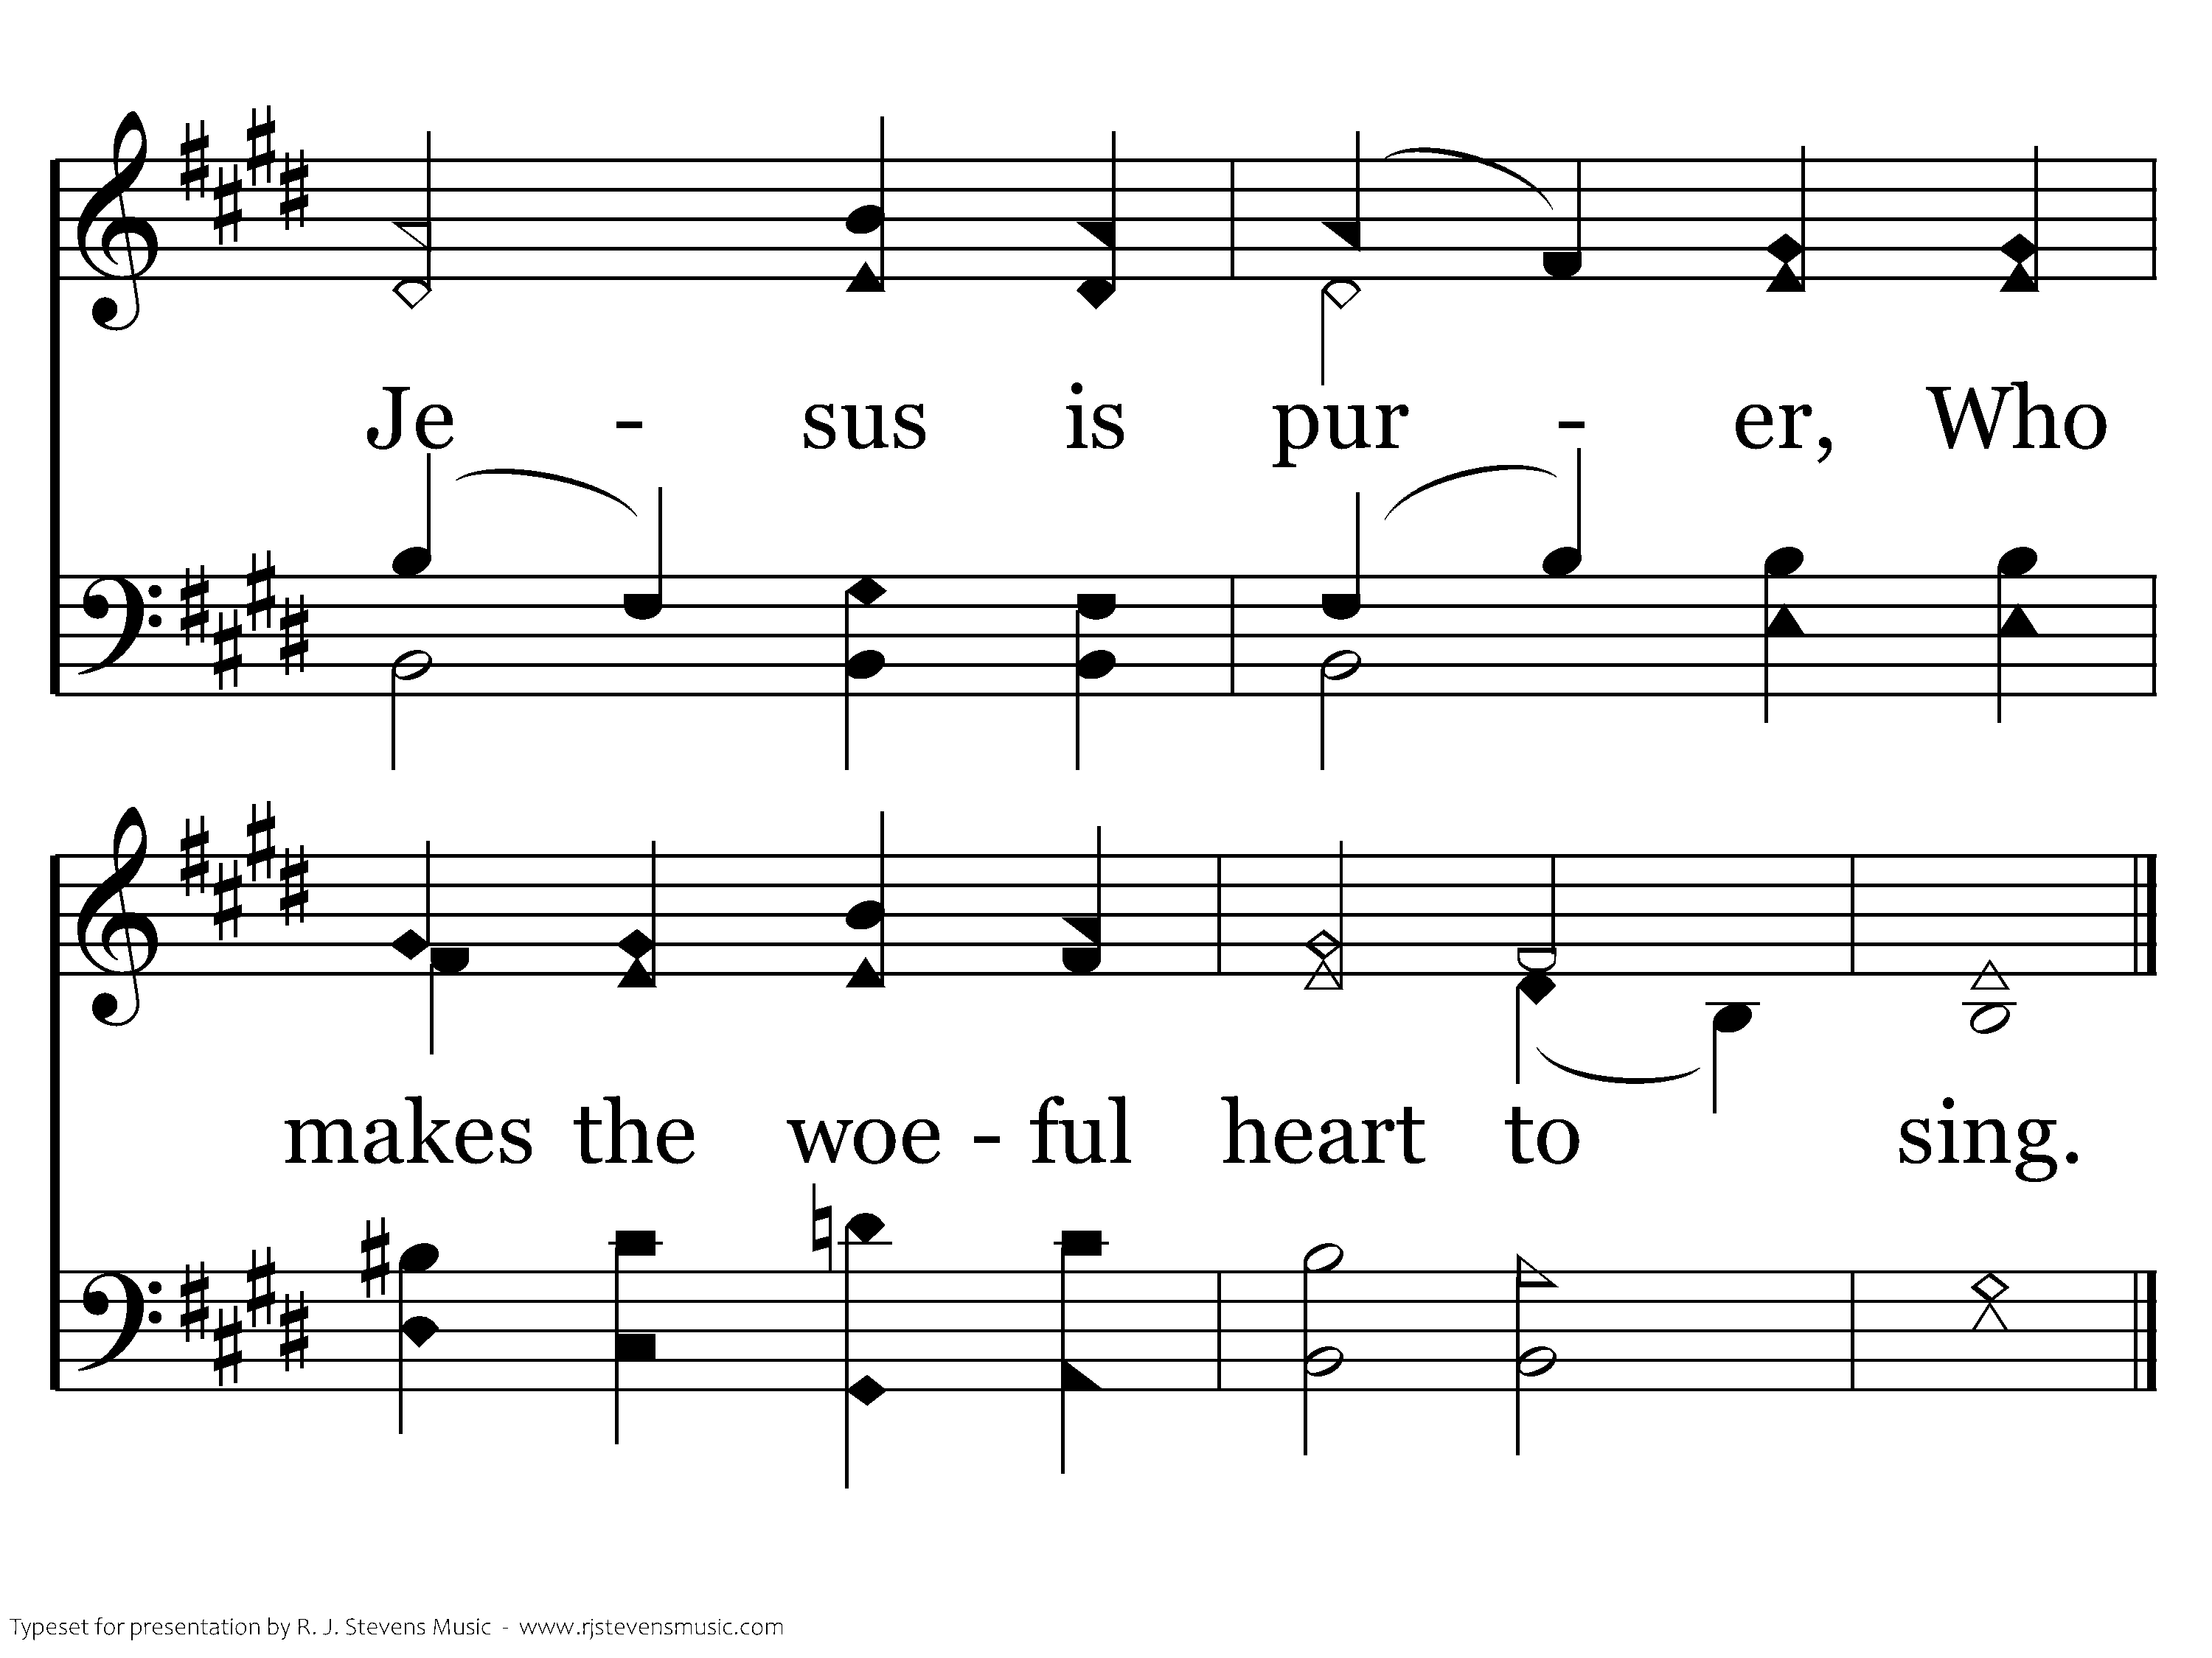
041.15 - Fairest Lord Jesus - 2.3
End of Verse 2

Slide 8
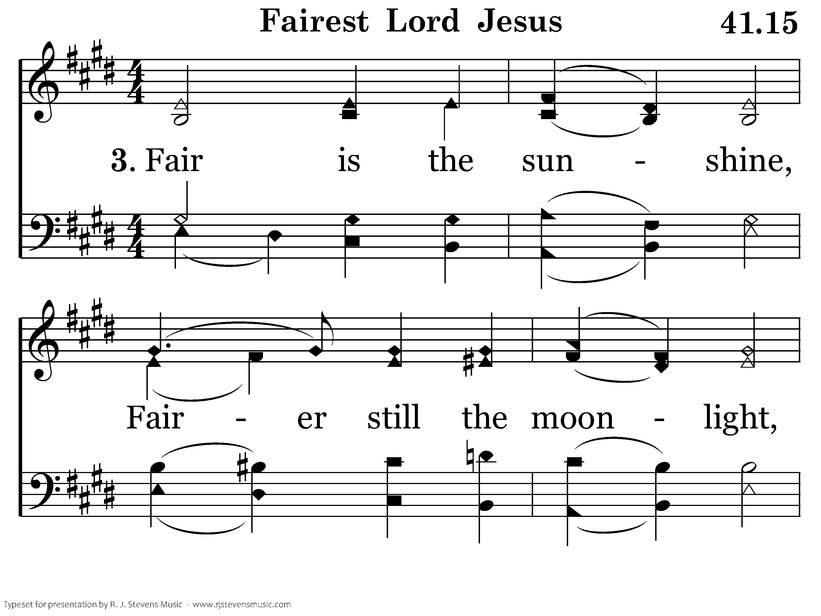
041.15 - Fairest Lord Jesus - 3.1

Slide 9
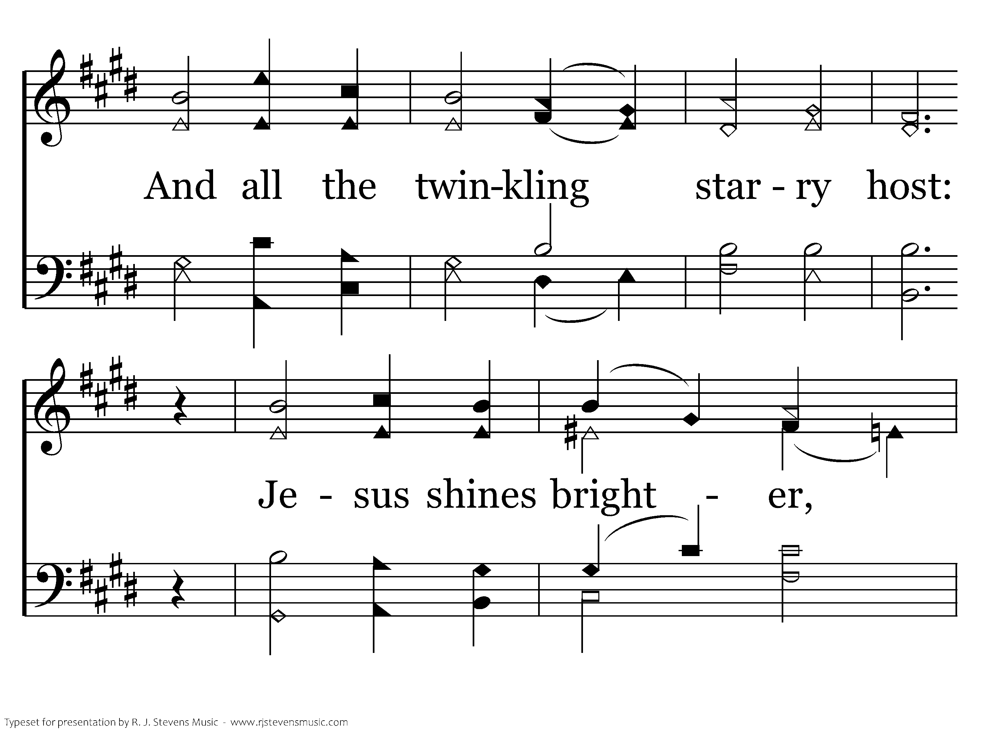
041.15 - Fairest Lord Jesus - 3.2

Slide 10
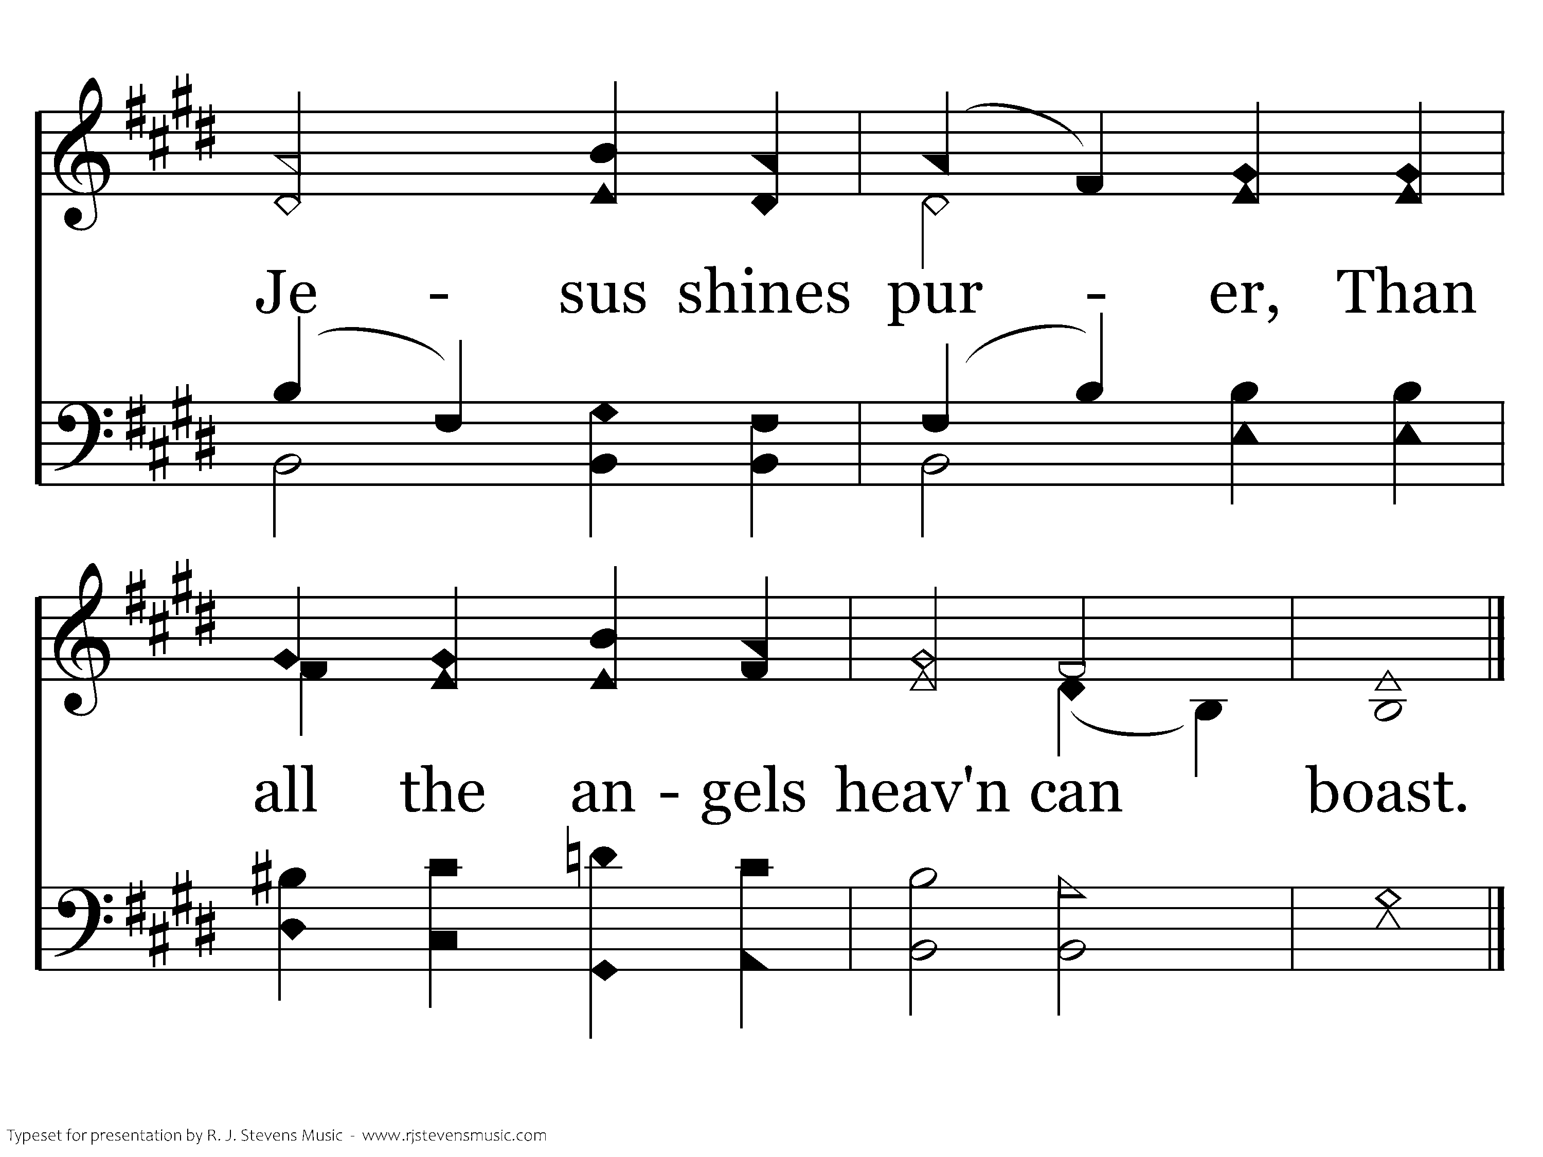
041.15 - Fairest Lord Jesus - 3.3
End of Verse 3

Slide 11
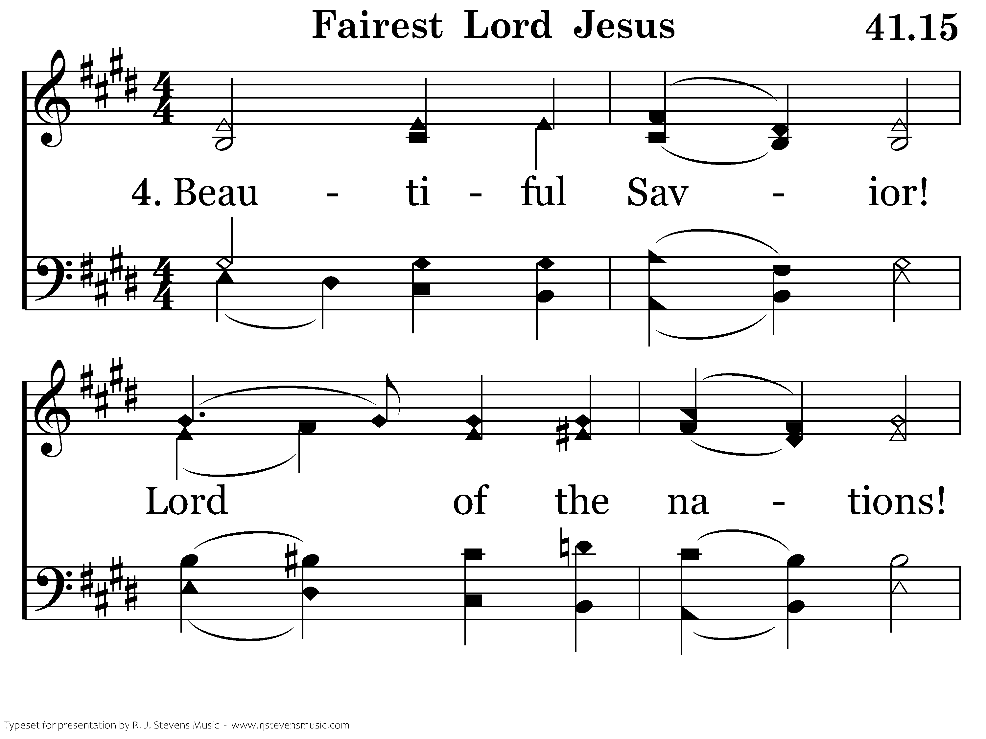
041.15 - Fairest Lord Jesus - 4.1

Slide 12
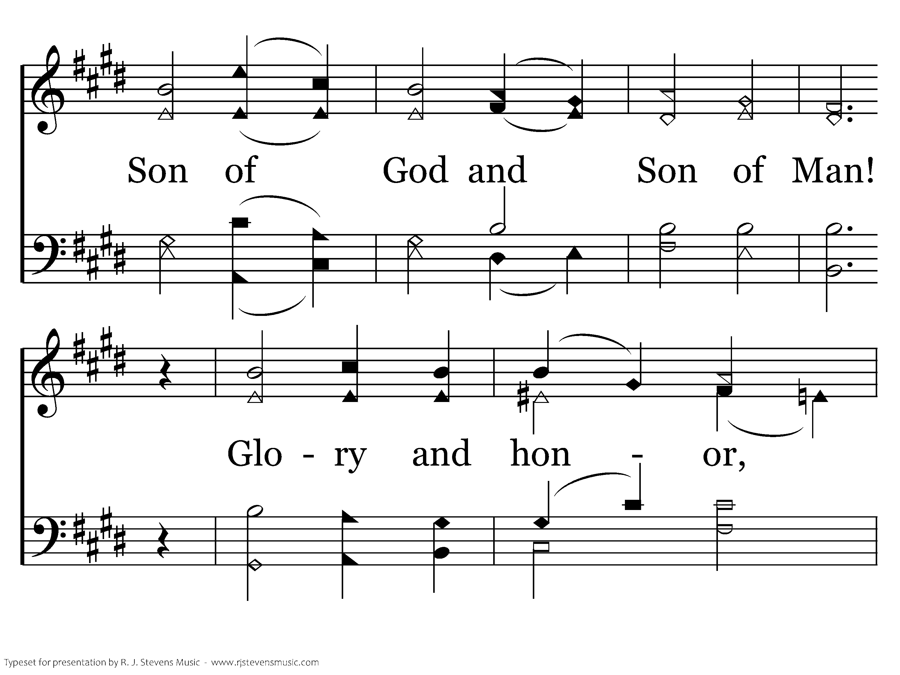
041.15 - Fairest Lord Jesus - 4.2

Slide 13
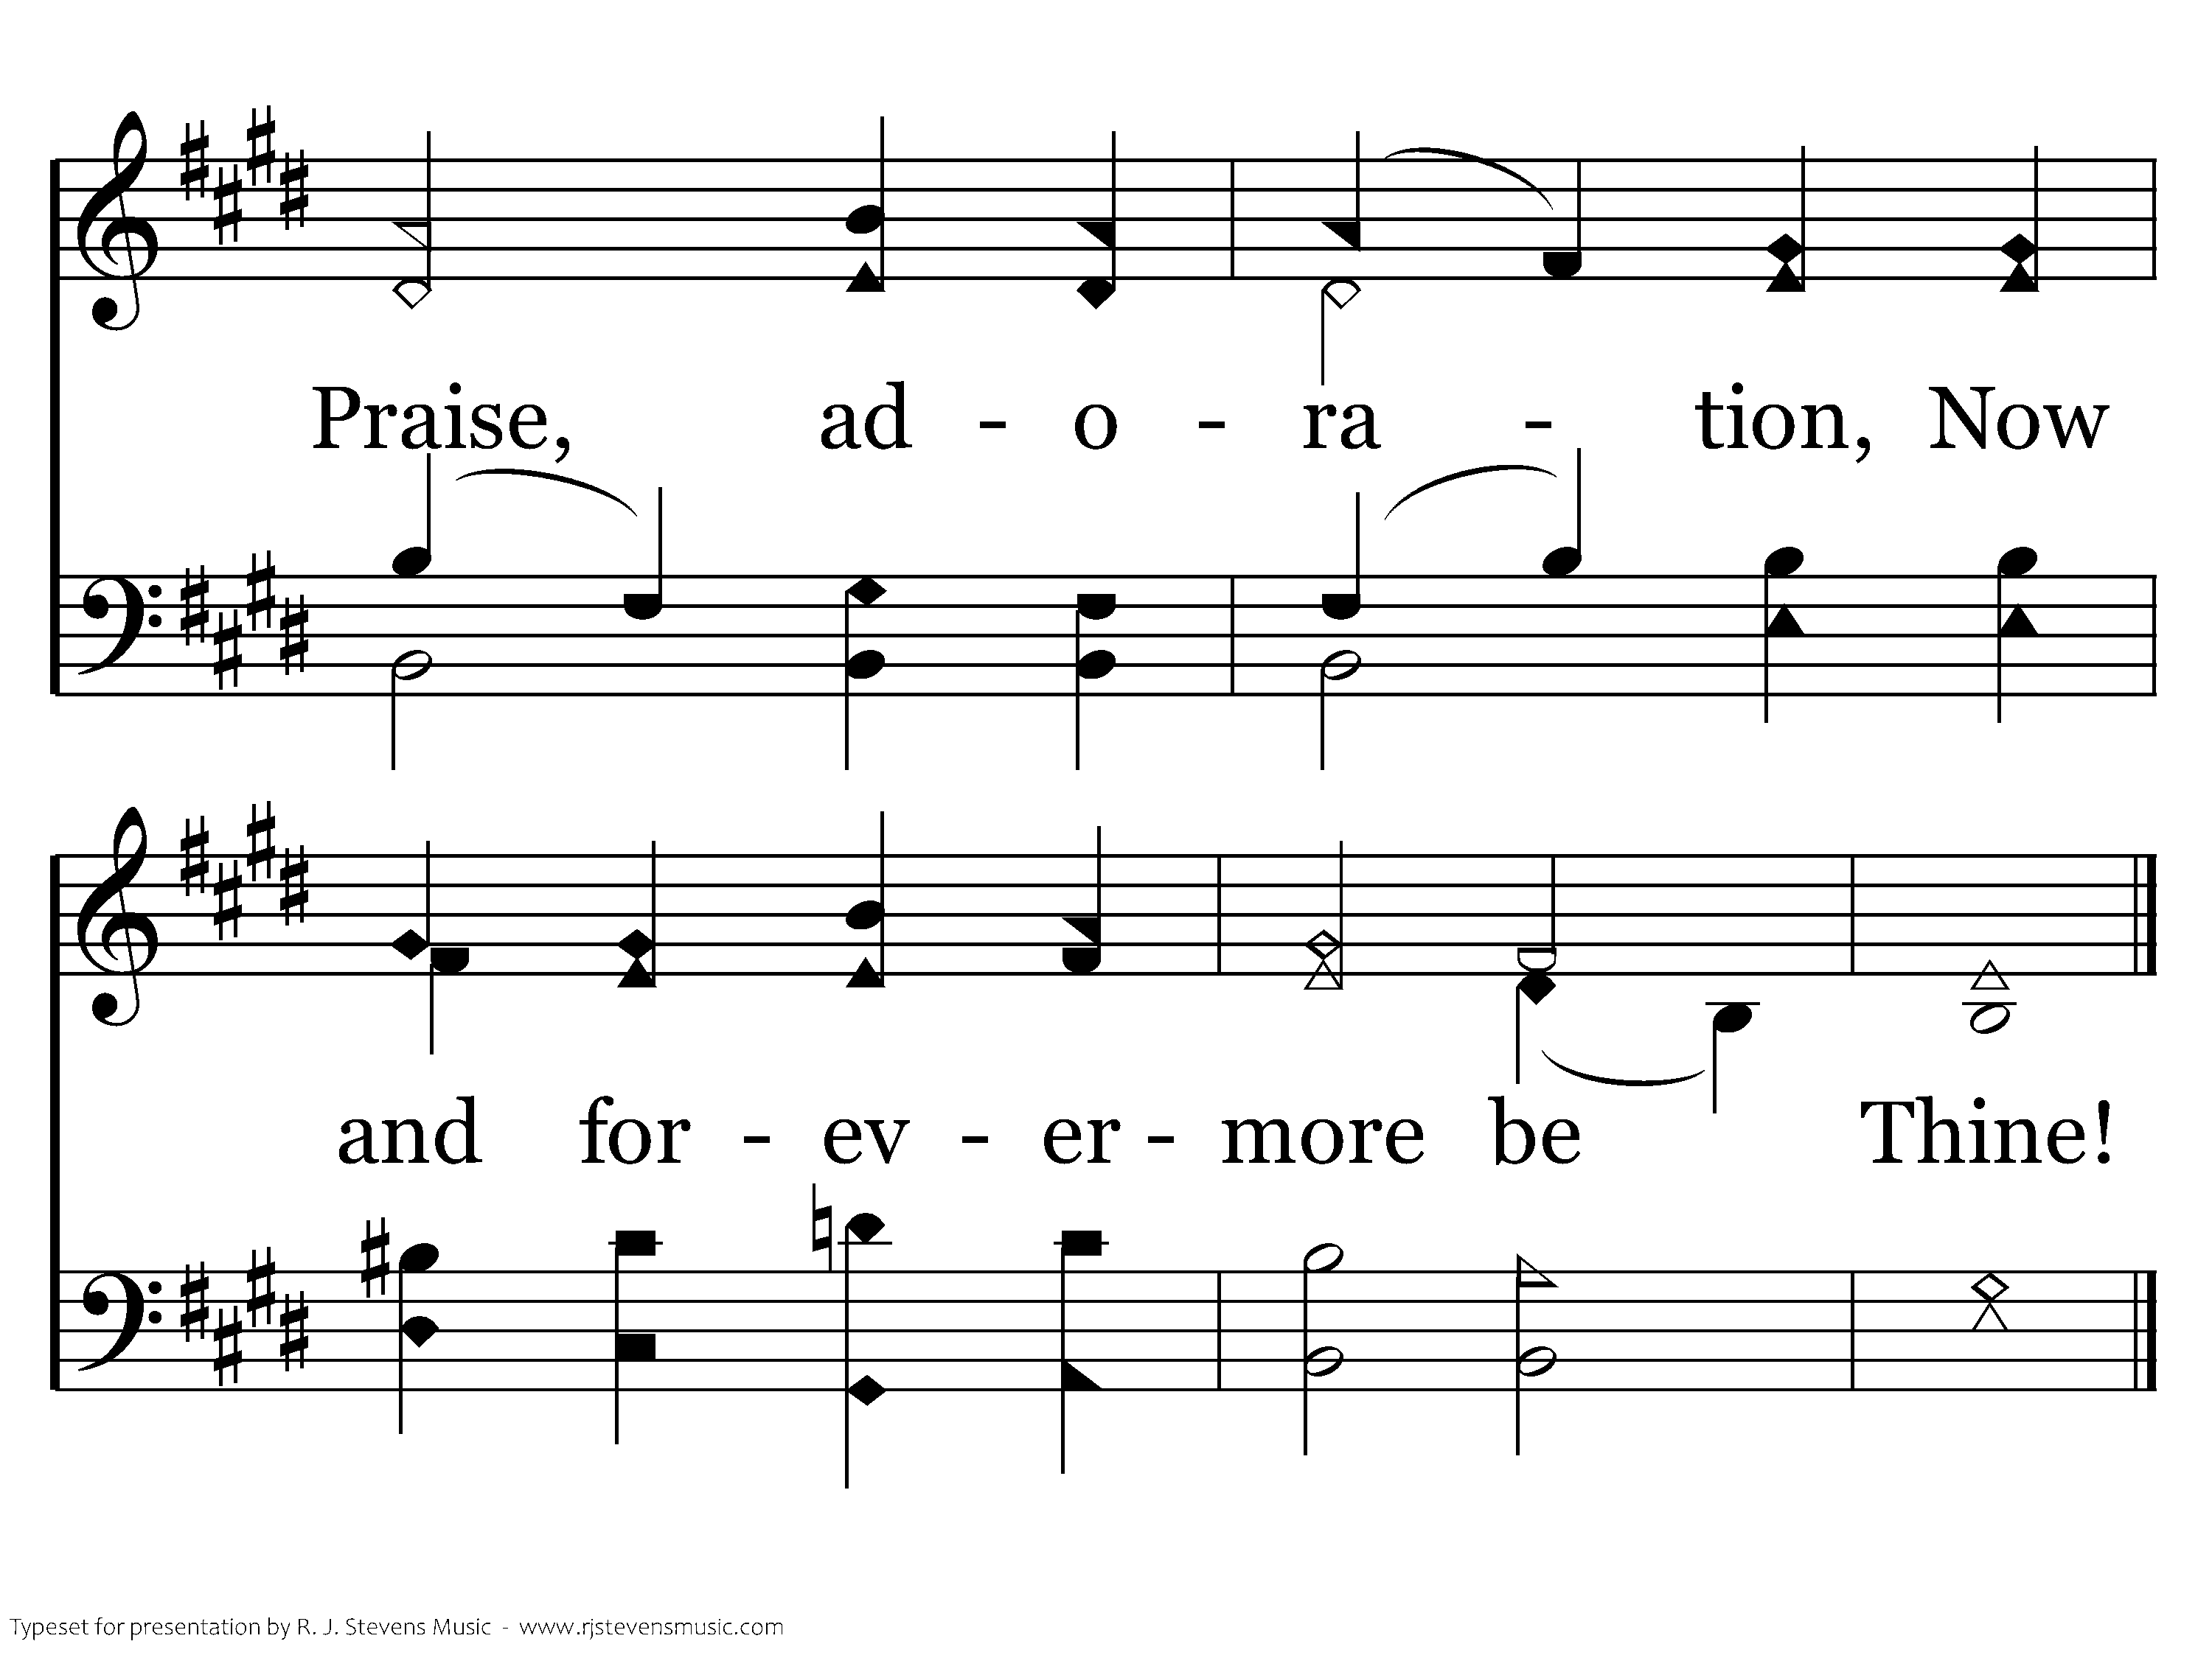
041.15 - Fairest Lord Jesus - 4.3
End of Song

Slide 14
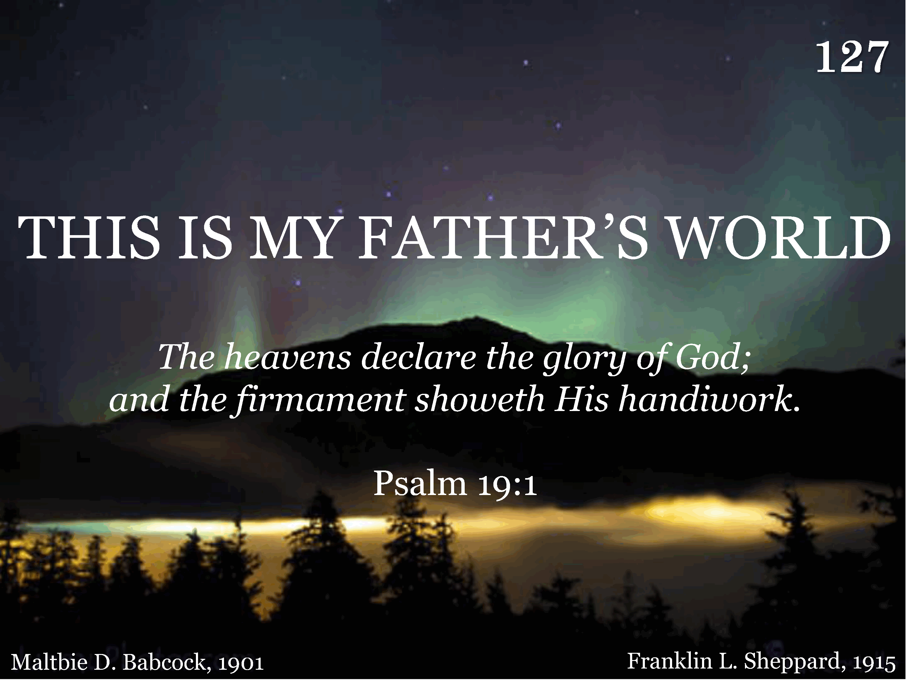
127 - This Is My Father's World - Title

Slide 15
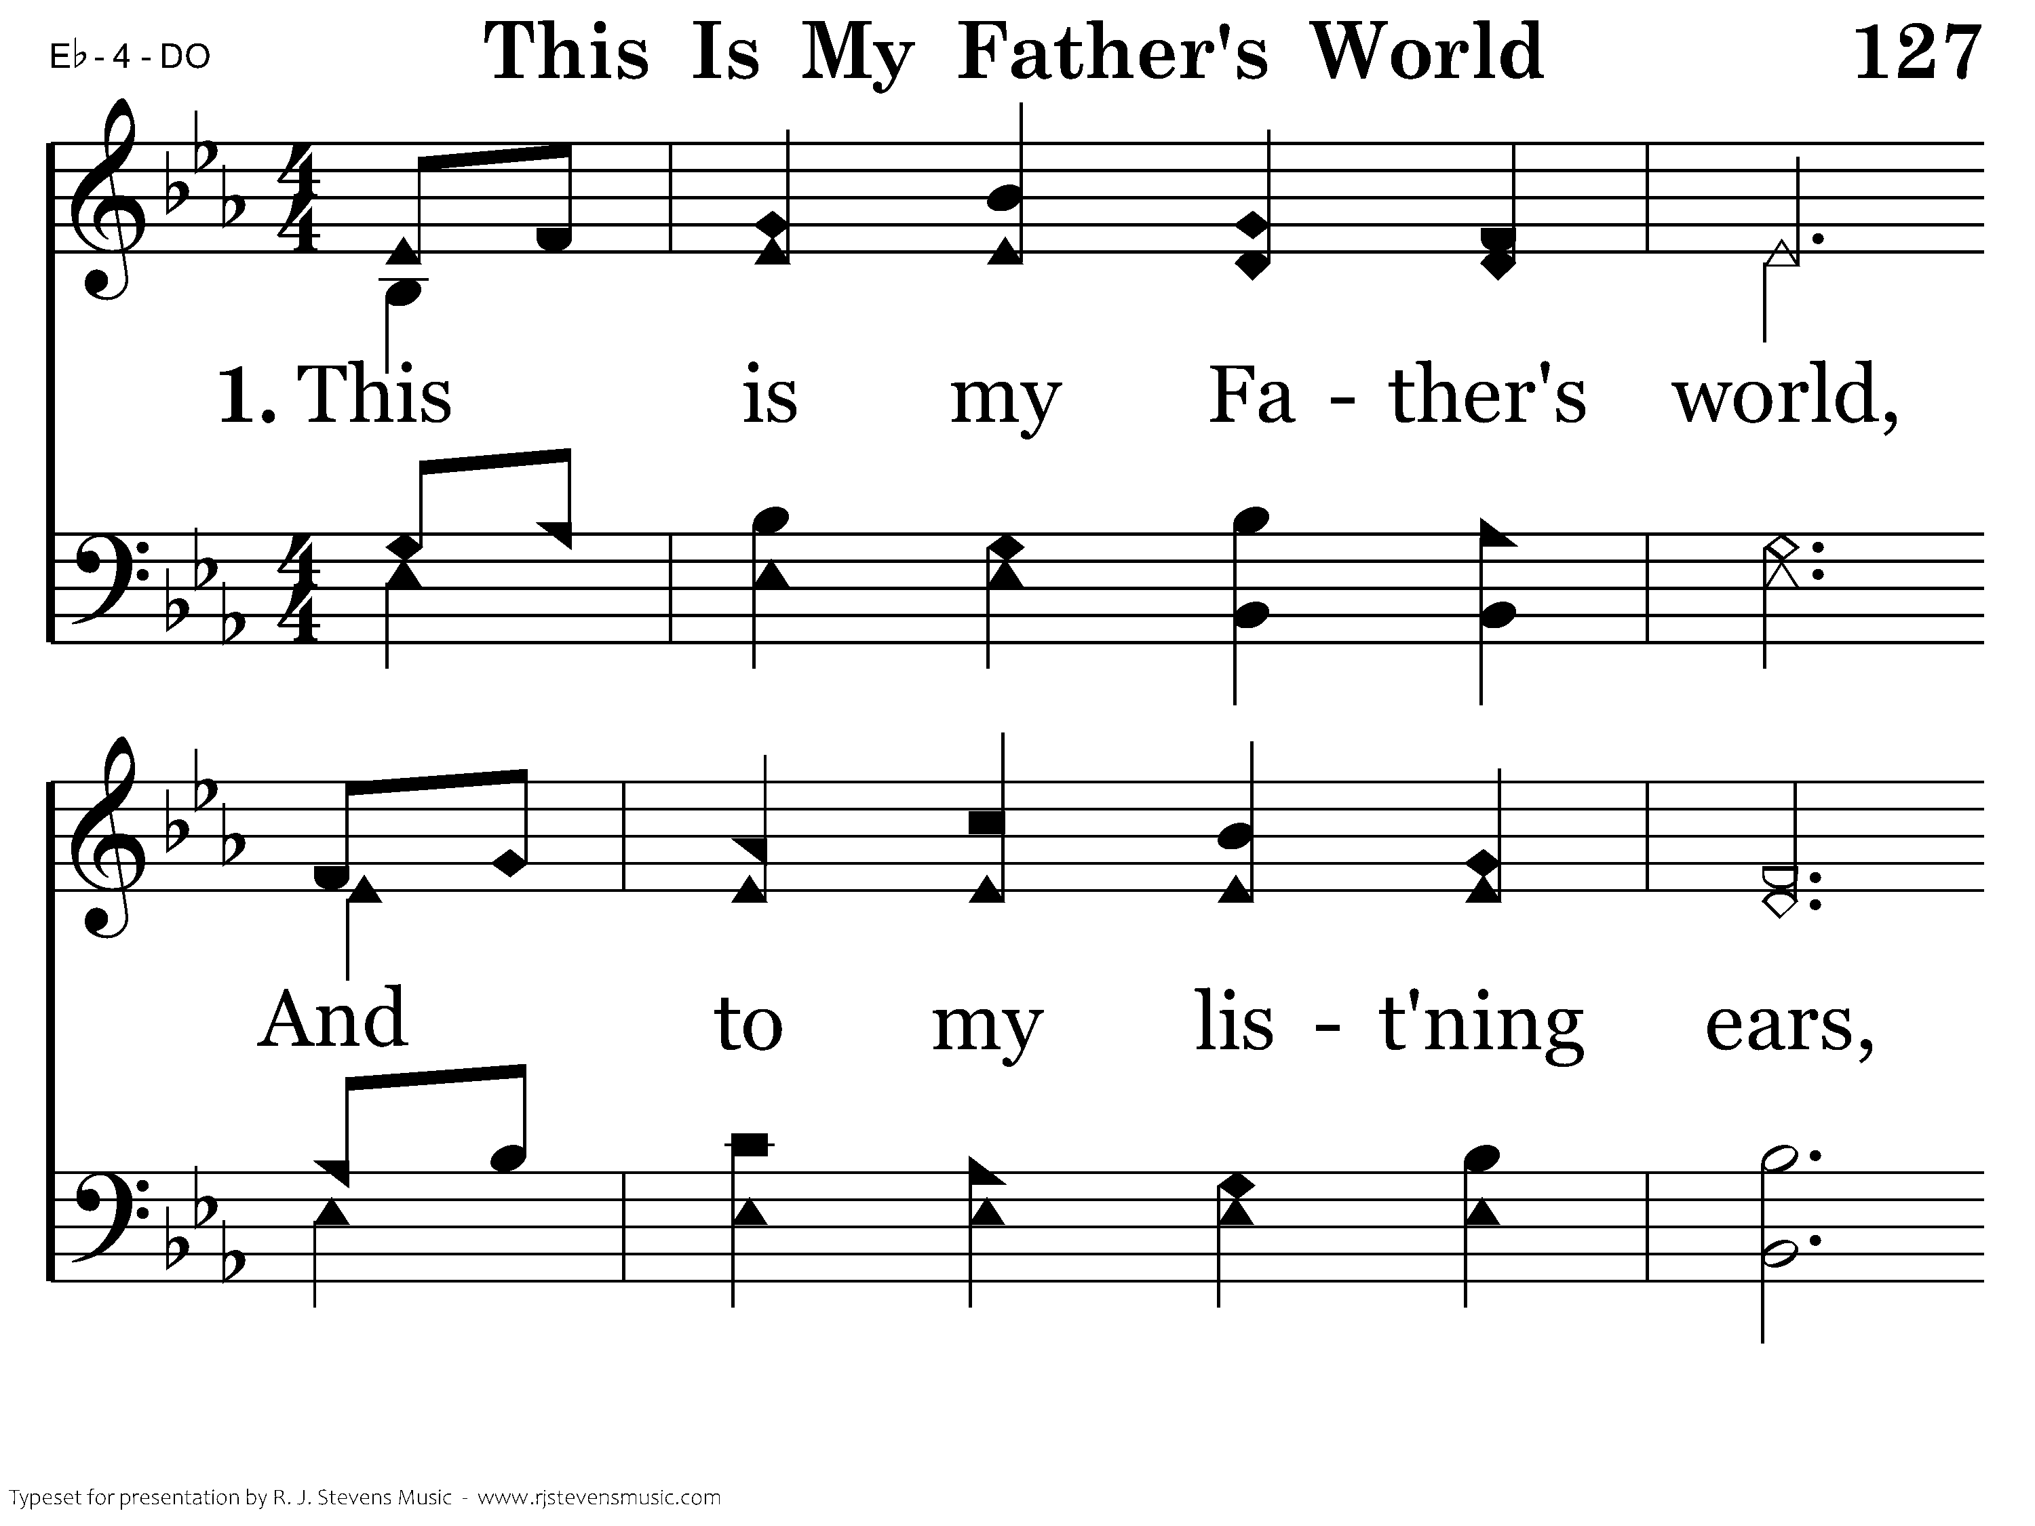
127 - This Is My Father's World - 1.1

Slide 16
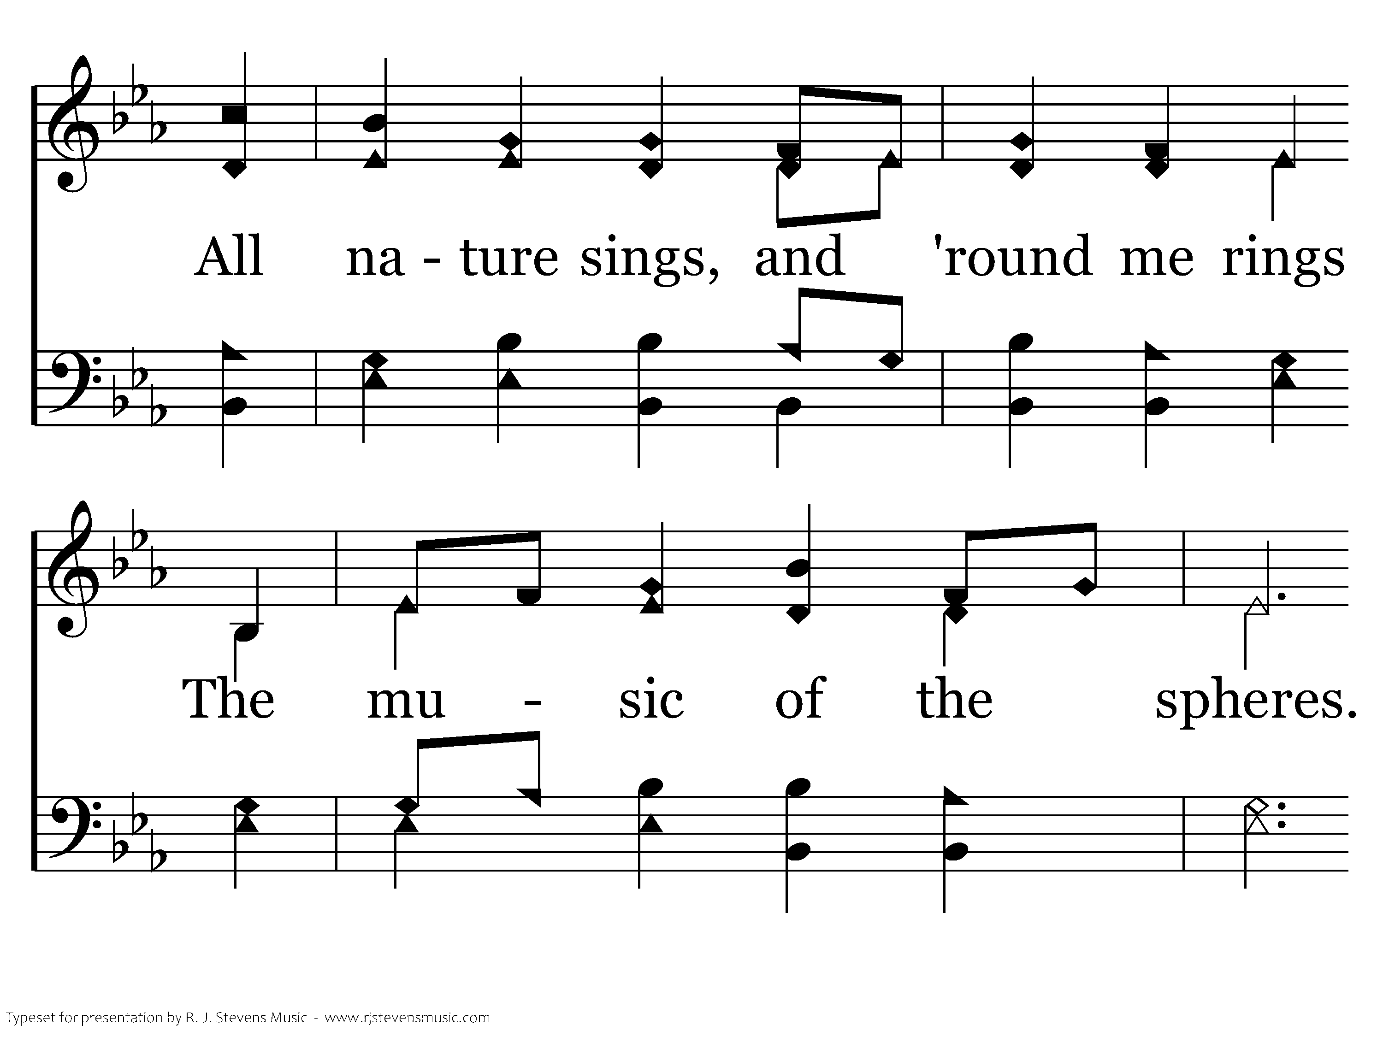
127 - This Is My Father's World - 1.2

Slide 17
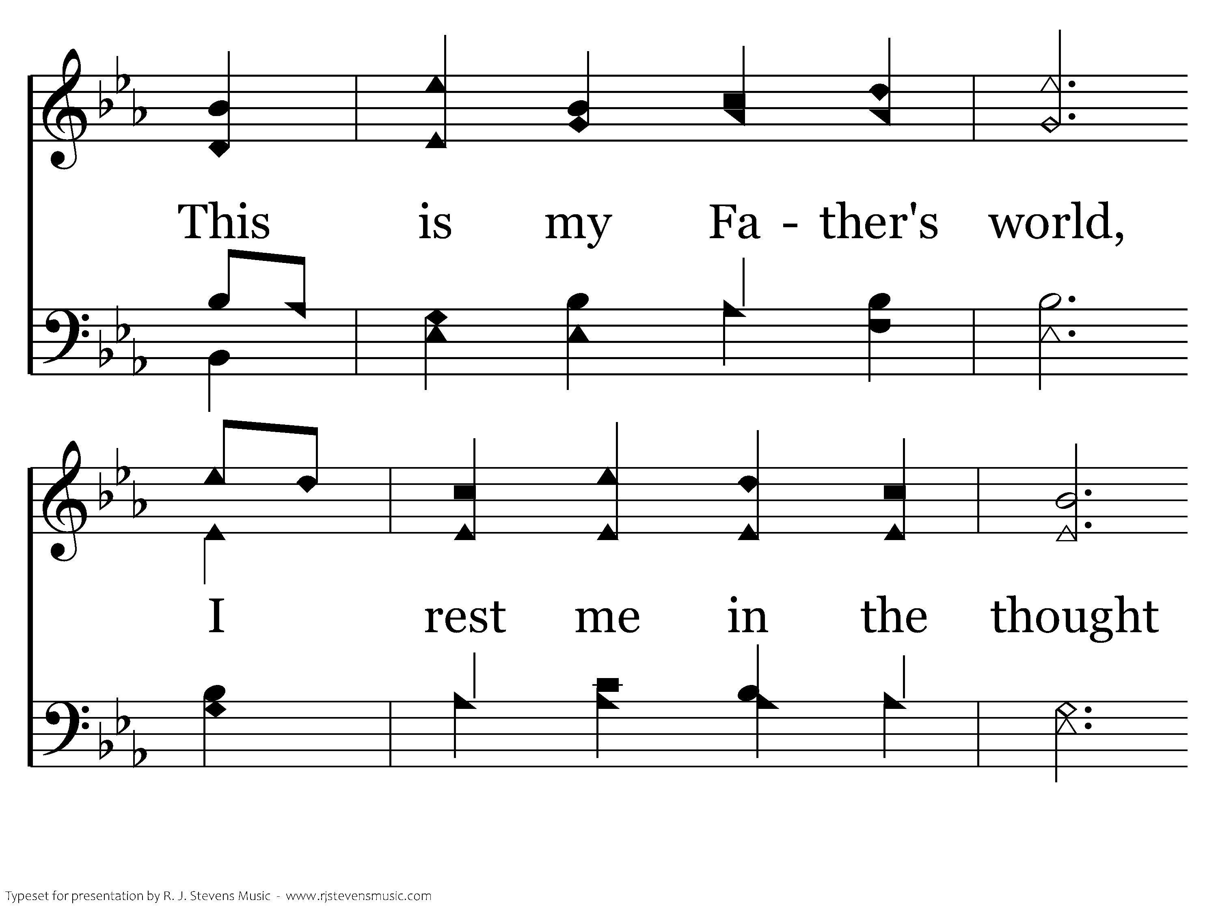
127 - This Is My Father's World - 1.3

Slide 18
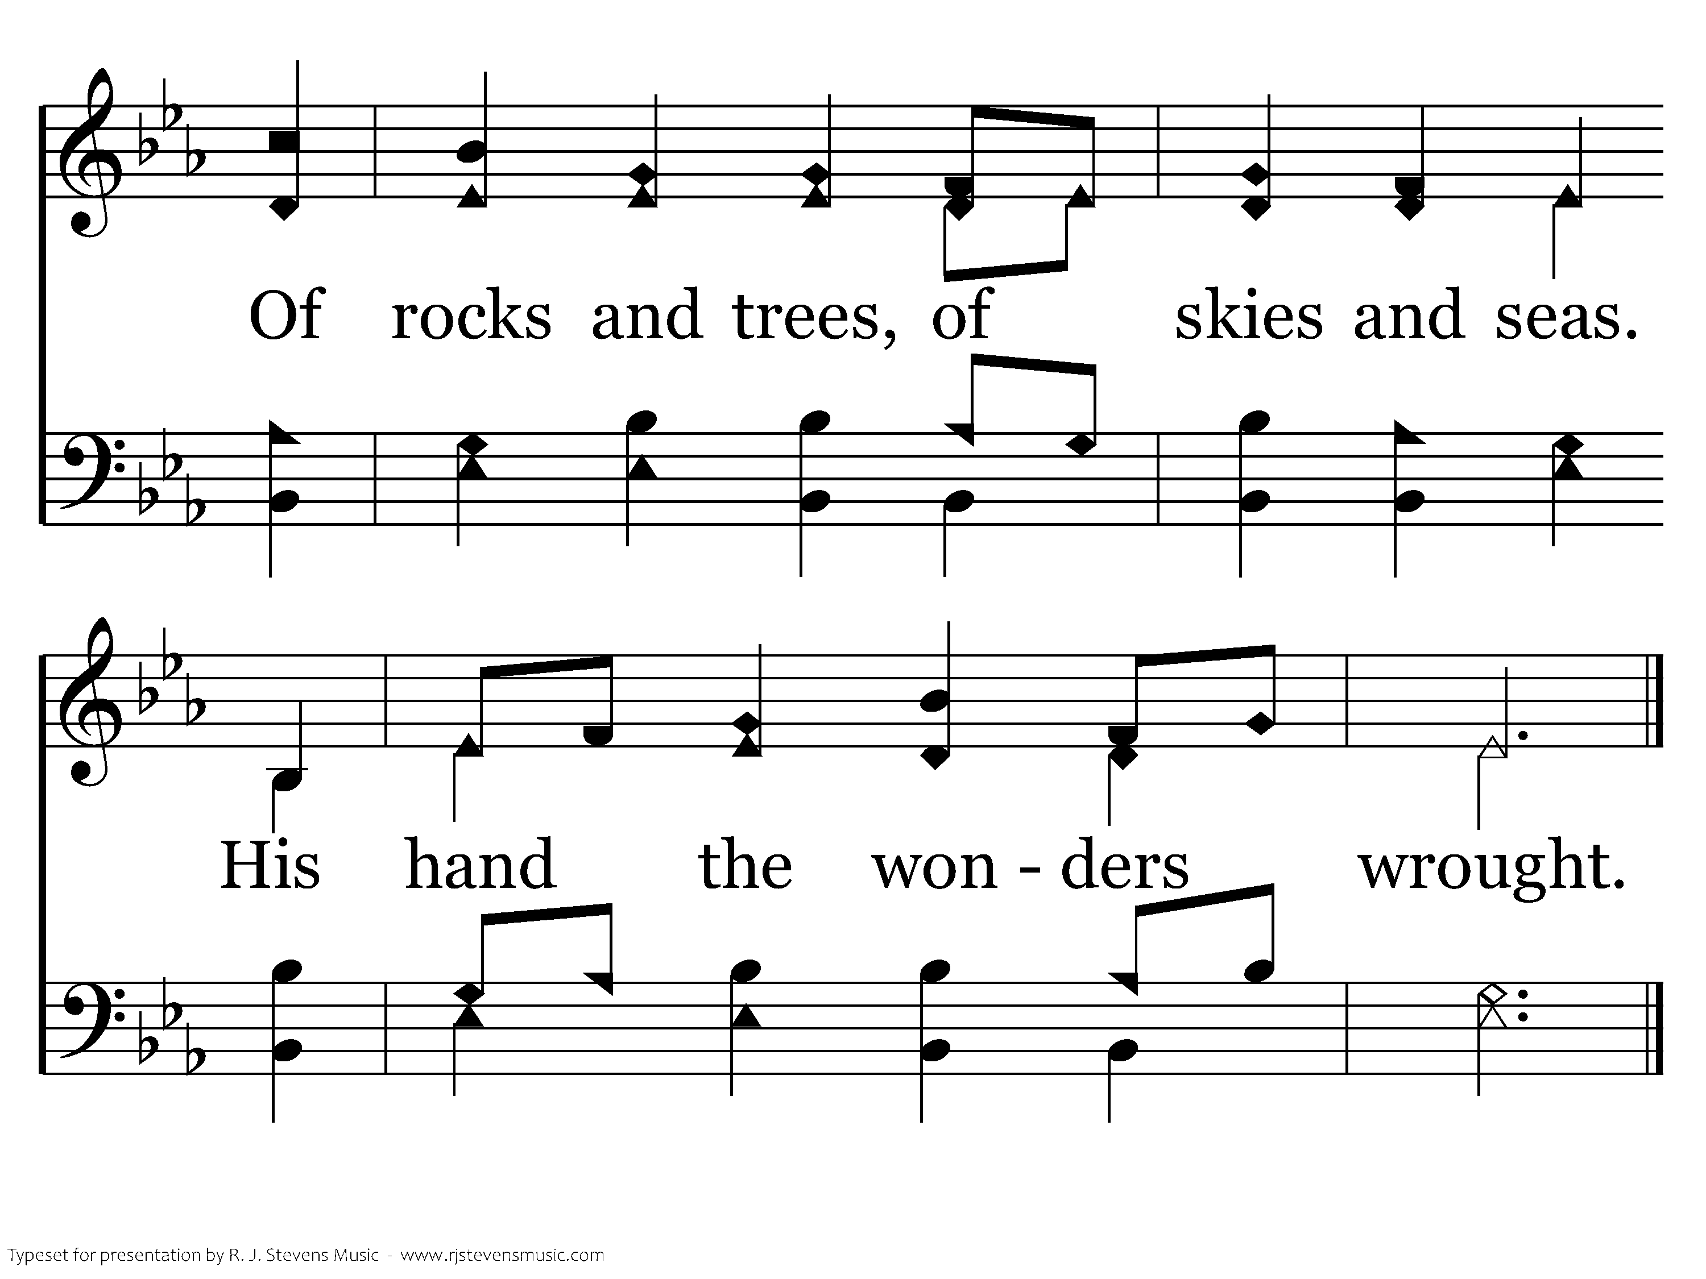
127 - This Is My Father's World - 1.4
End of Verse 1

Slide 19
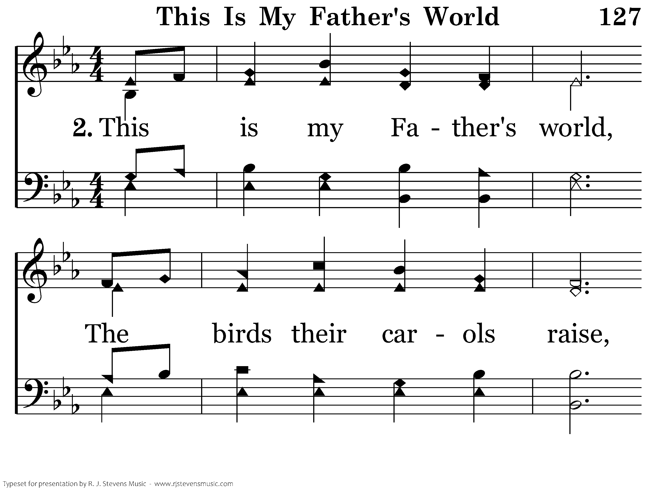
127 - This Is My Father's World - 2.1

Slide 20
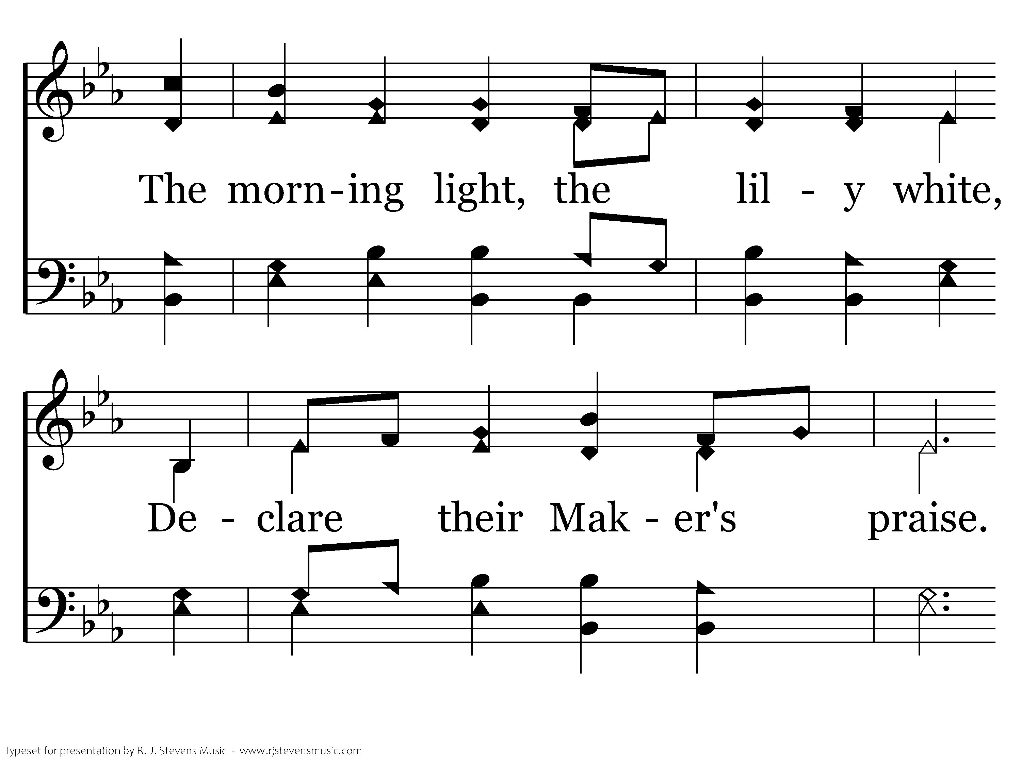
127 - This Is My Father's World - 2.2

Slide 21
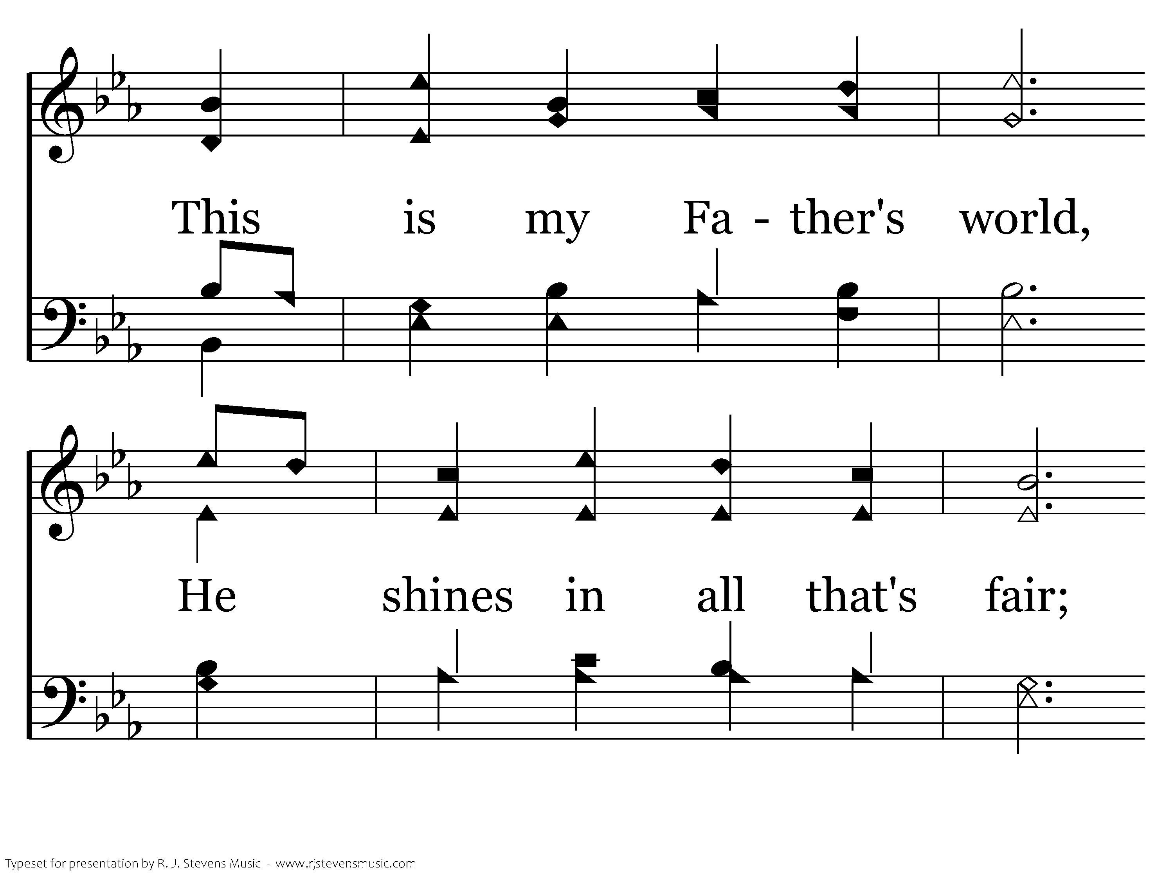
127 - This Is My Father's World - 2.3

Slide 22
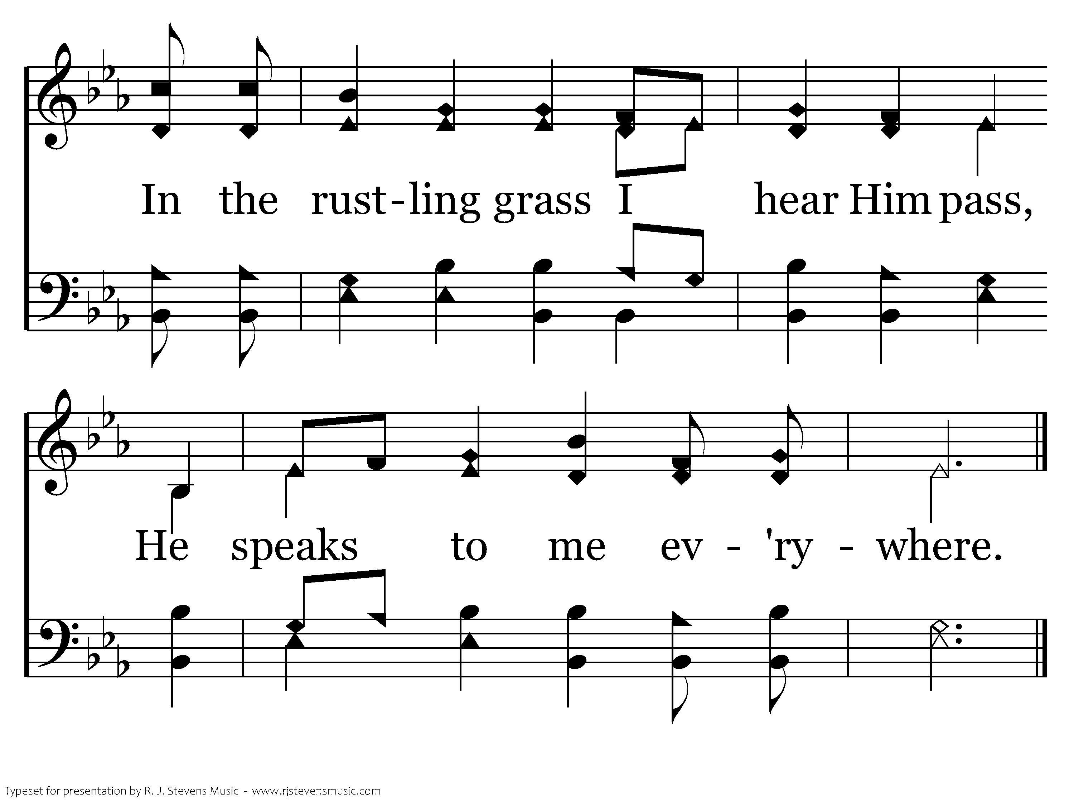
127 - This Is My Father's World - 2.4
End of Verse 2

Slide 23
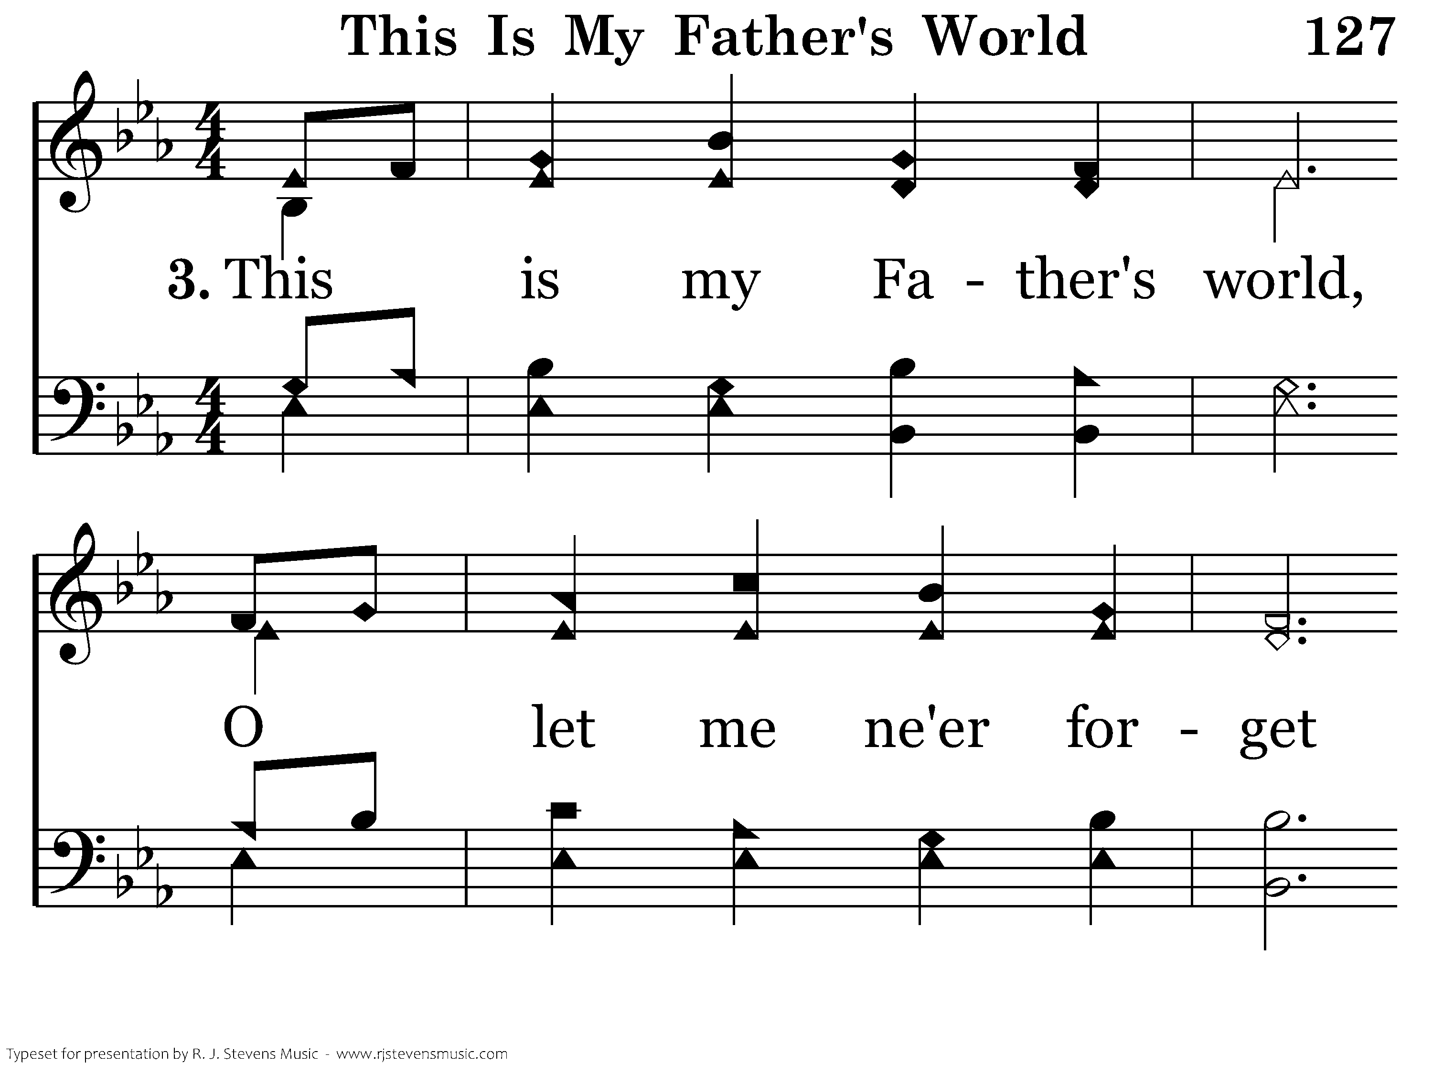
127 - This Is My Father's World - 3.1

Slide 24
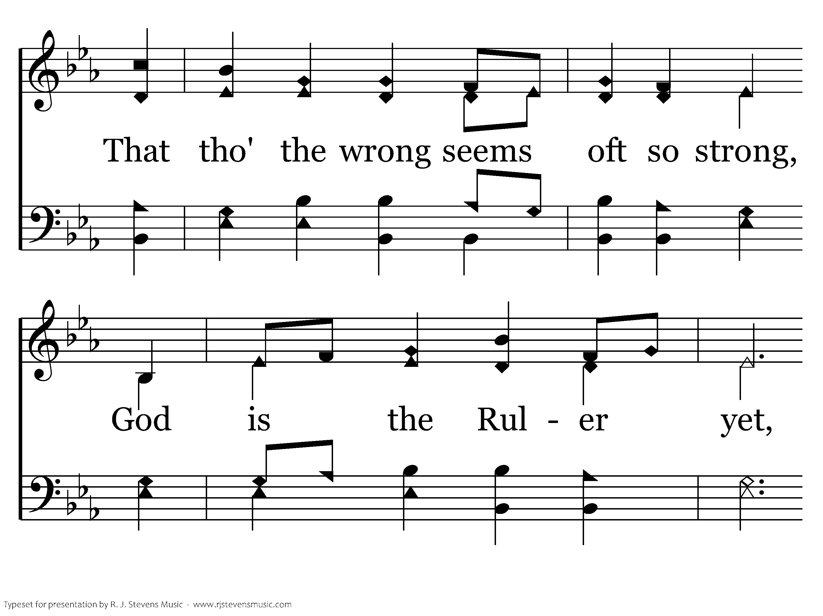
127 - This Is My Father's World - 3.2

Slide 25
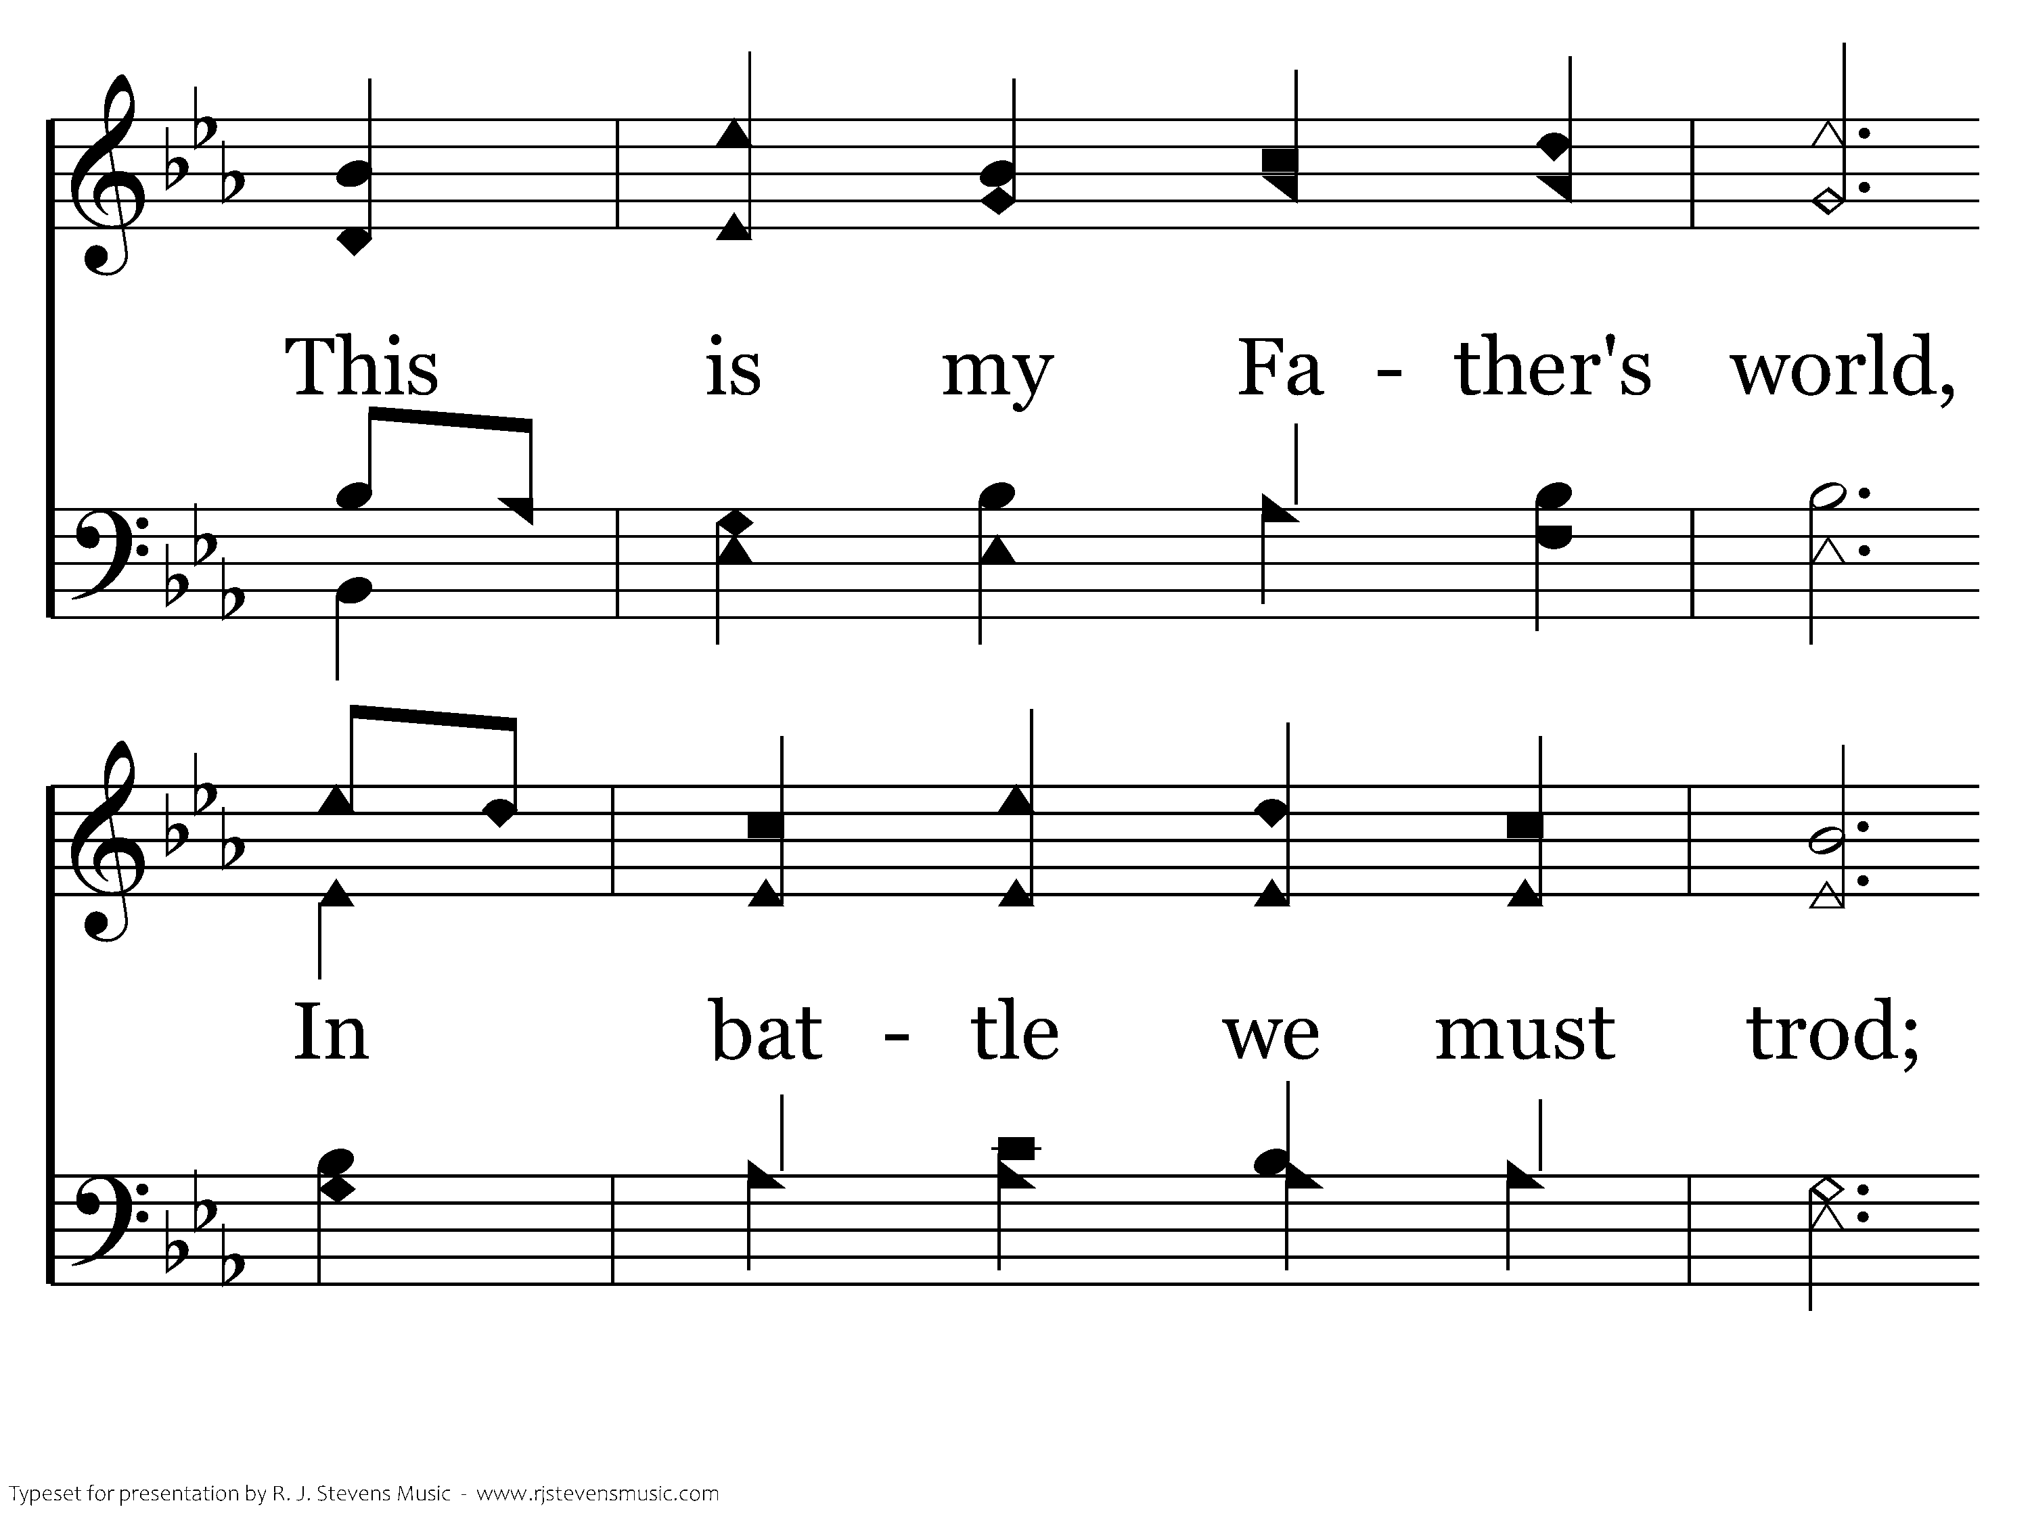
127 - This Is My Father's World - 3.3

Slide 26
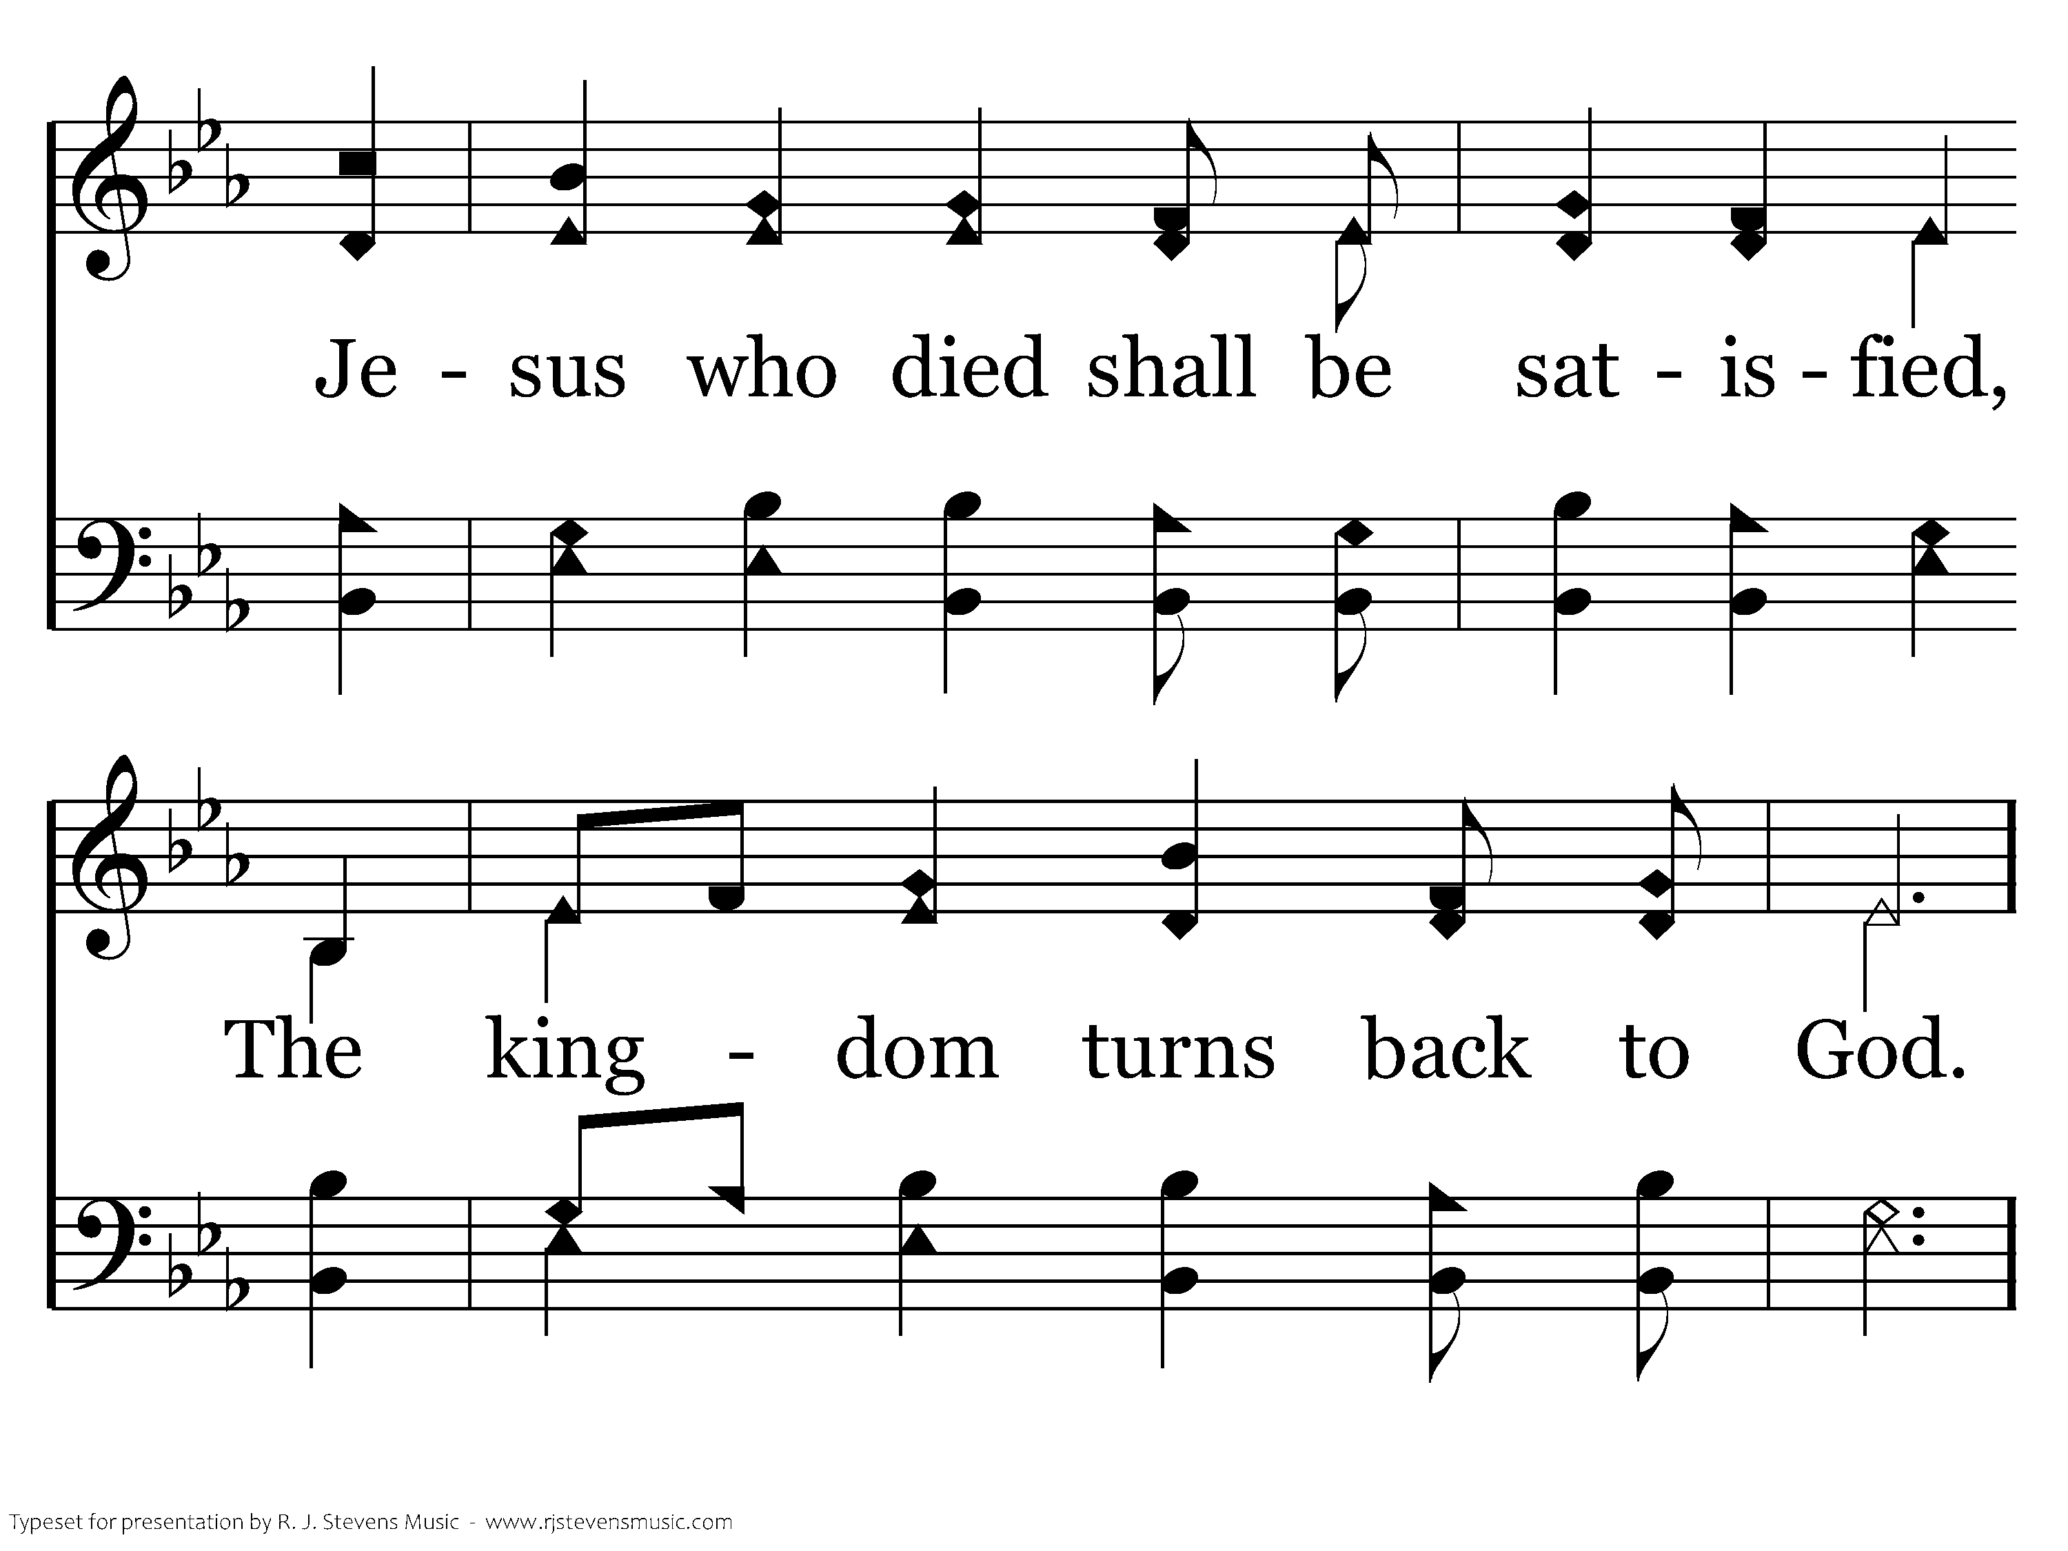
127 - This Is My Father's World - 3.4

Slide 27
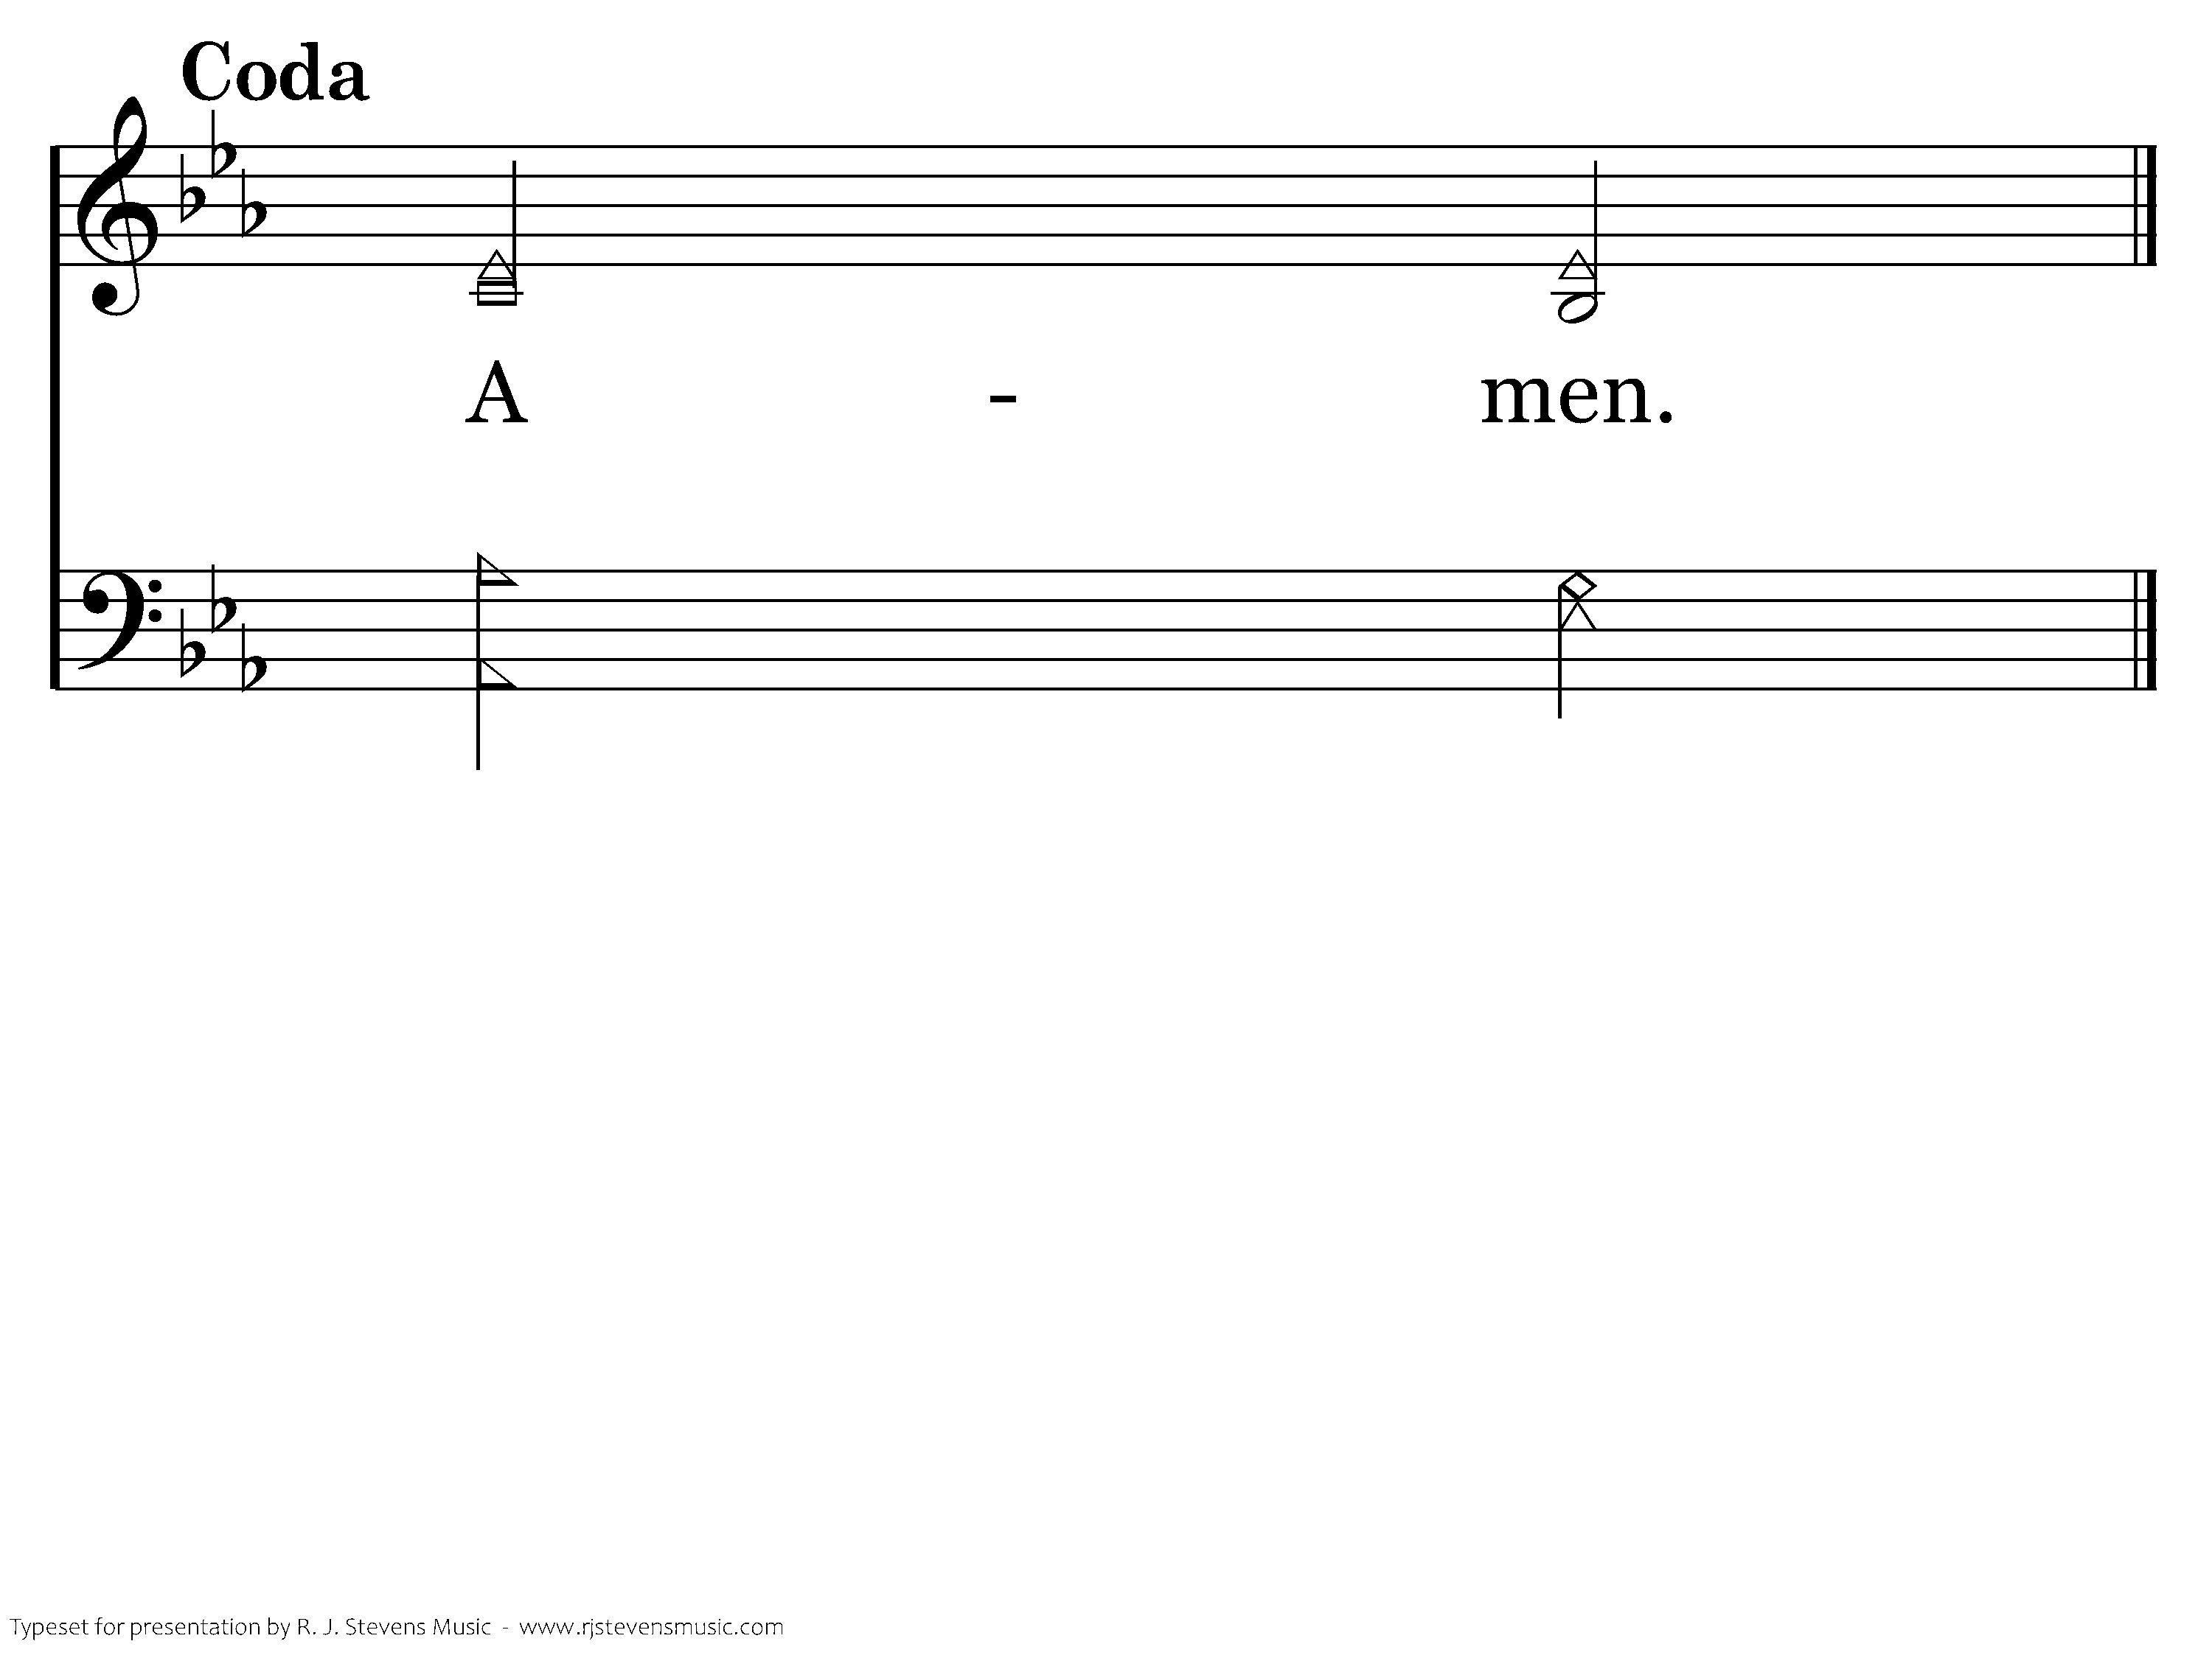
127 - This Is My Father's World - D.1
End of Song

Slide 28
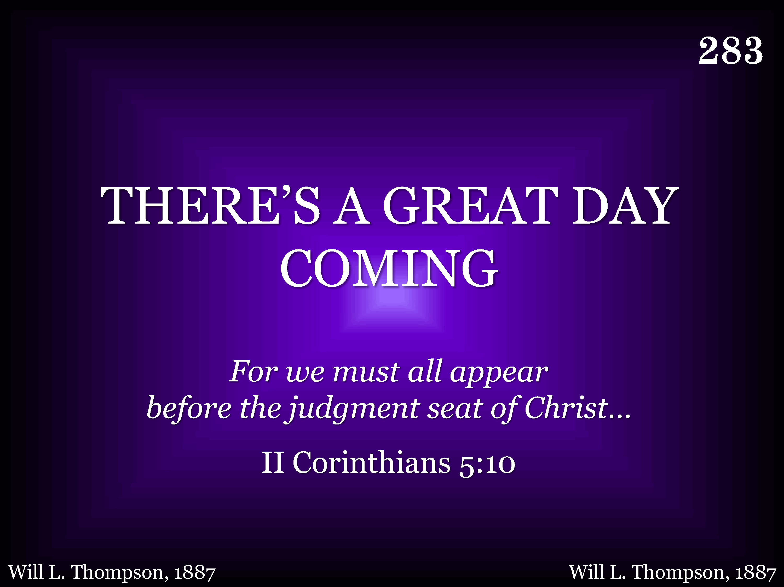
283 - There's A Great Day Coming - Title

Slide 29
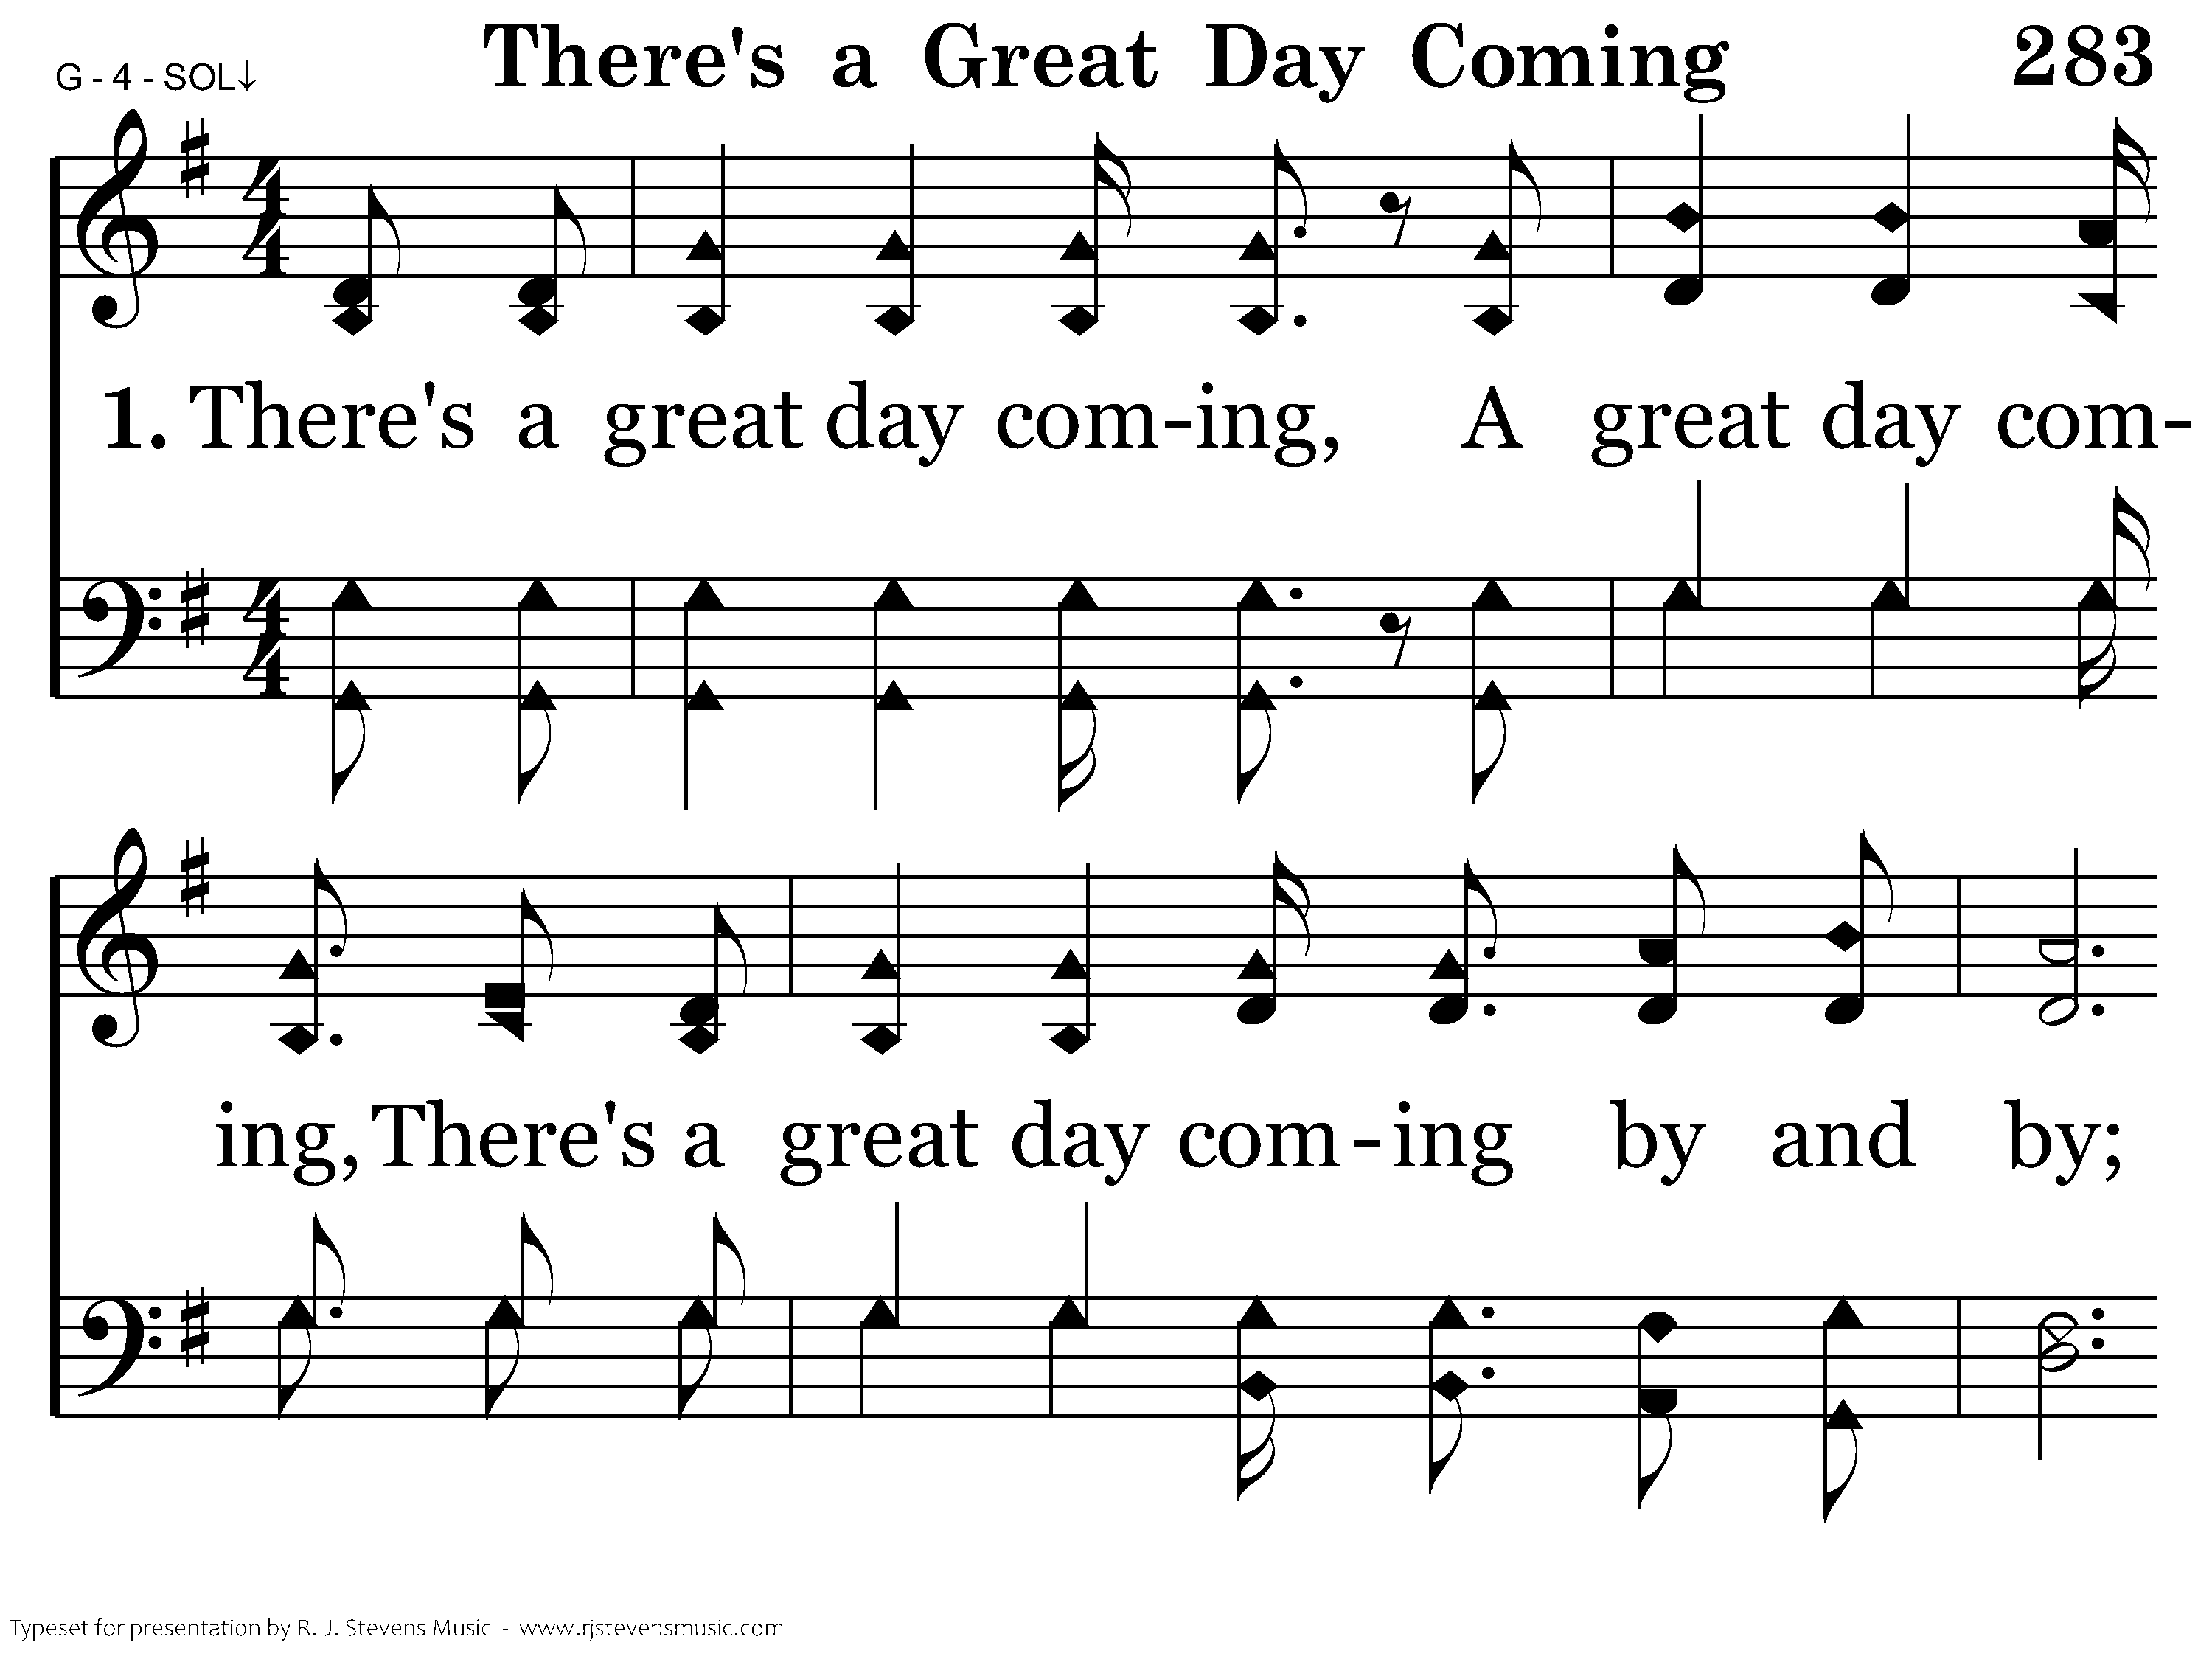
283 - There's A Great Day Coming - 1.1

Slide 30
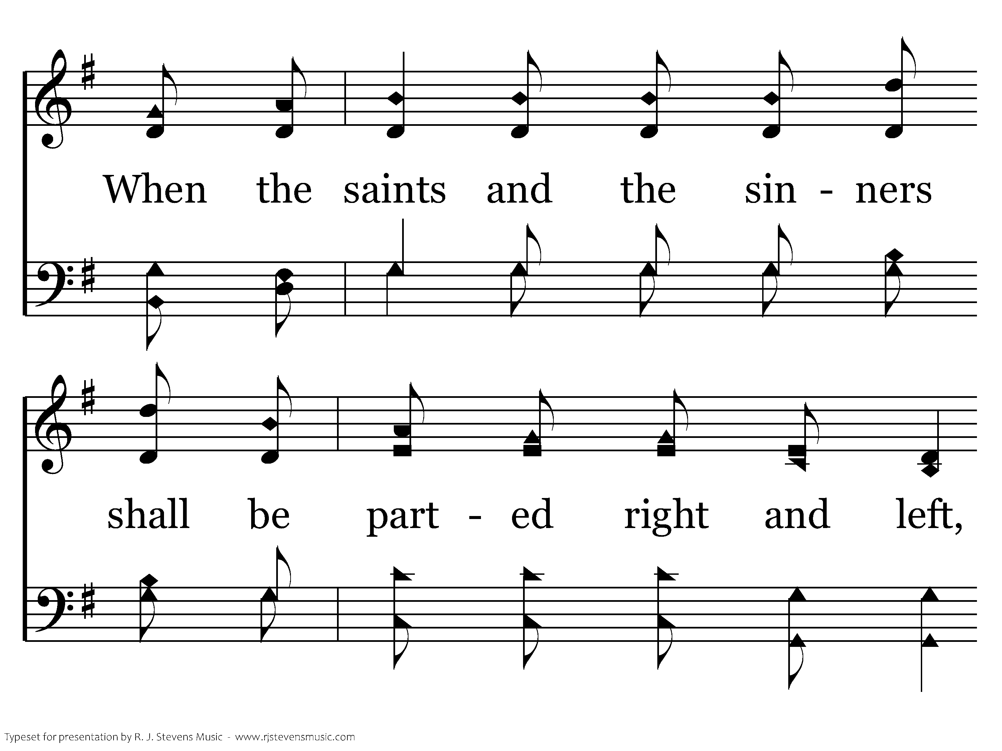
283 - There's A Great Day Coming - 1.2

Slide 31
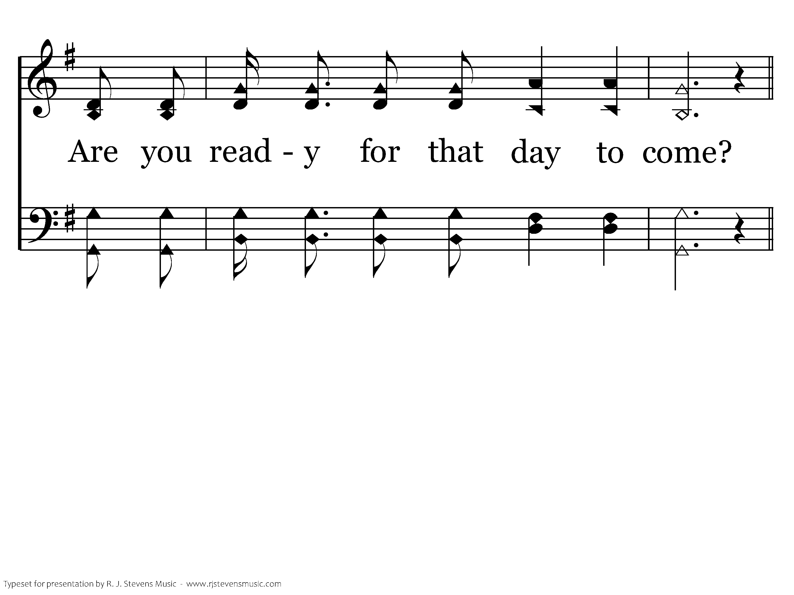
283 - There's A Great Day Coming - 1.3

Slide 32
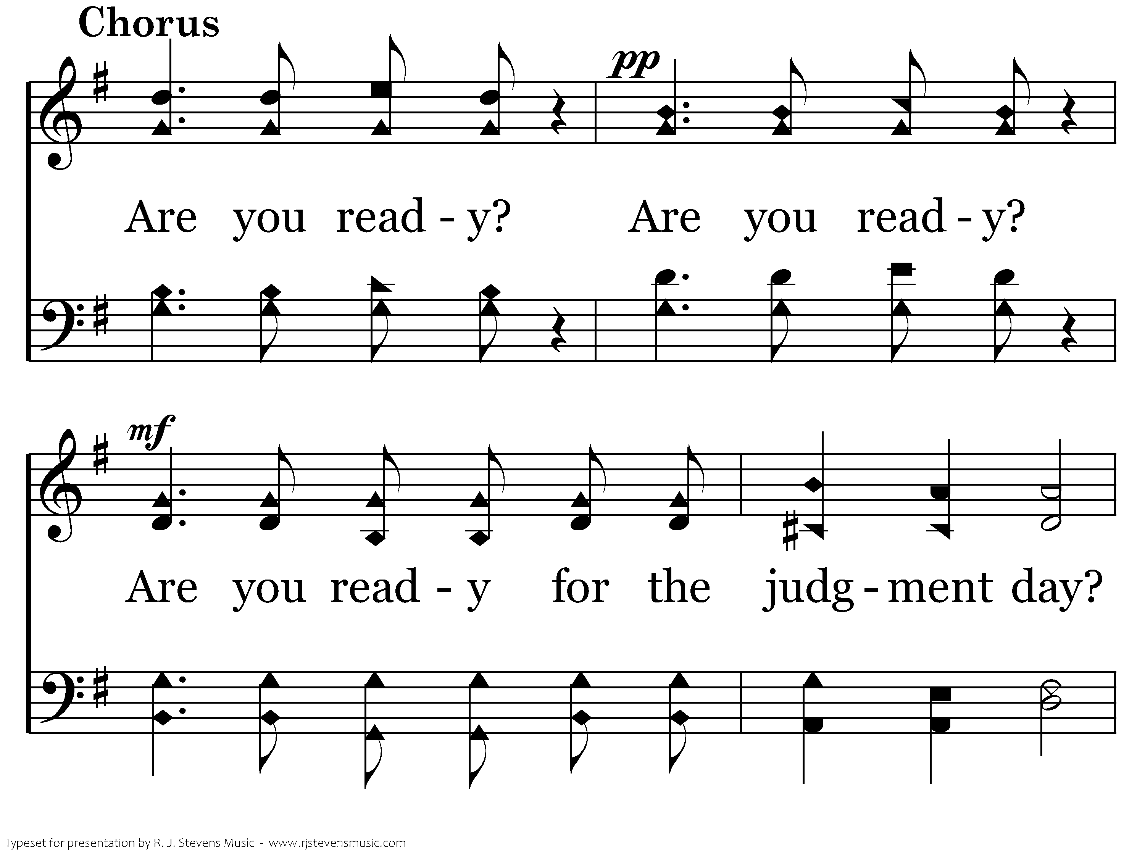
283 - There's A Great Day Coming - C.1

Slide 33
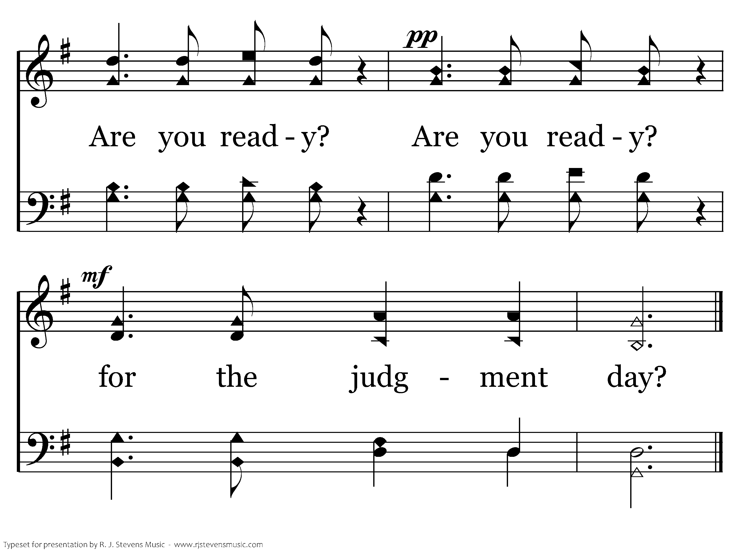
283 - There's A Great Day Coming - C.2
End of Verse 1

Slide 34
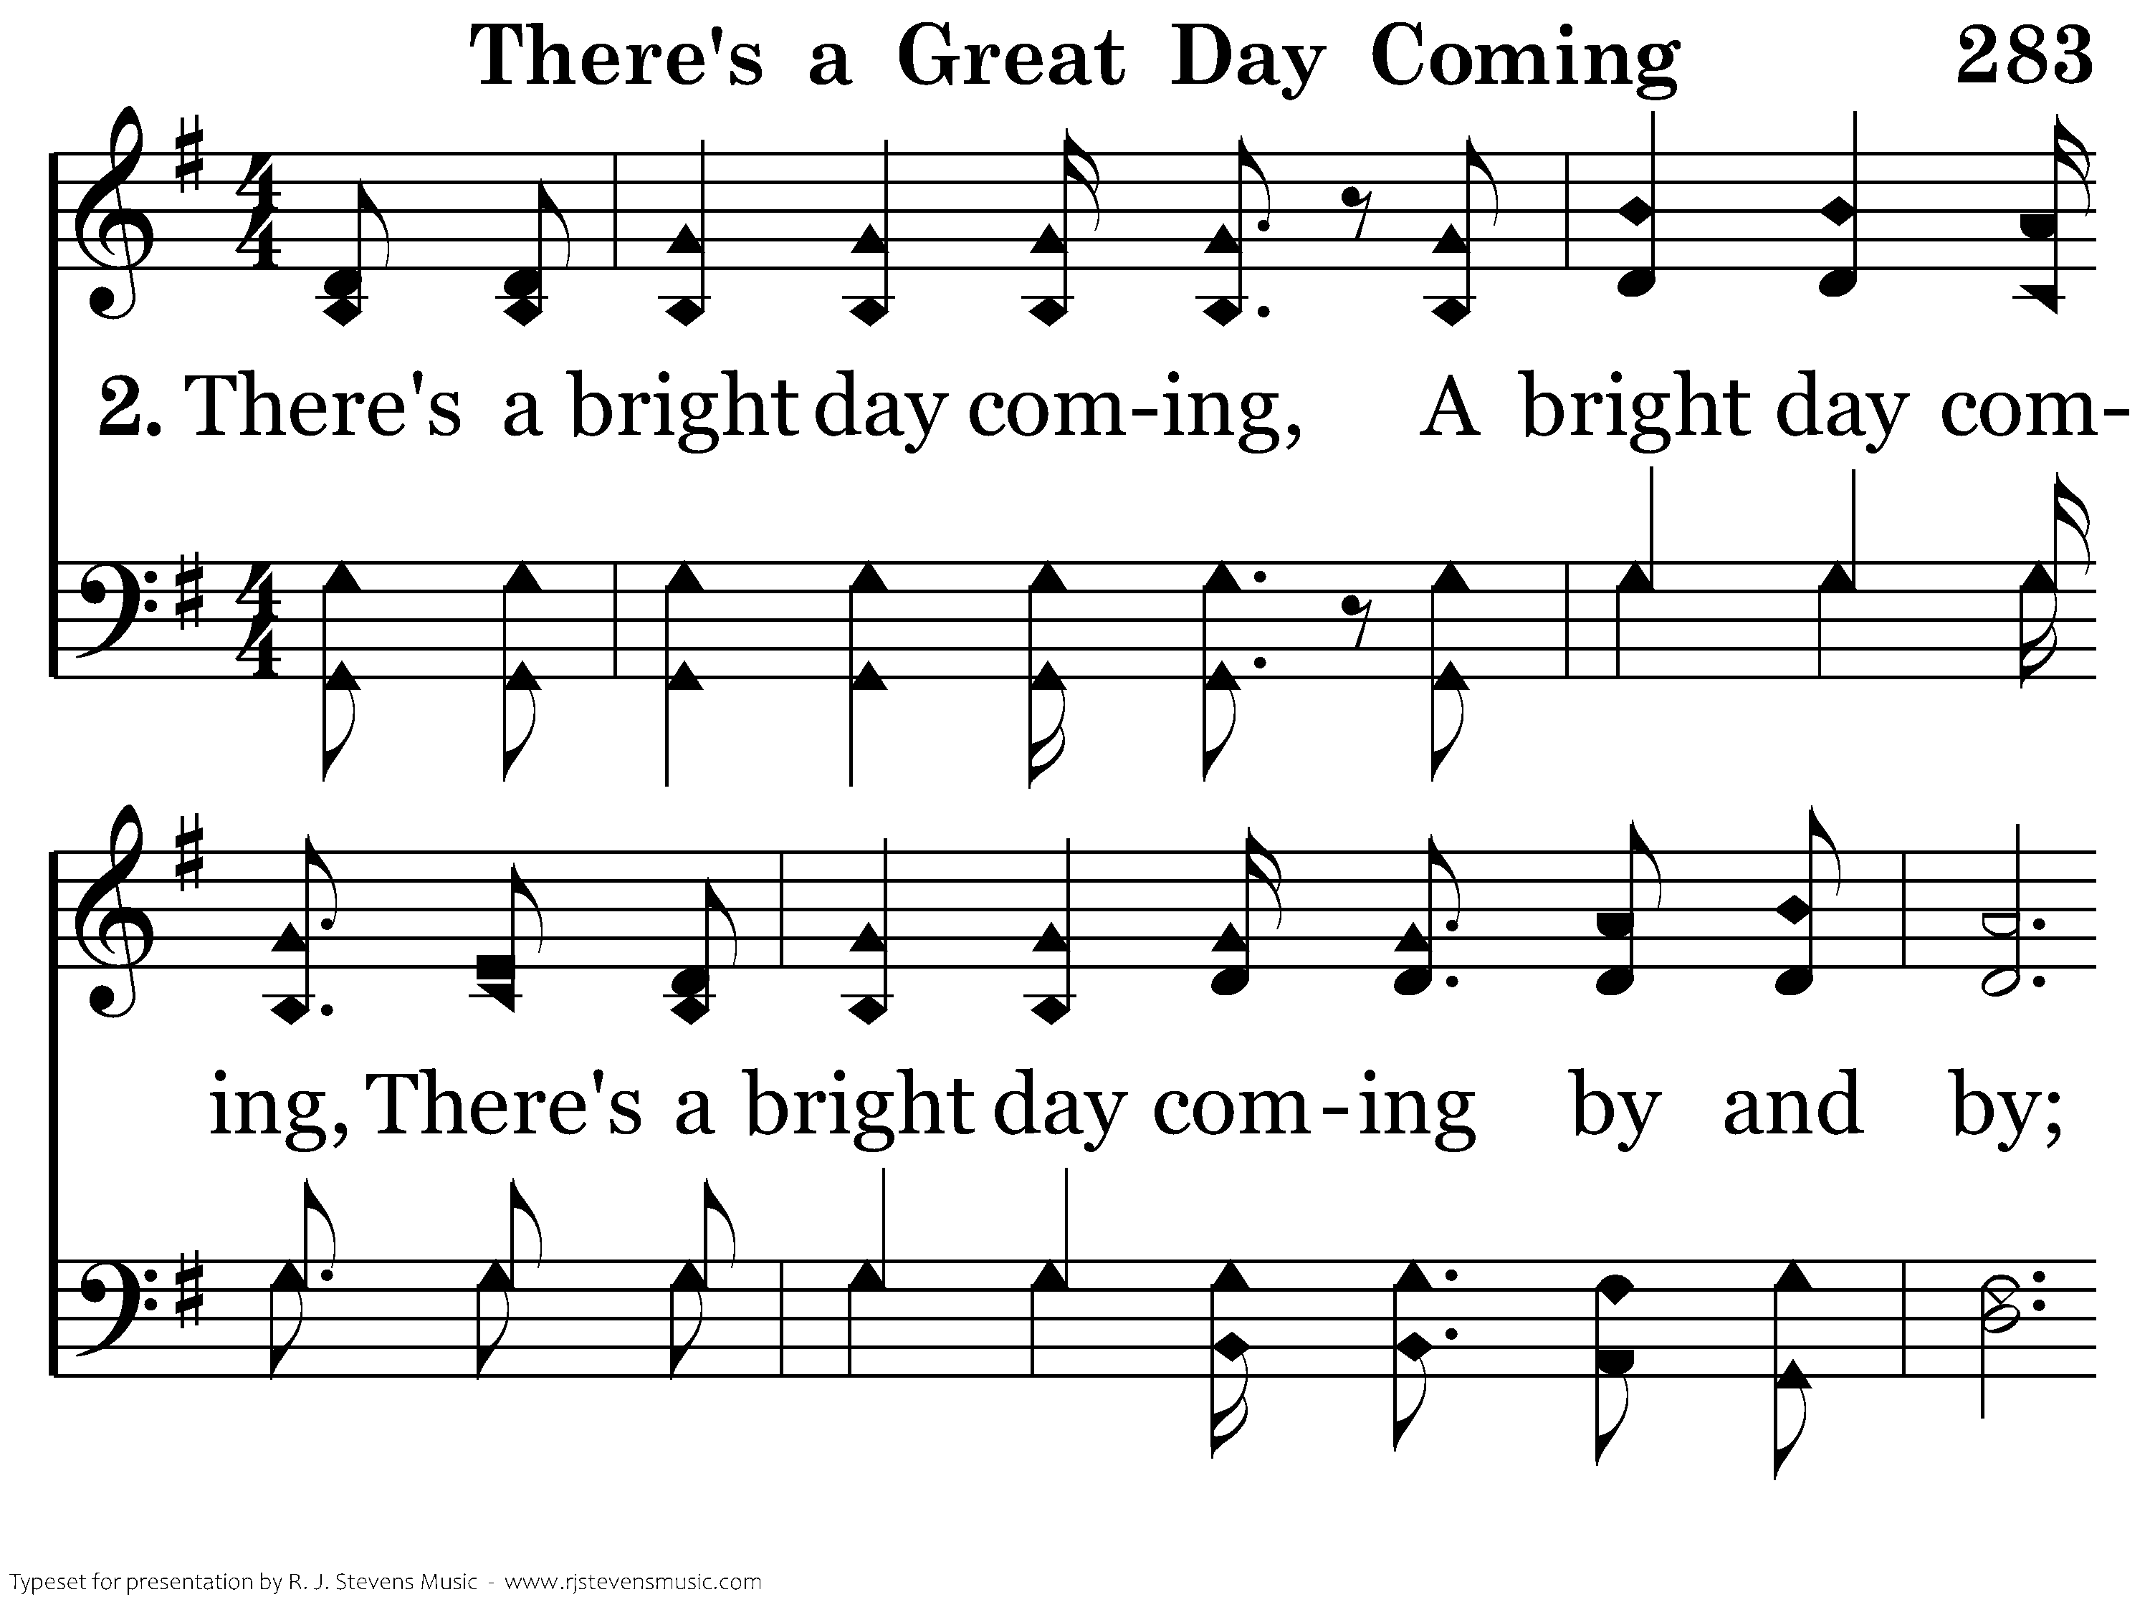
283 - There's A Great Day Coming - 2.1

Slide 35
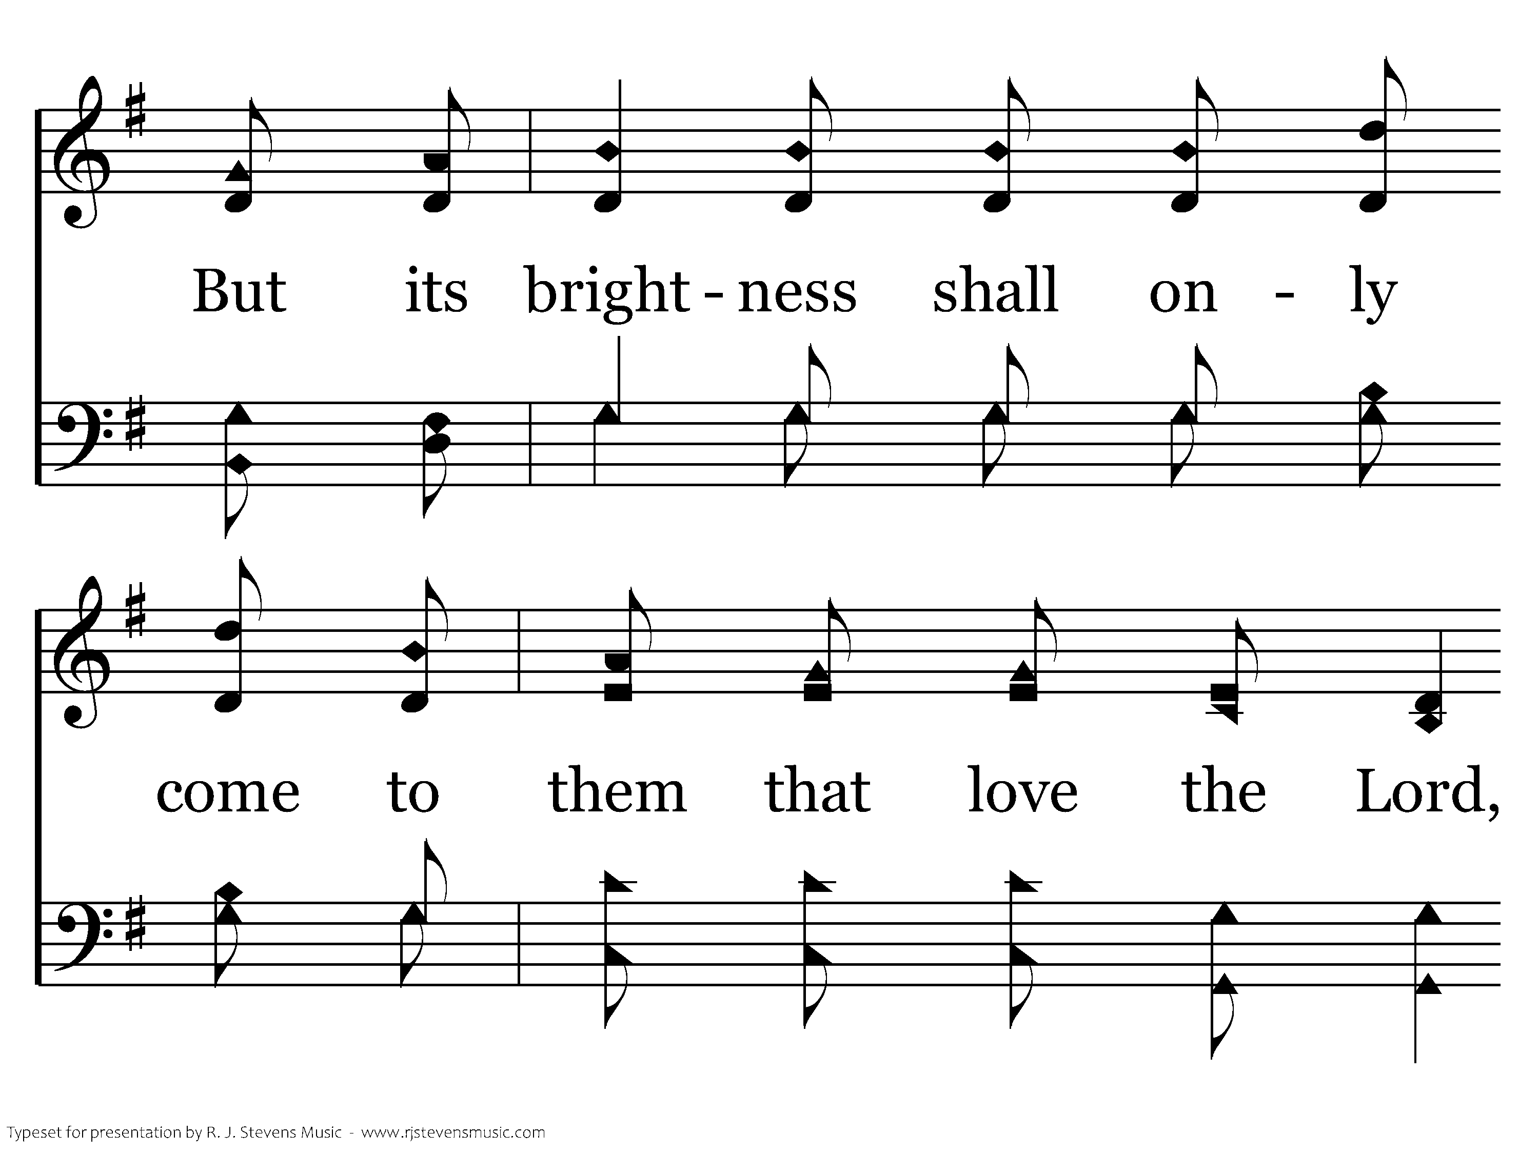
283 - There's A Great Day Coming - 2.2

Slide 36
283 - There's A Great Day Coming - 2.3

Slide 37
283 - There's A Great Day Coming - C.1

Slide 38
283 - There's A Great Day Coming - C.2
End of Verse 2

Slide 39
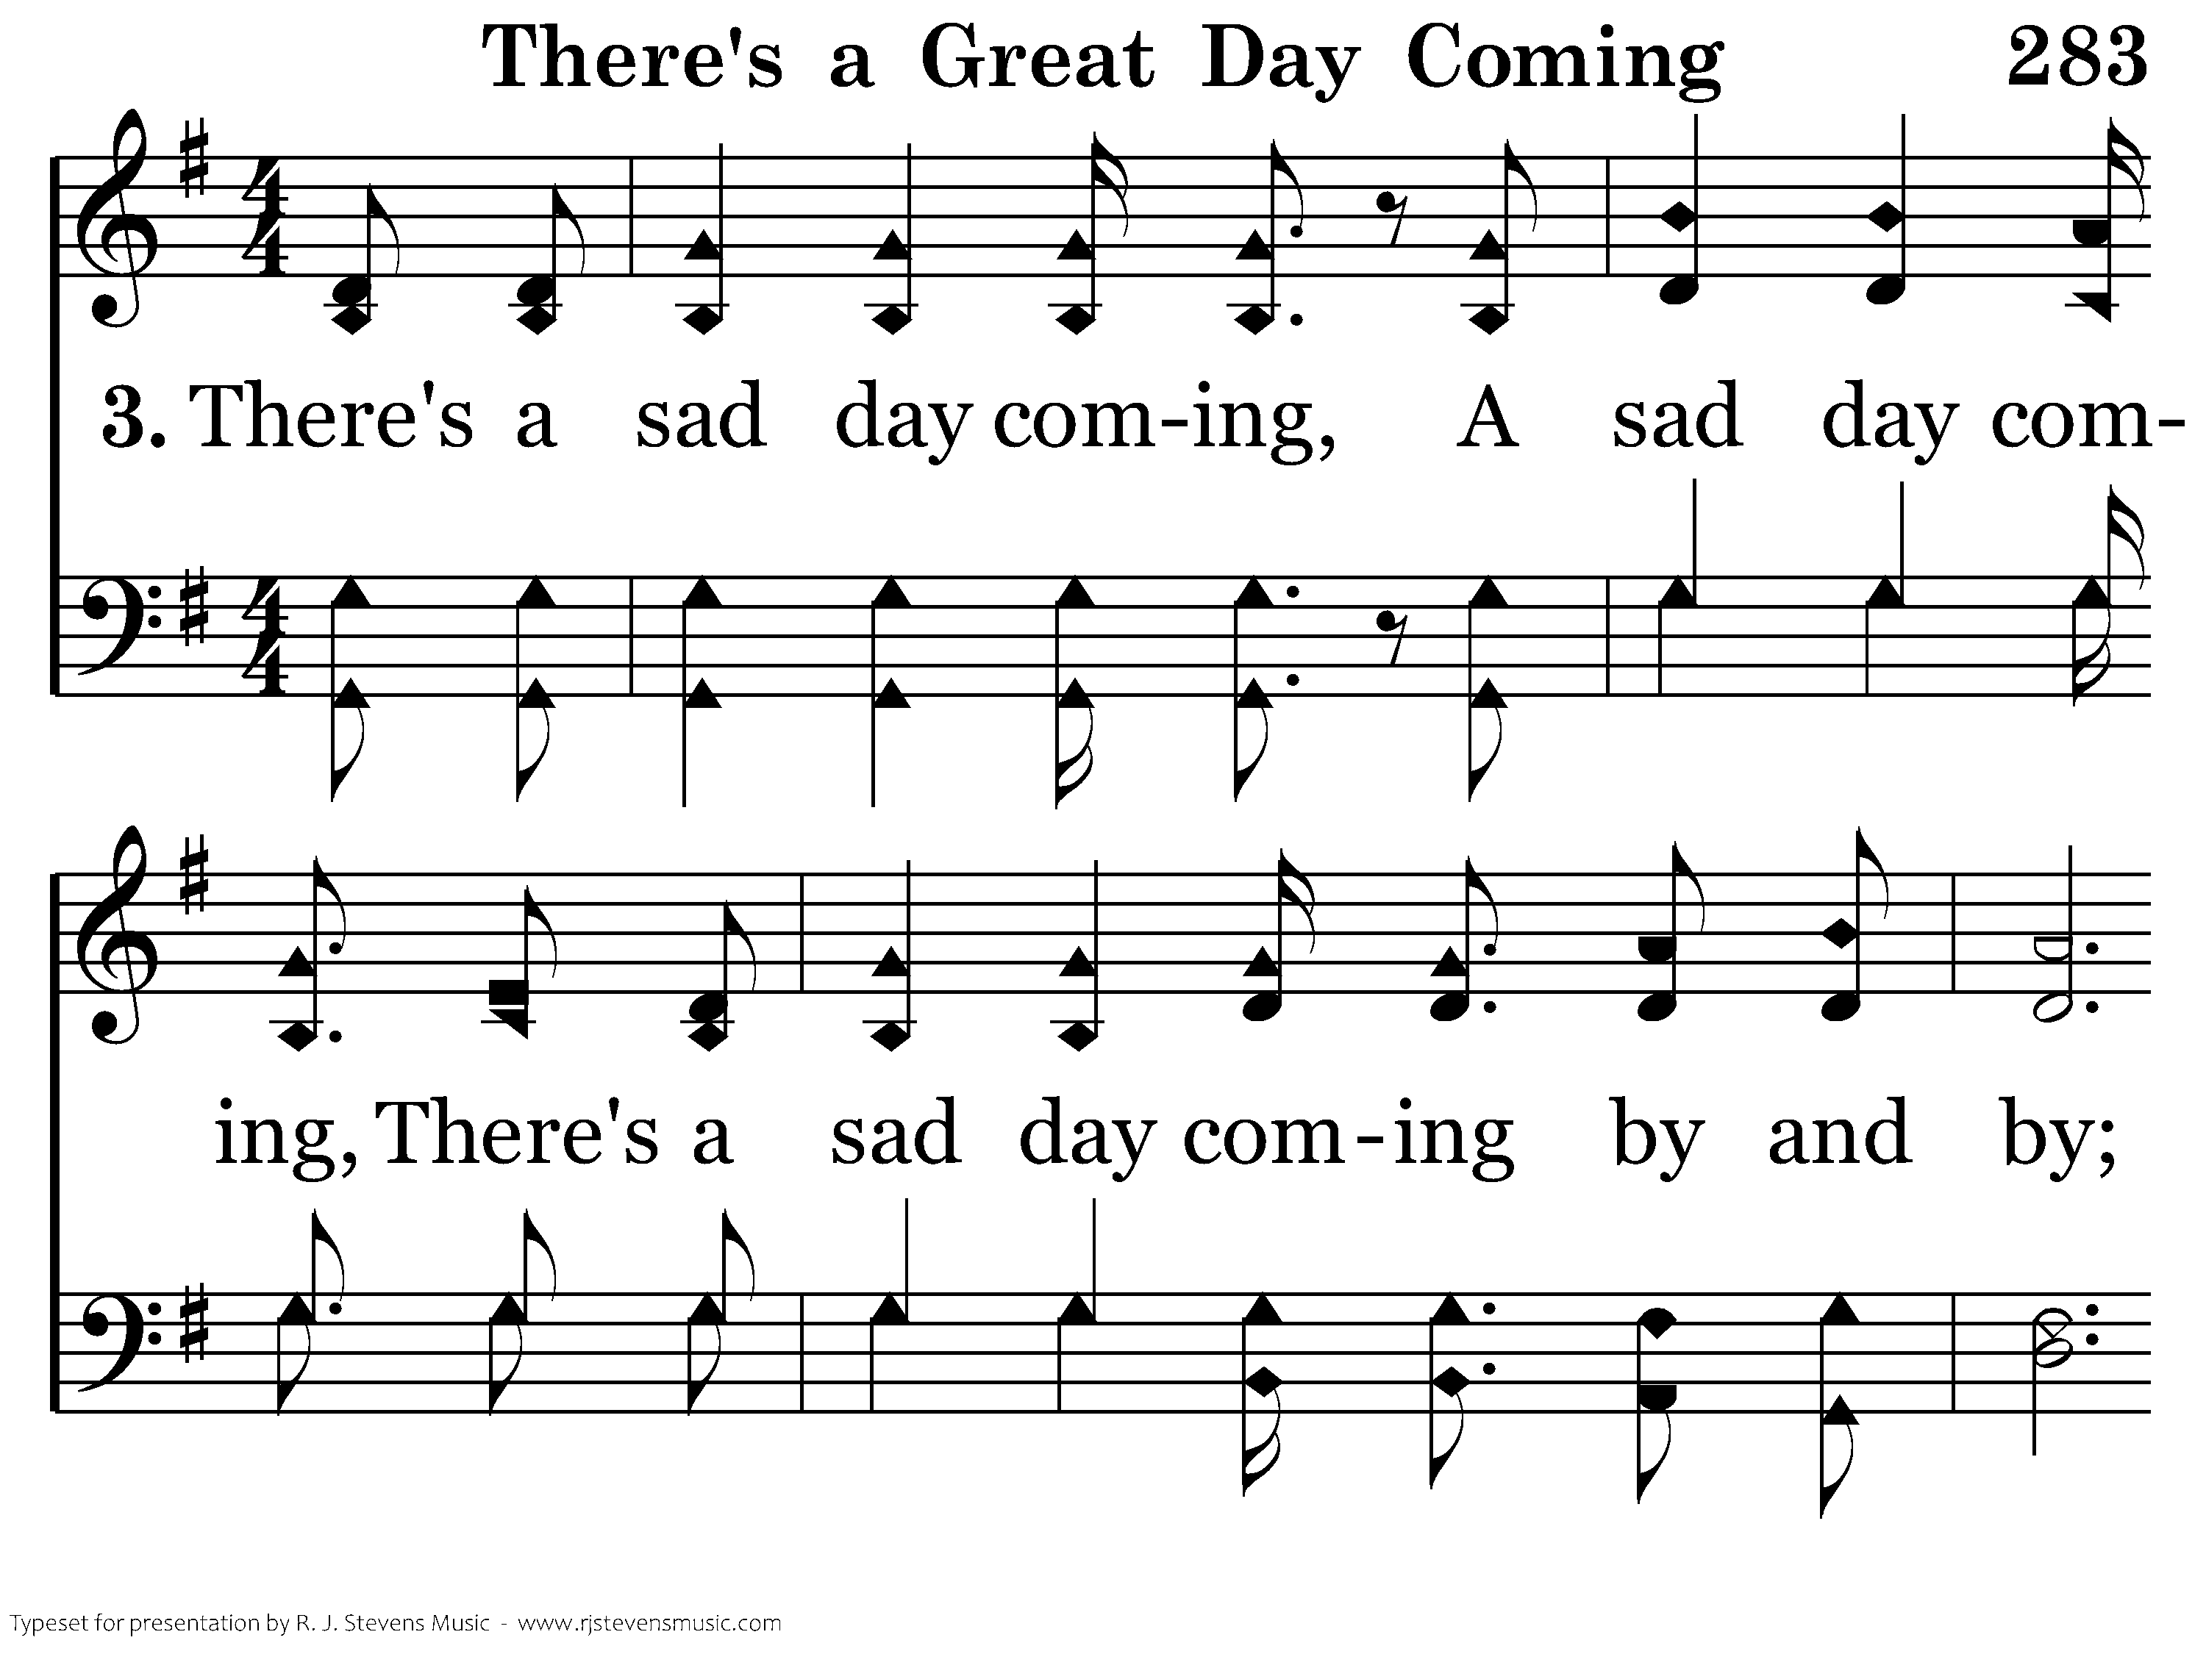
283 - There's A Great Day Coming - 3.1

Slide 40
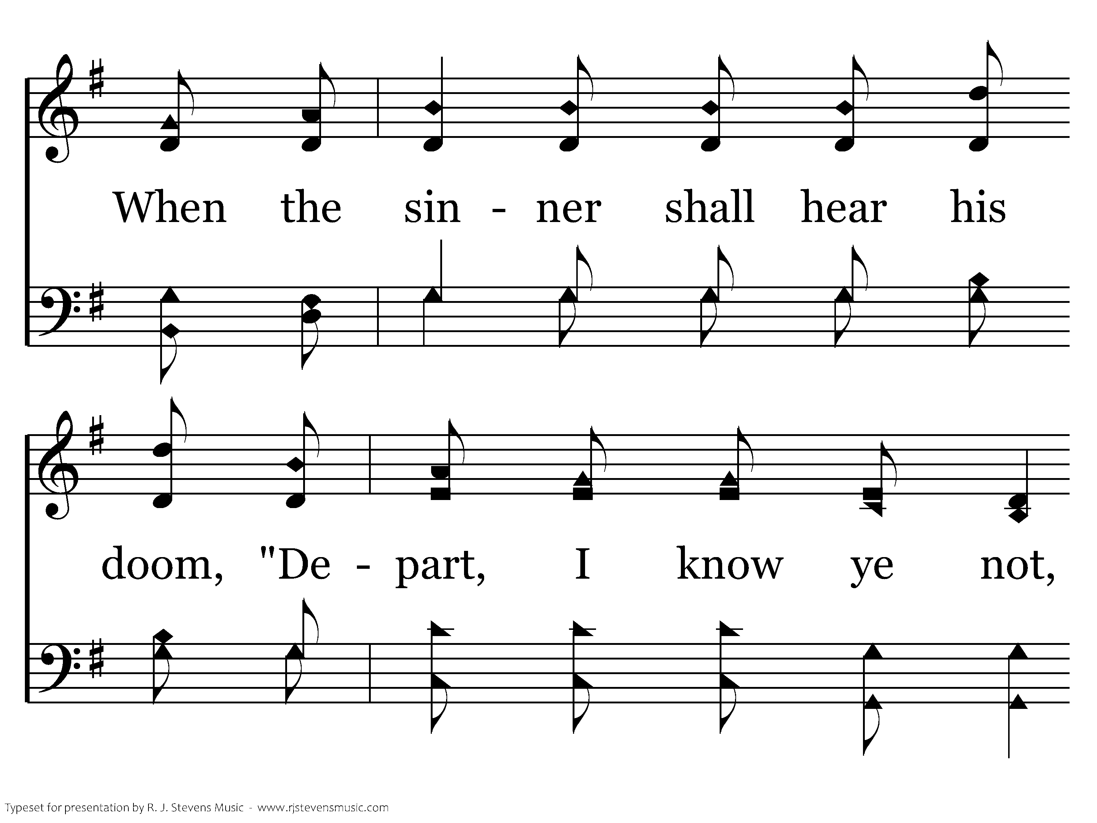
283 - There's A Great Day Coming - 3.2

Slide 41
283 - There's A Great Day Coming - 3.3

Slide 42
283 - There's A Great Day Coming - C.1

Slide 43
283 - There's A Great Day Coming - C.2
End of Song

Slide 44

159 - When My Love To Christ Grows Weak - Title

Slide 45
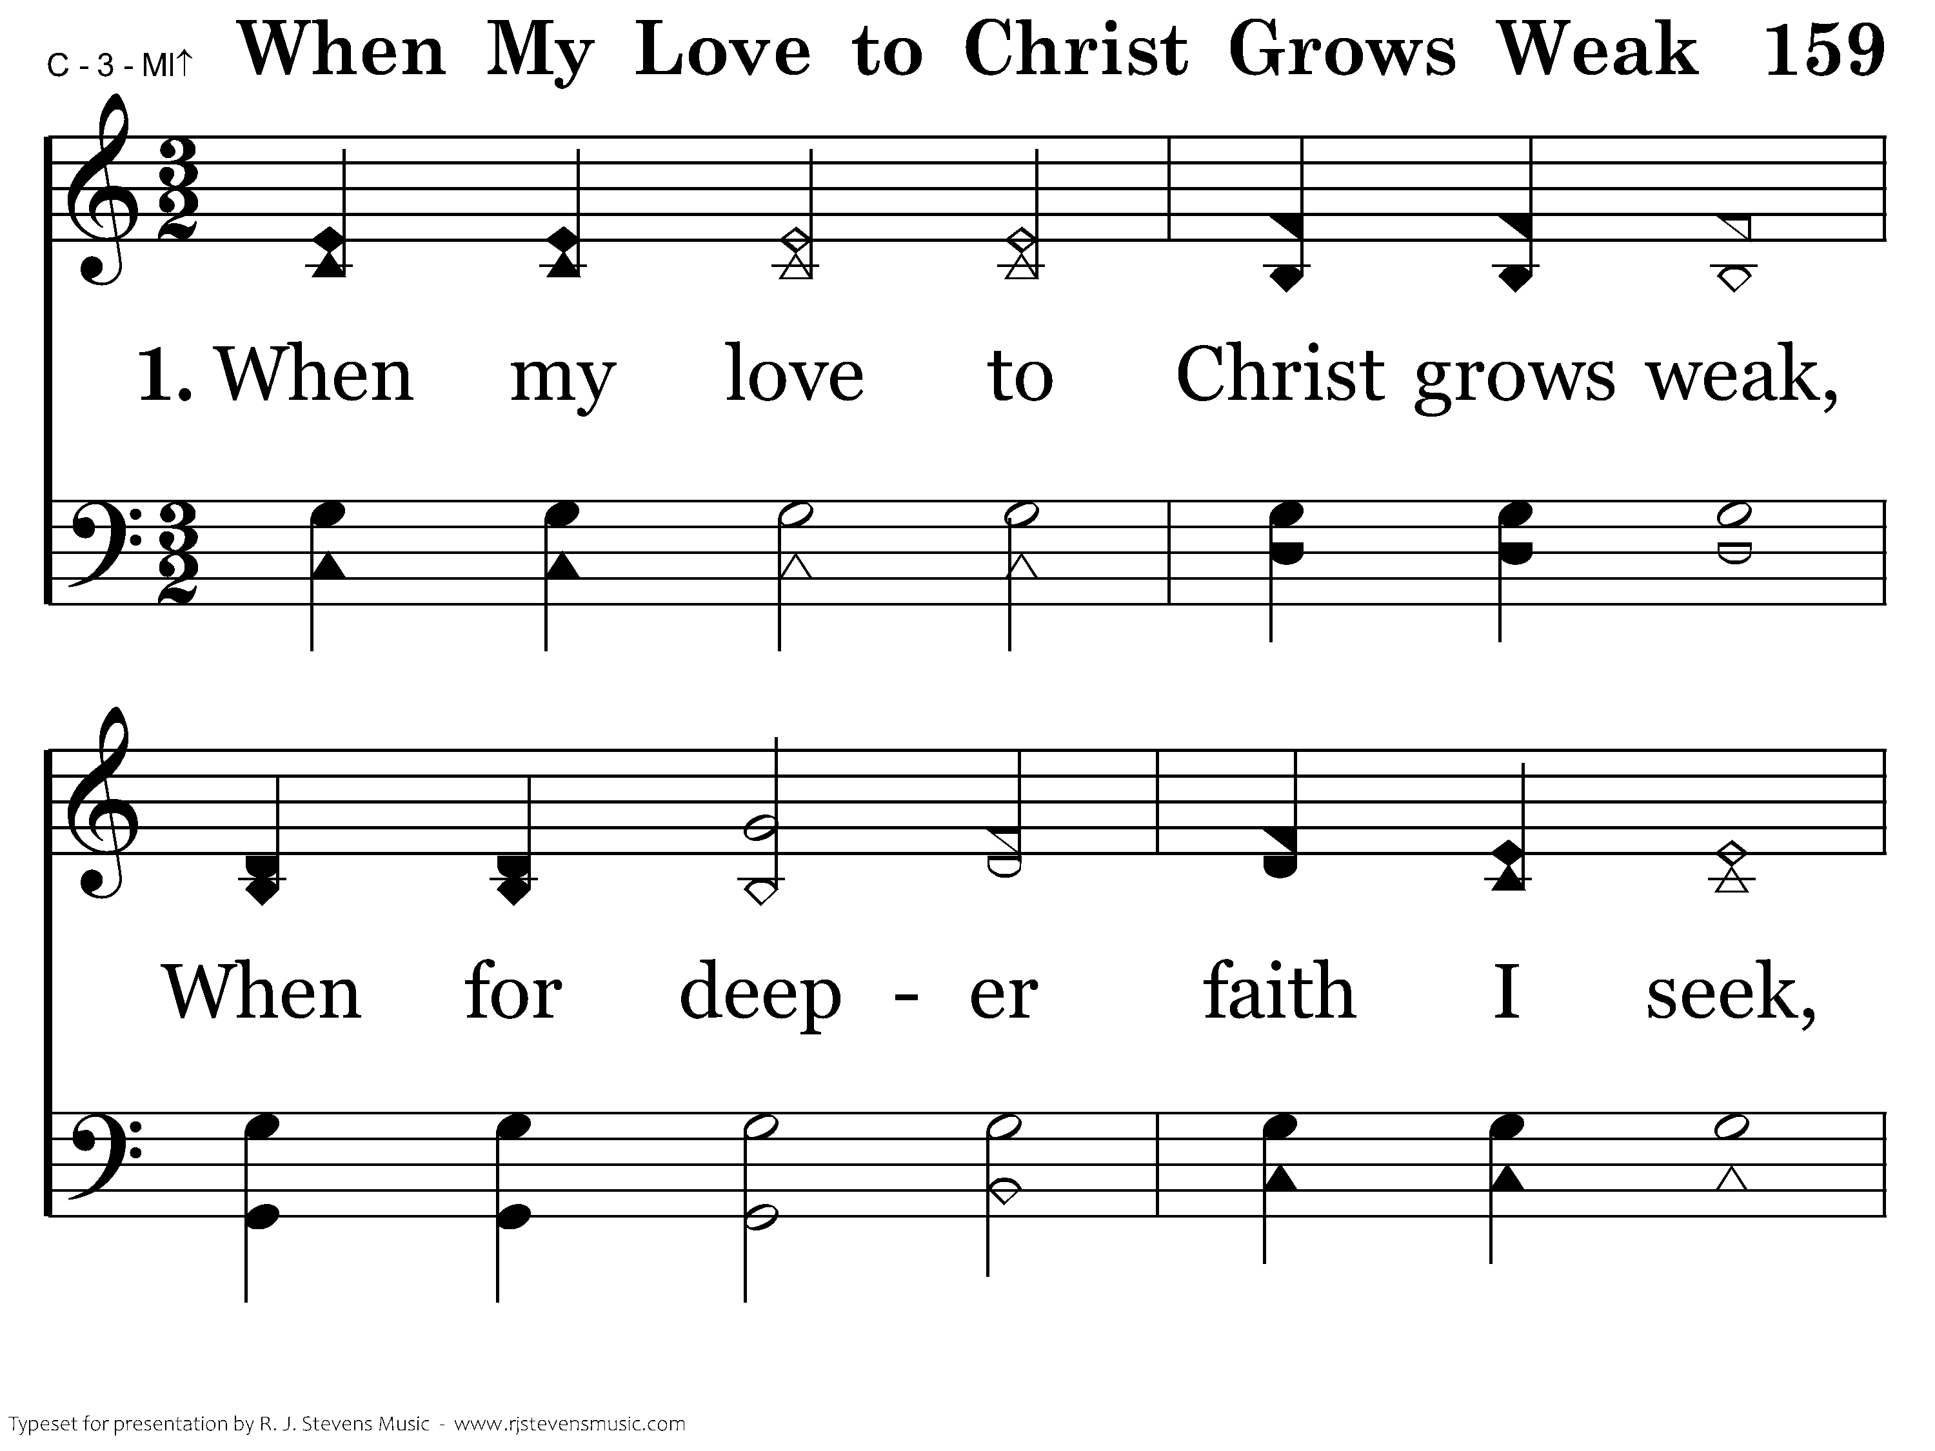
159 - When My Love To Christ Grows Weak - 1.1

Slide 46
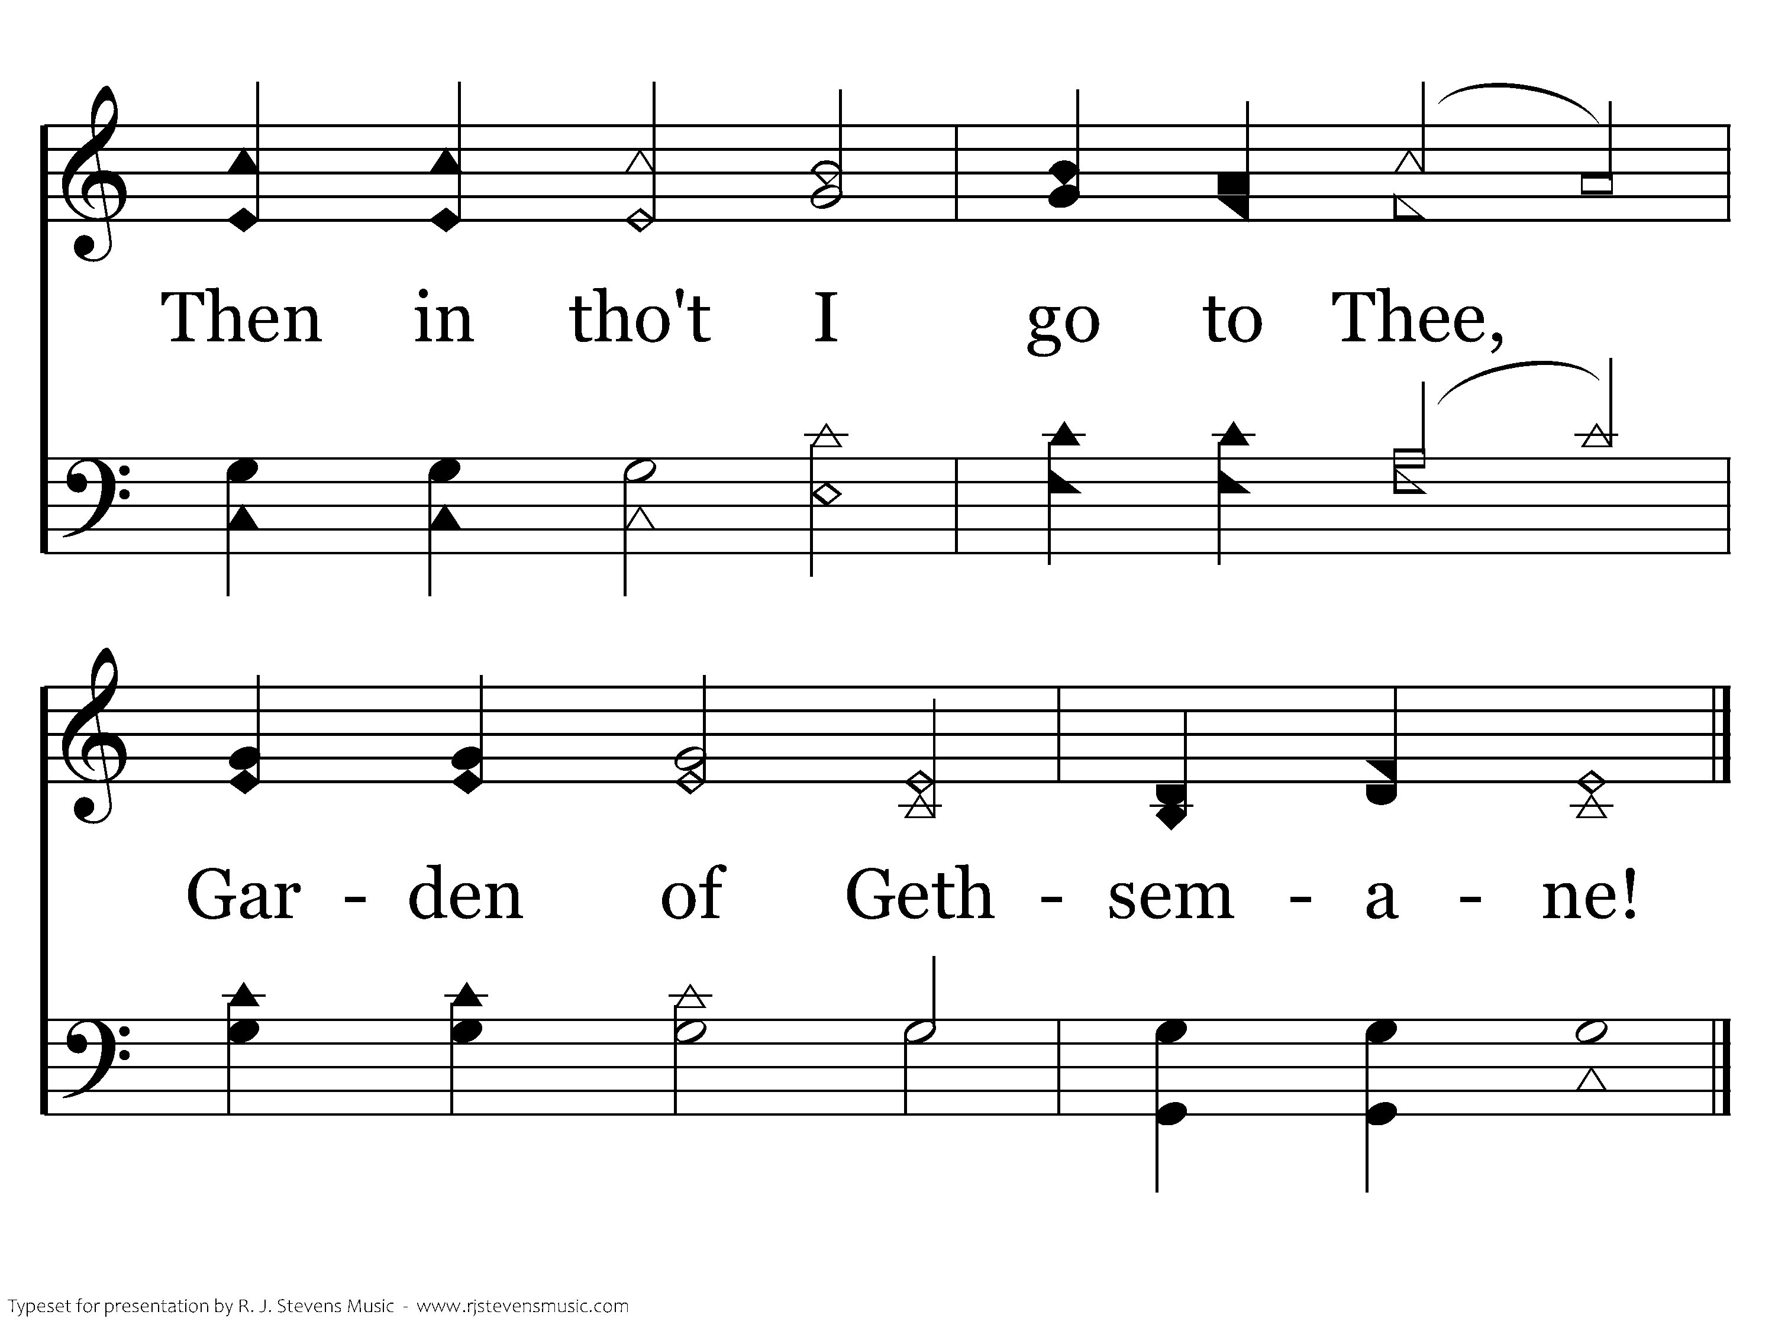
159 - When My Love To Christ Grows Weak - 1.2
End of Verse 1

Slide 47
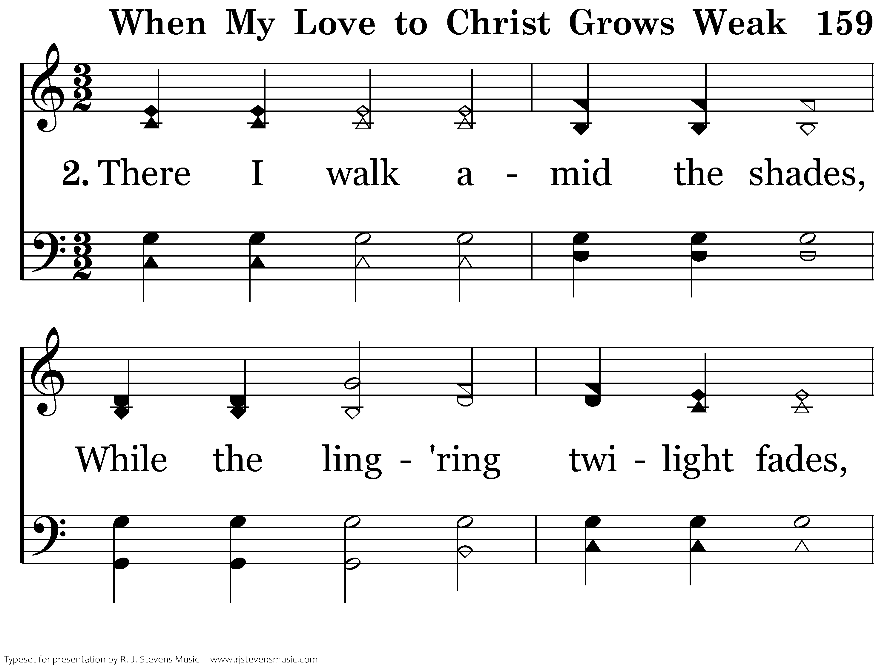
159 - When My Love To Christ Grows Weak - 2.1

Slide 48
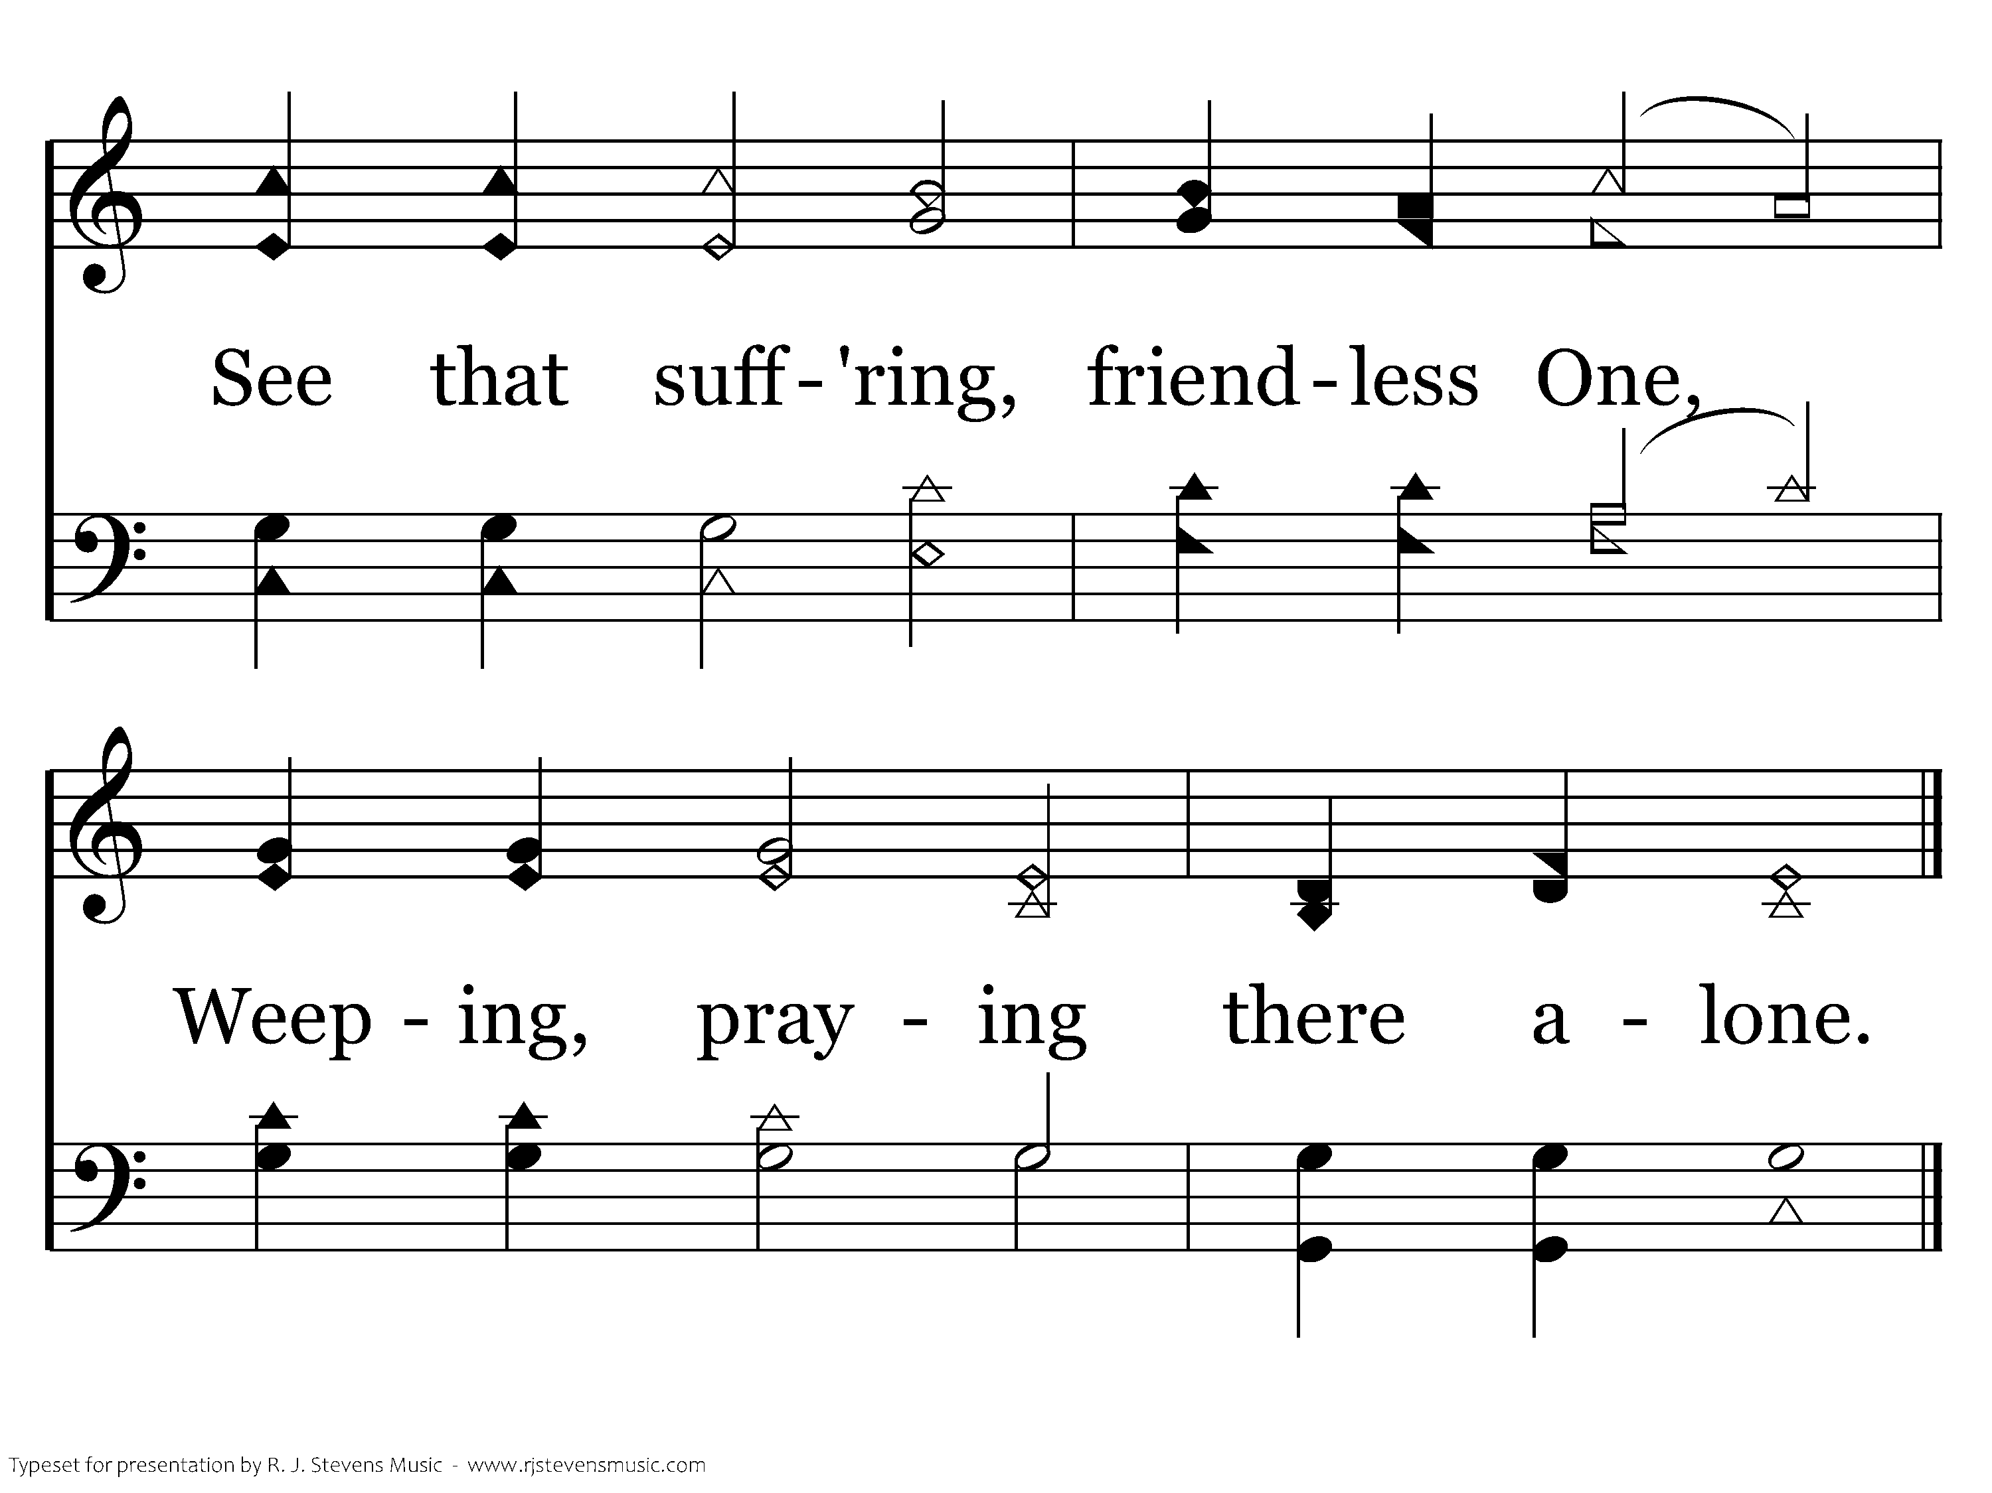
159 - When My Love To Christ Grows Weak - 2.2
End of Verse 2

Slide 49
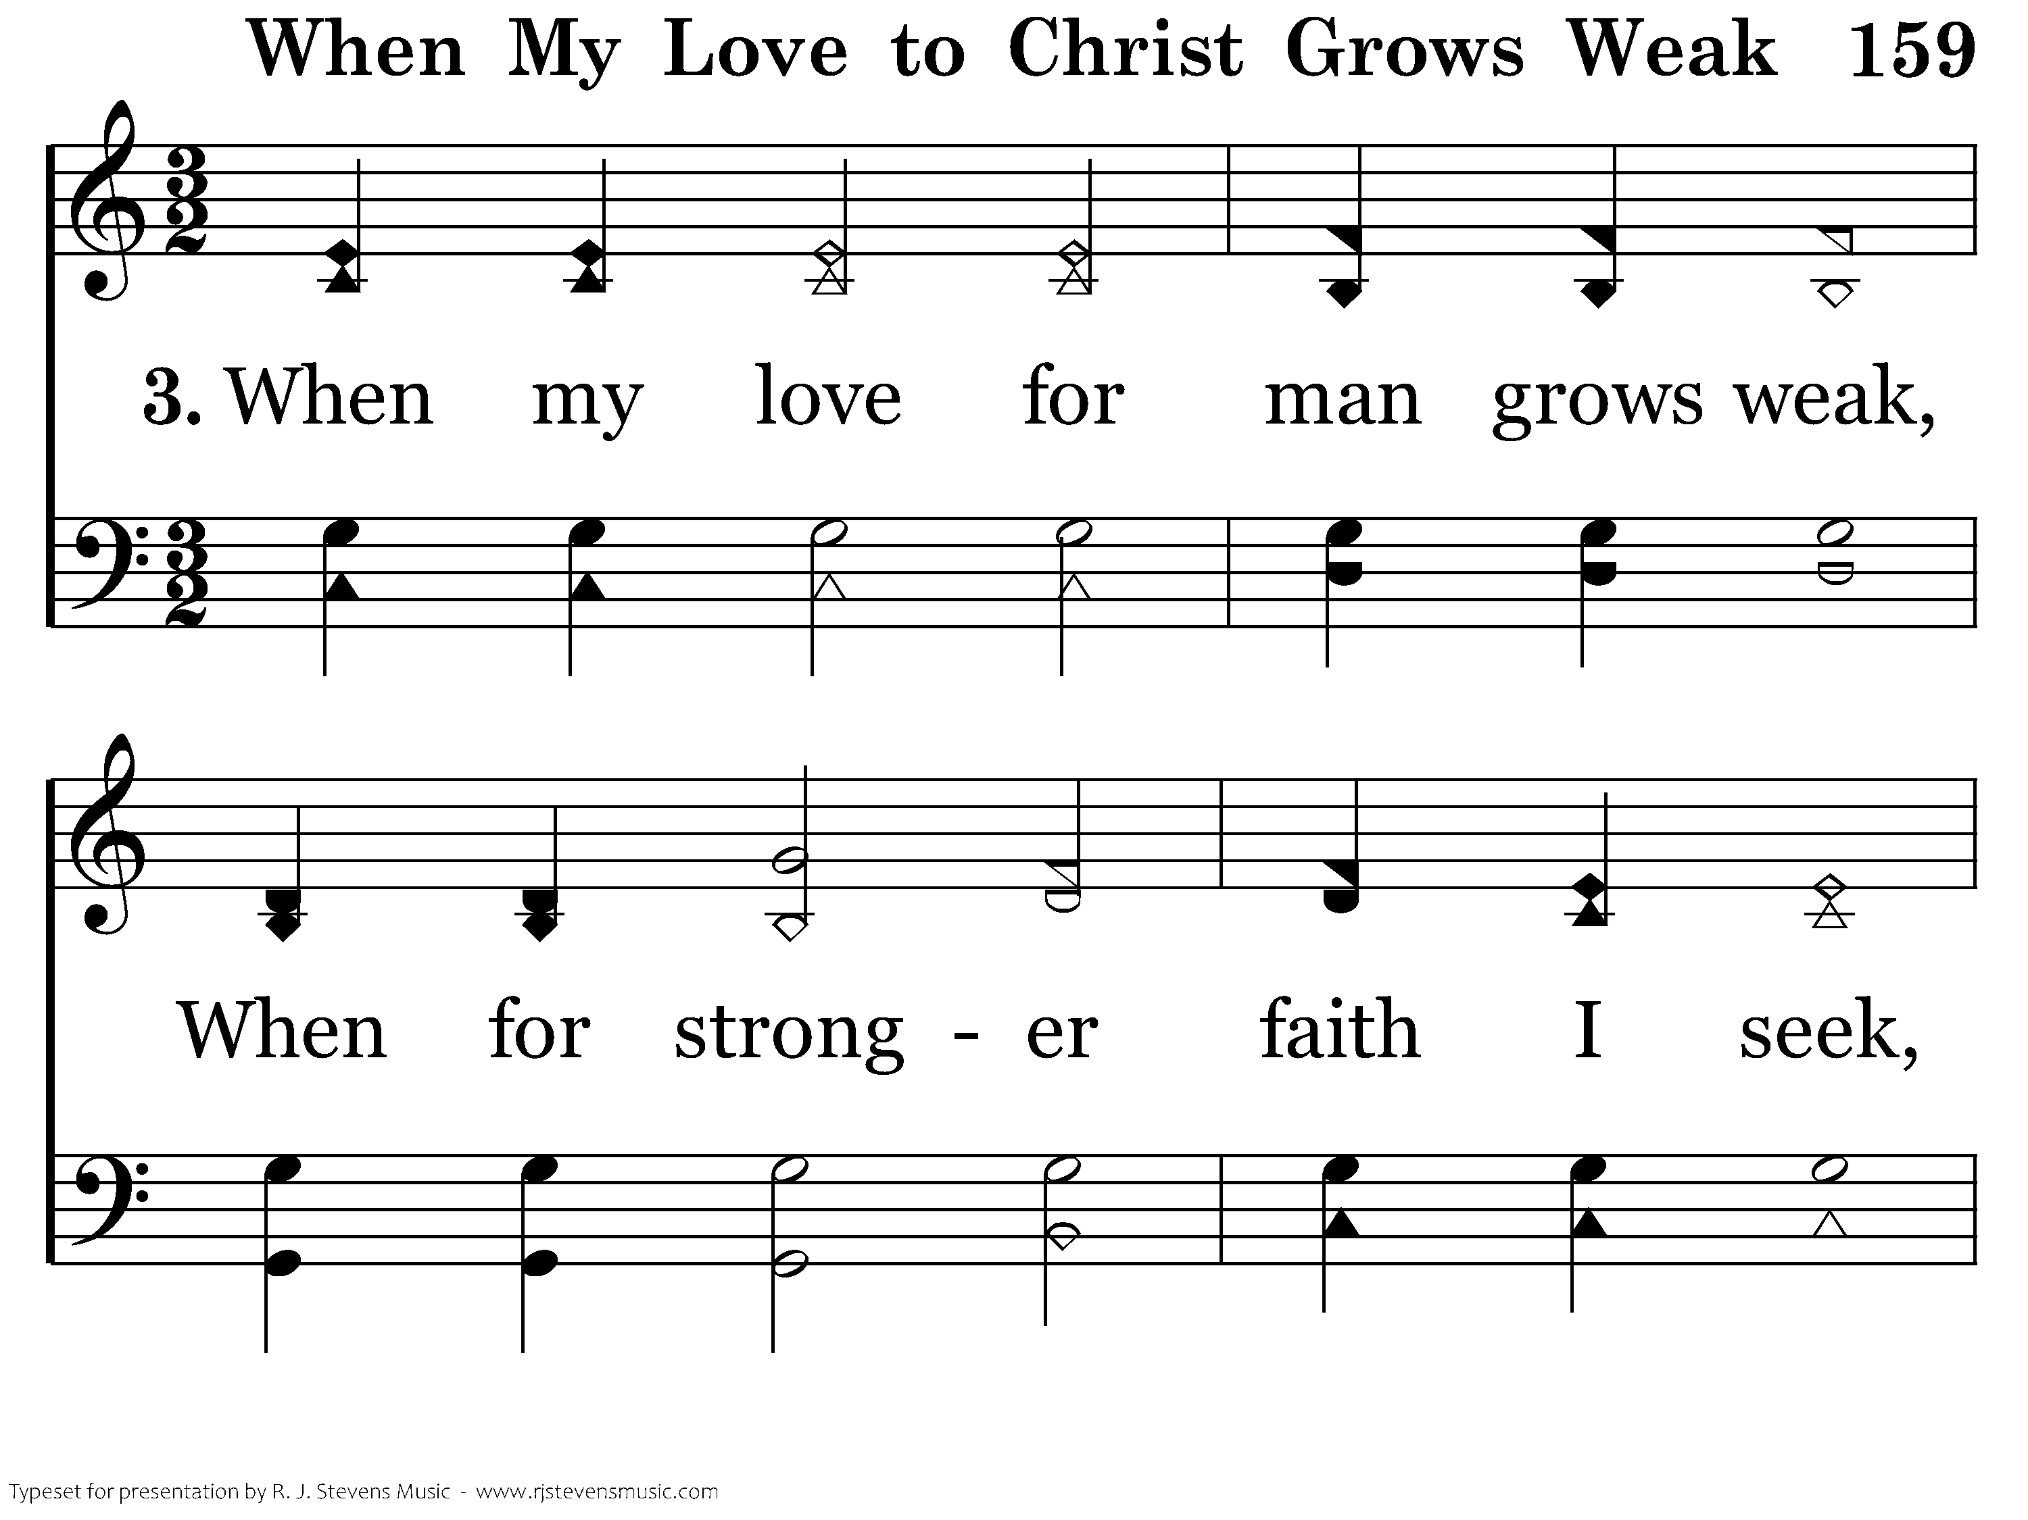
159 - When My Love To Christ Grows Weak - 3.1

Slide 50
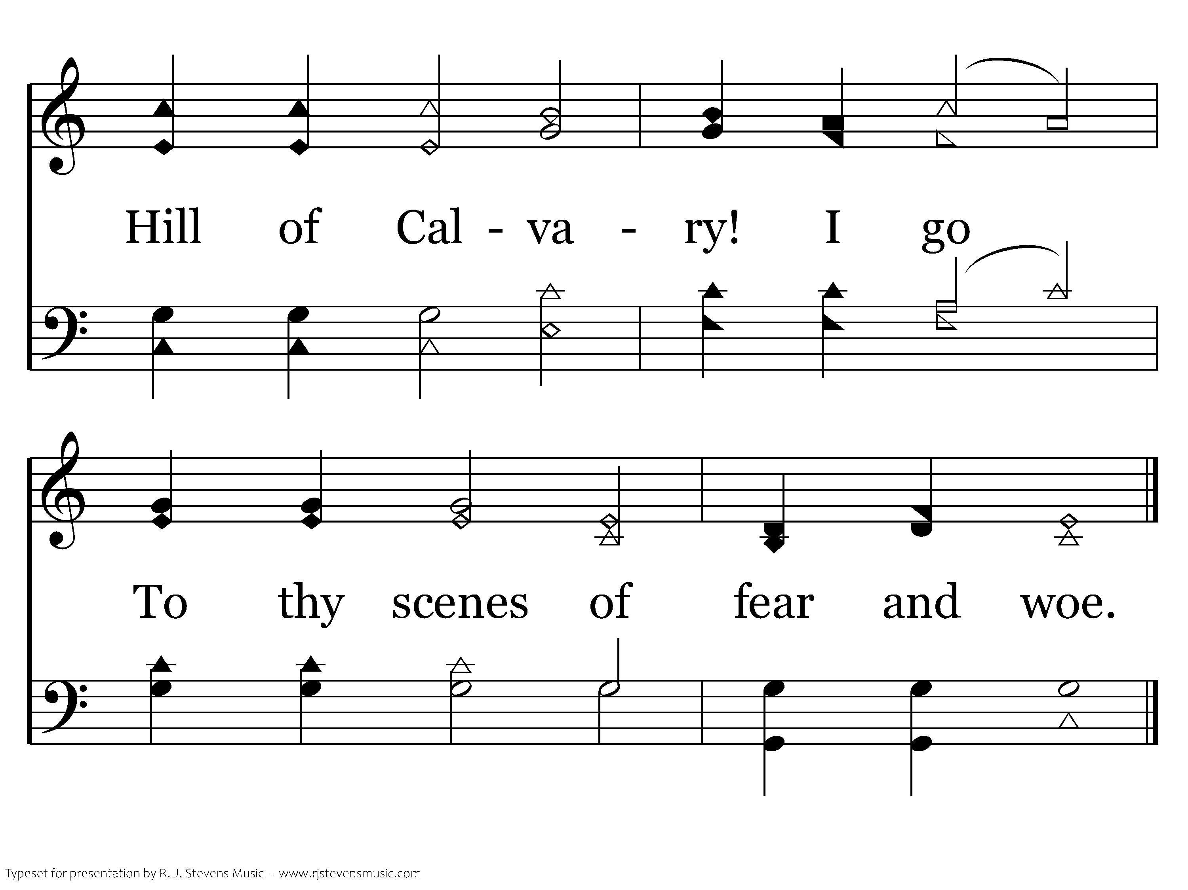
159 - When My Love To Christ Grows Weak - 3.2
End of Verse 3

Slide 51
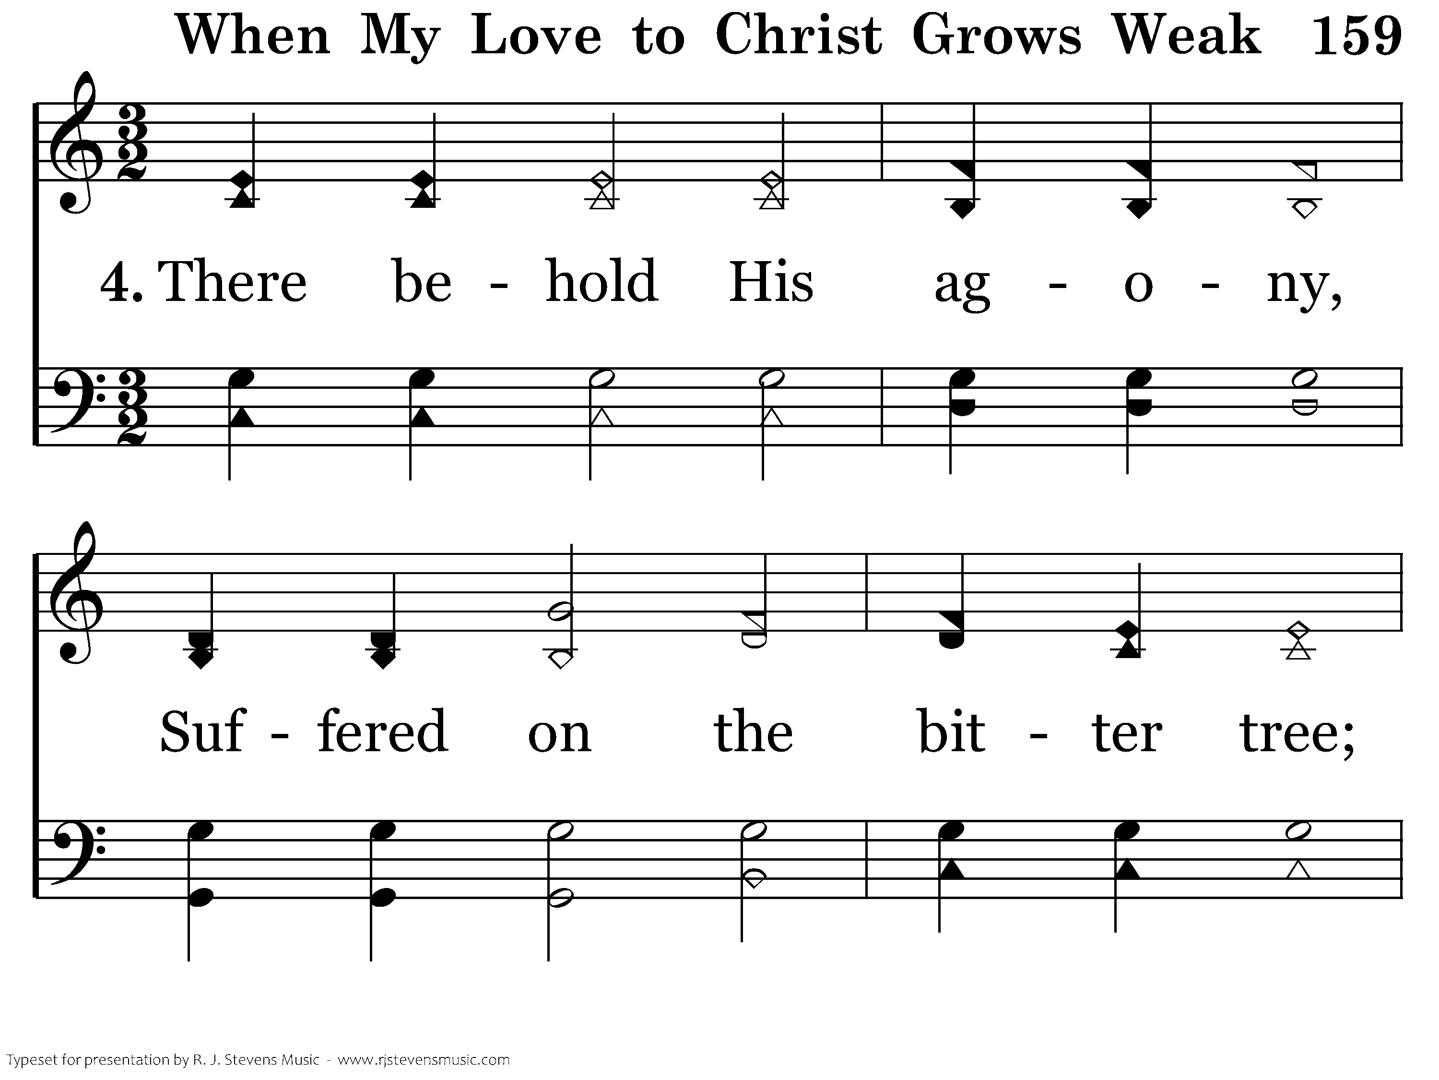
159 - When My Love To Christ Grows Weak - 4.1

Slide 52
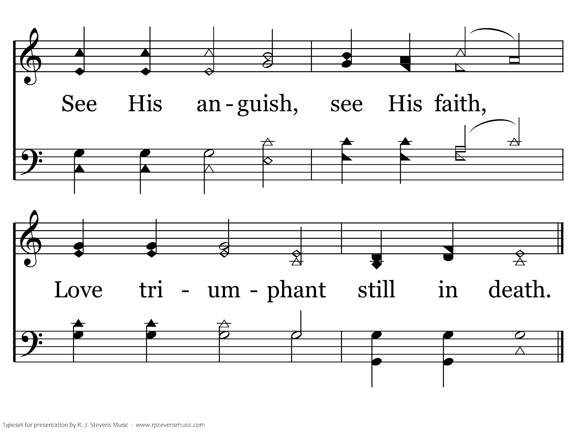
159 - When My Love To Christ Grows Weak - 4.2
End of Verse 4

Slide 53
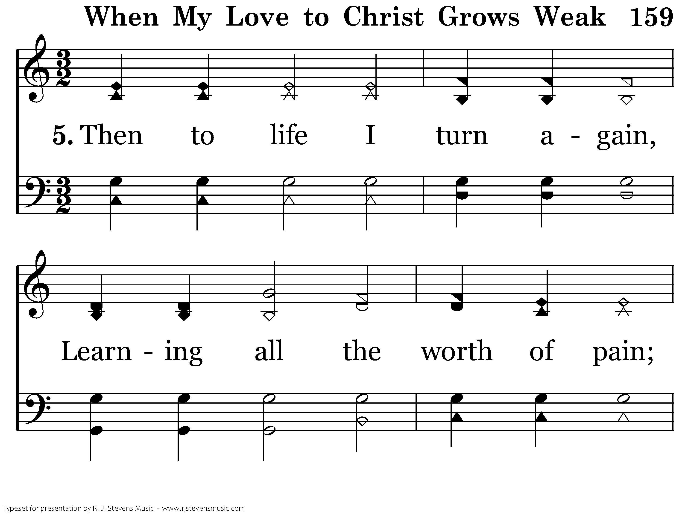
159 - When My Love To Christ Grows Weak - 5.1

Slide 54
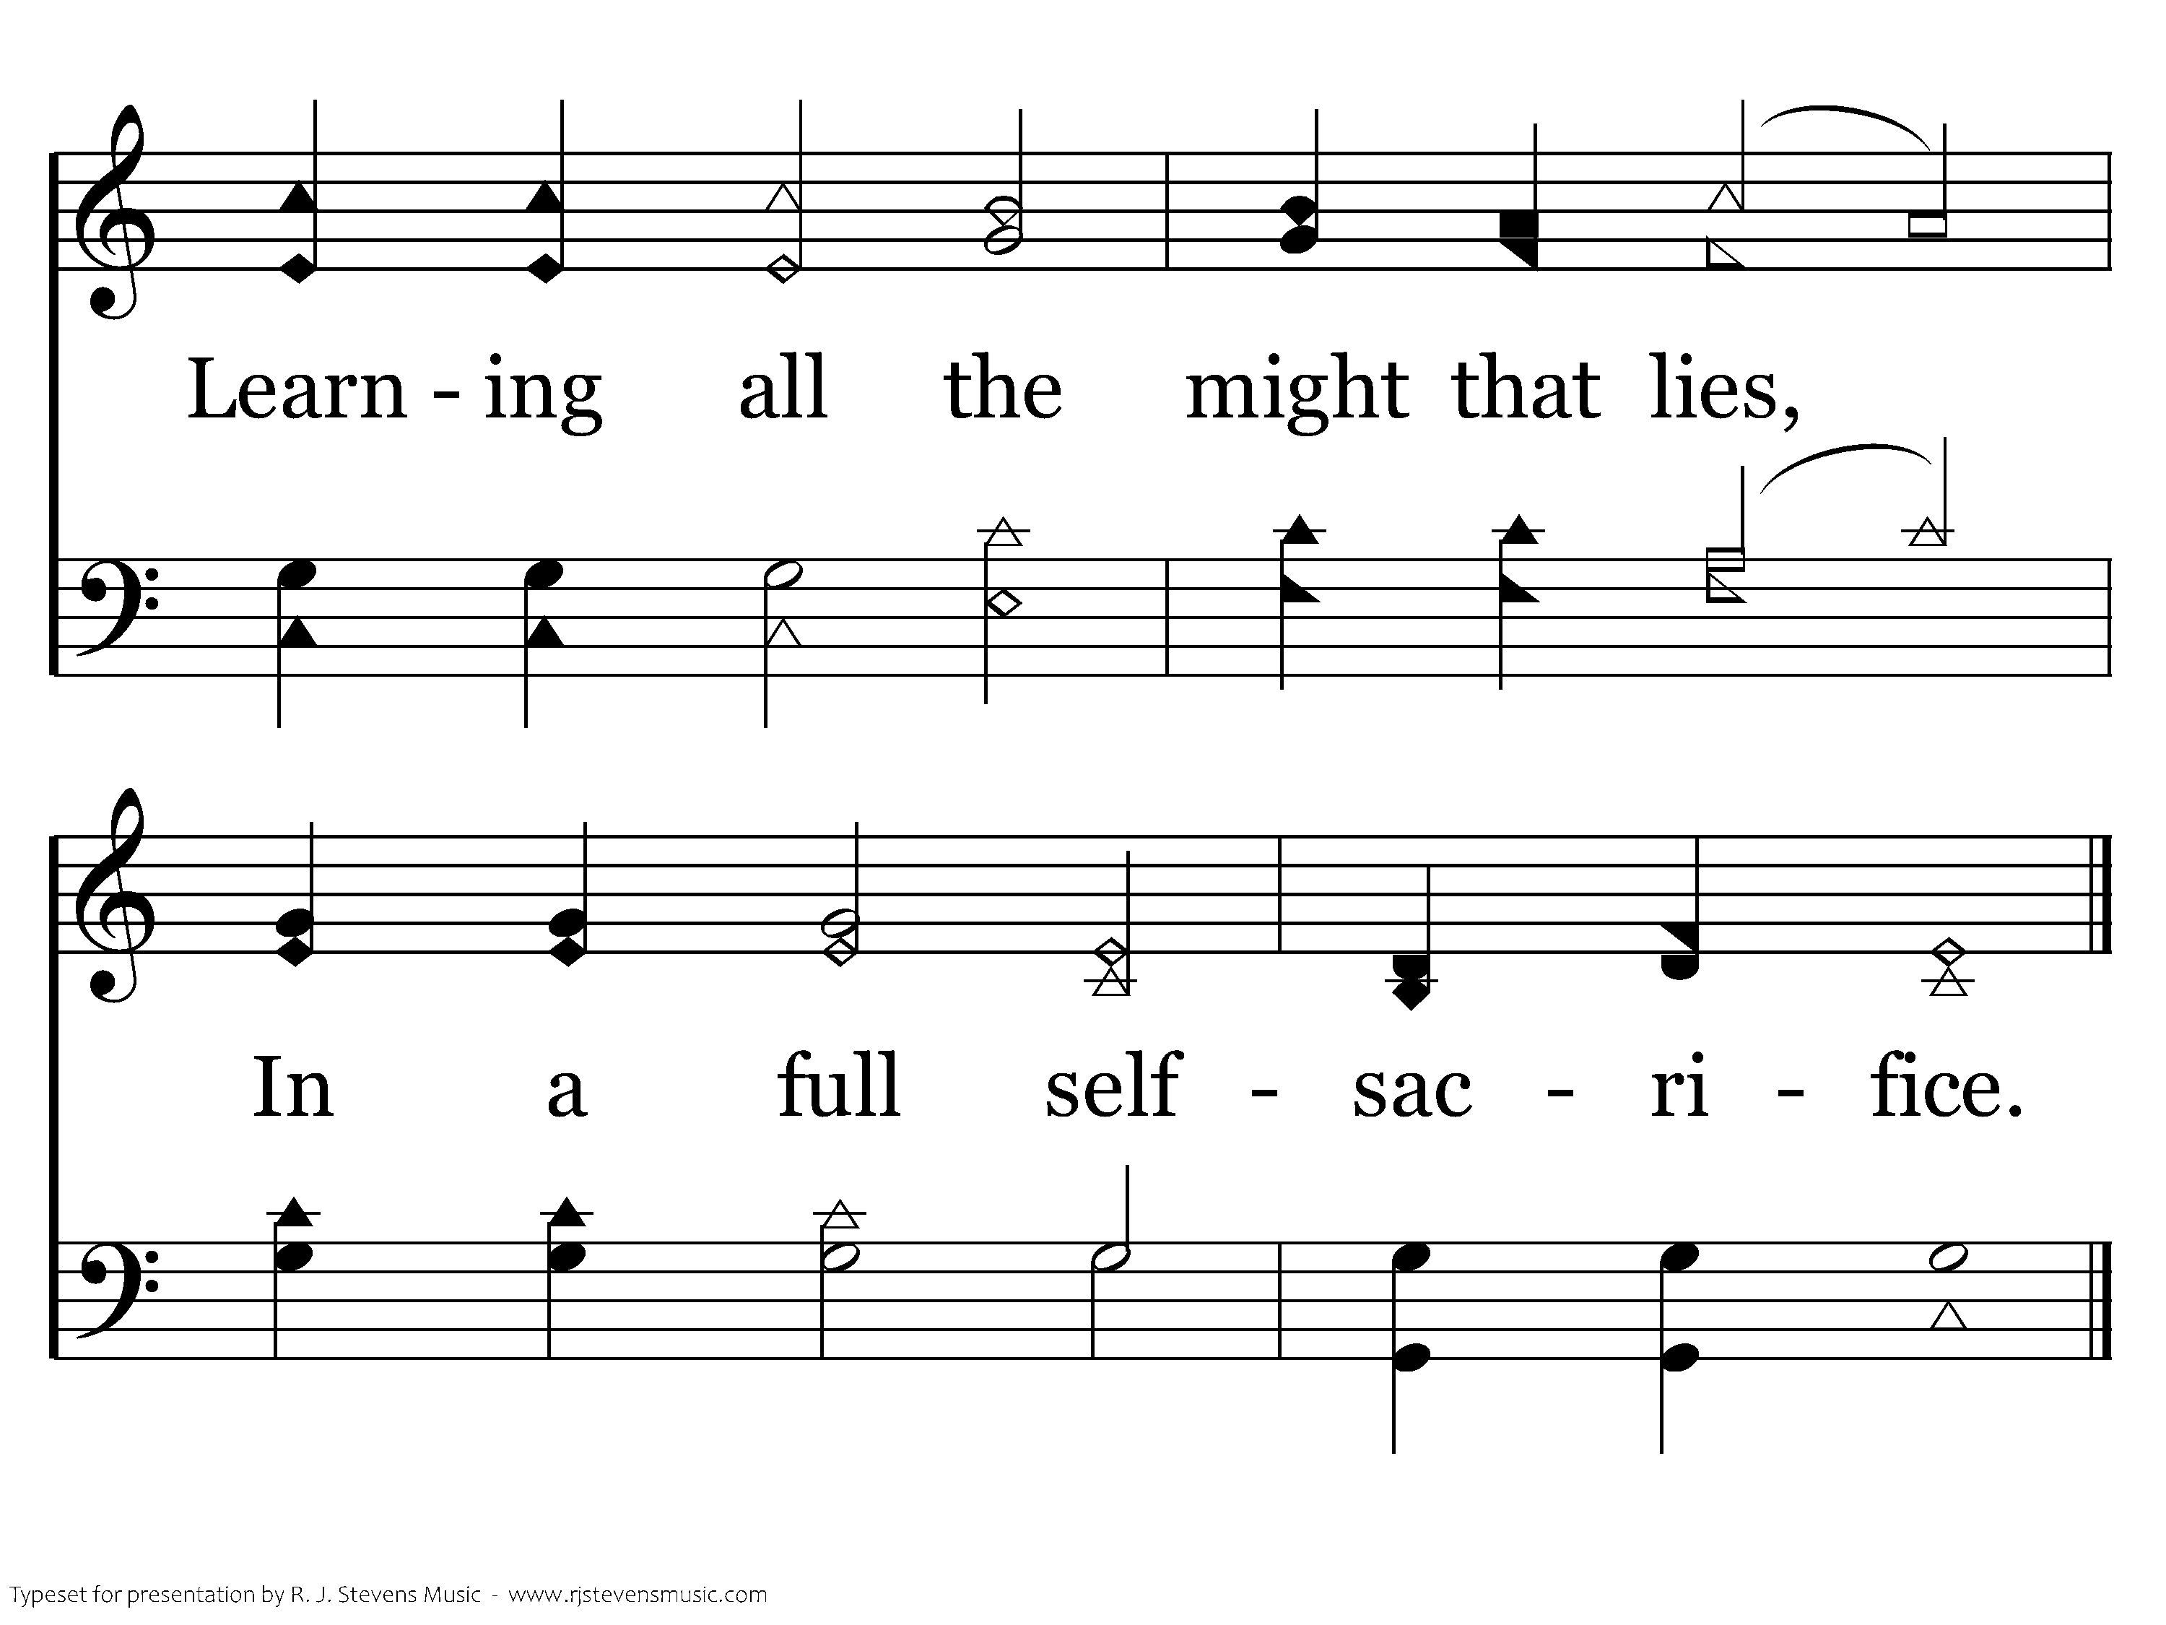
159 - When My Love To Christ Grows Weak - 5.2
End of Song

Slide 55
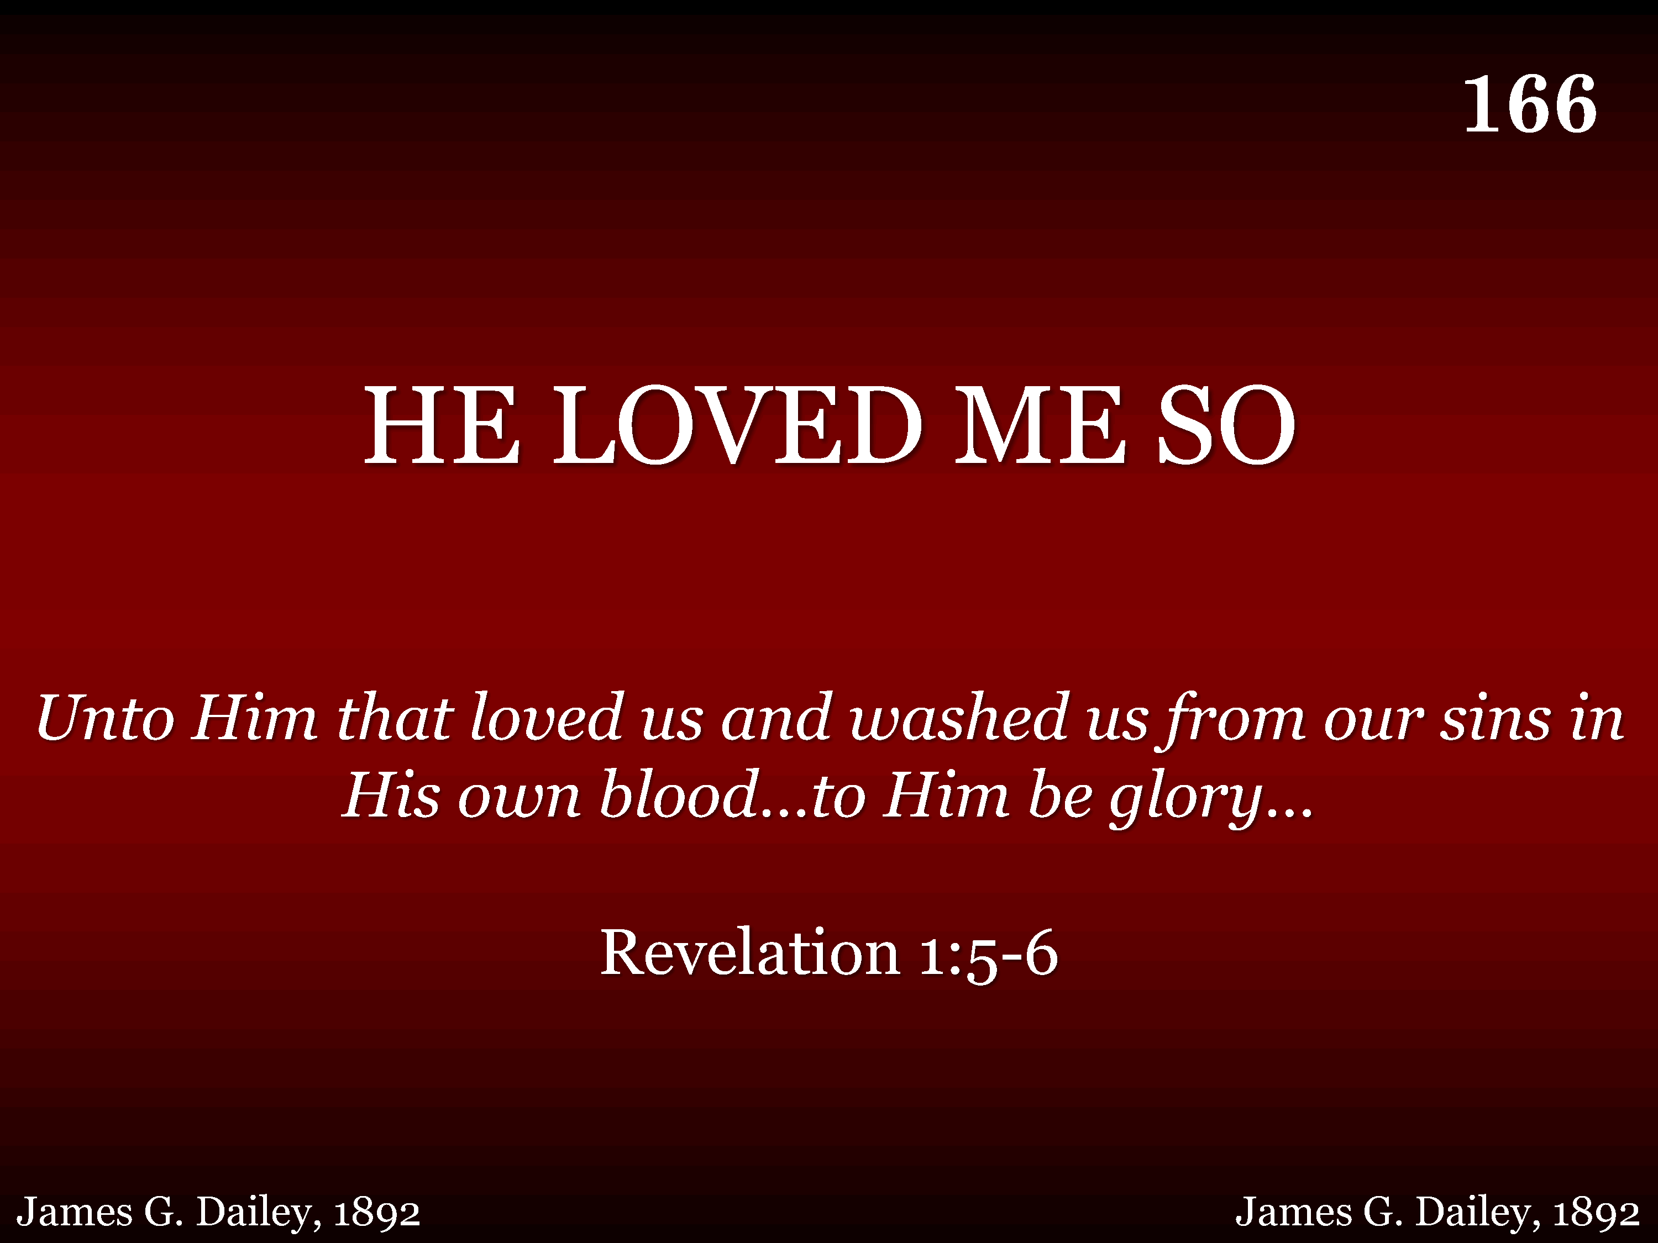
166 - He Loved Me So - Title

Slide 56
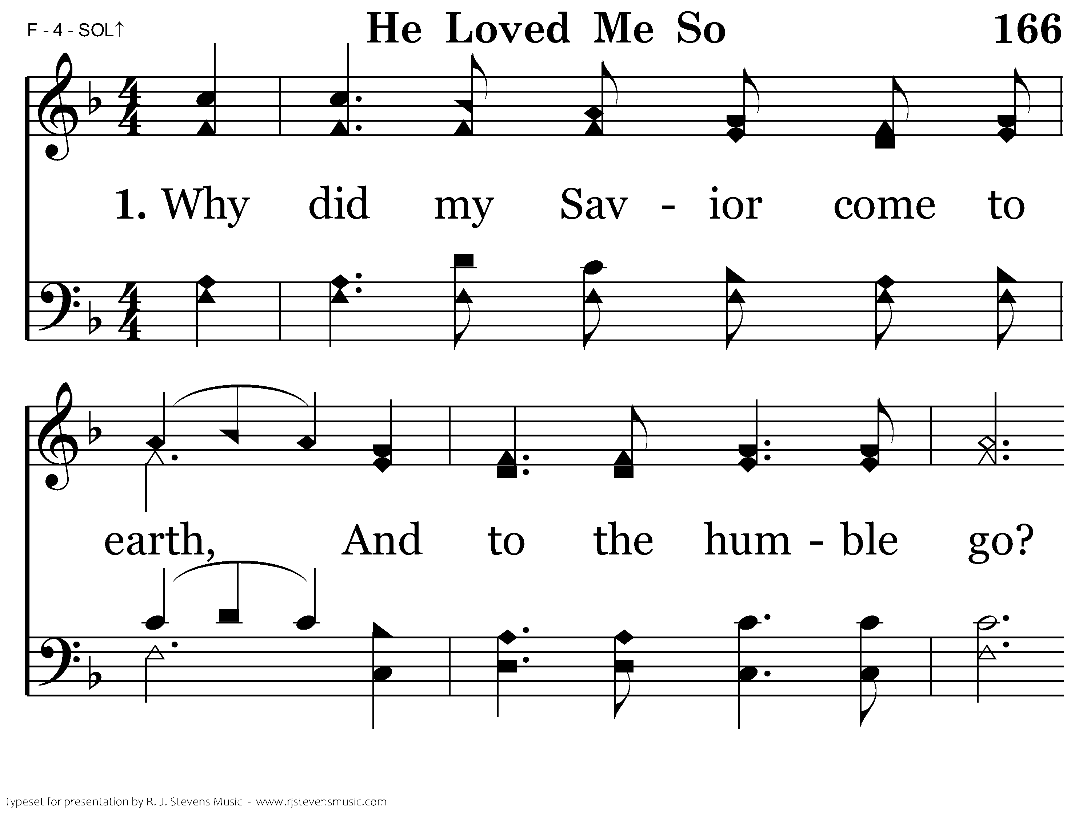
166 - He Loved Me So - 1.1

Slide 57
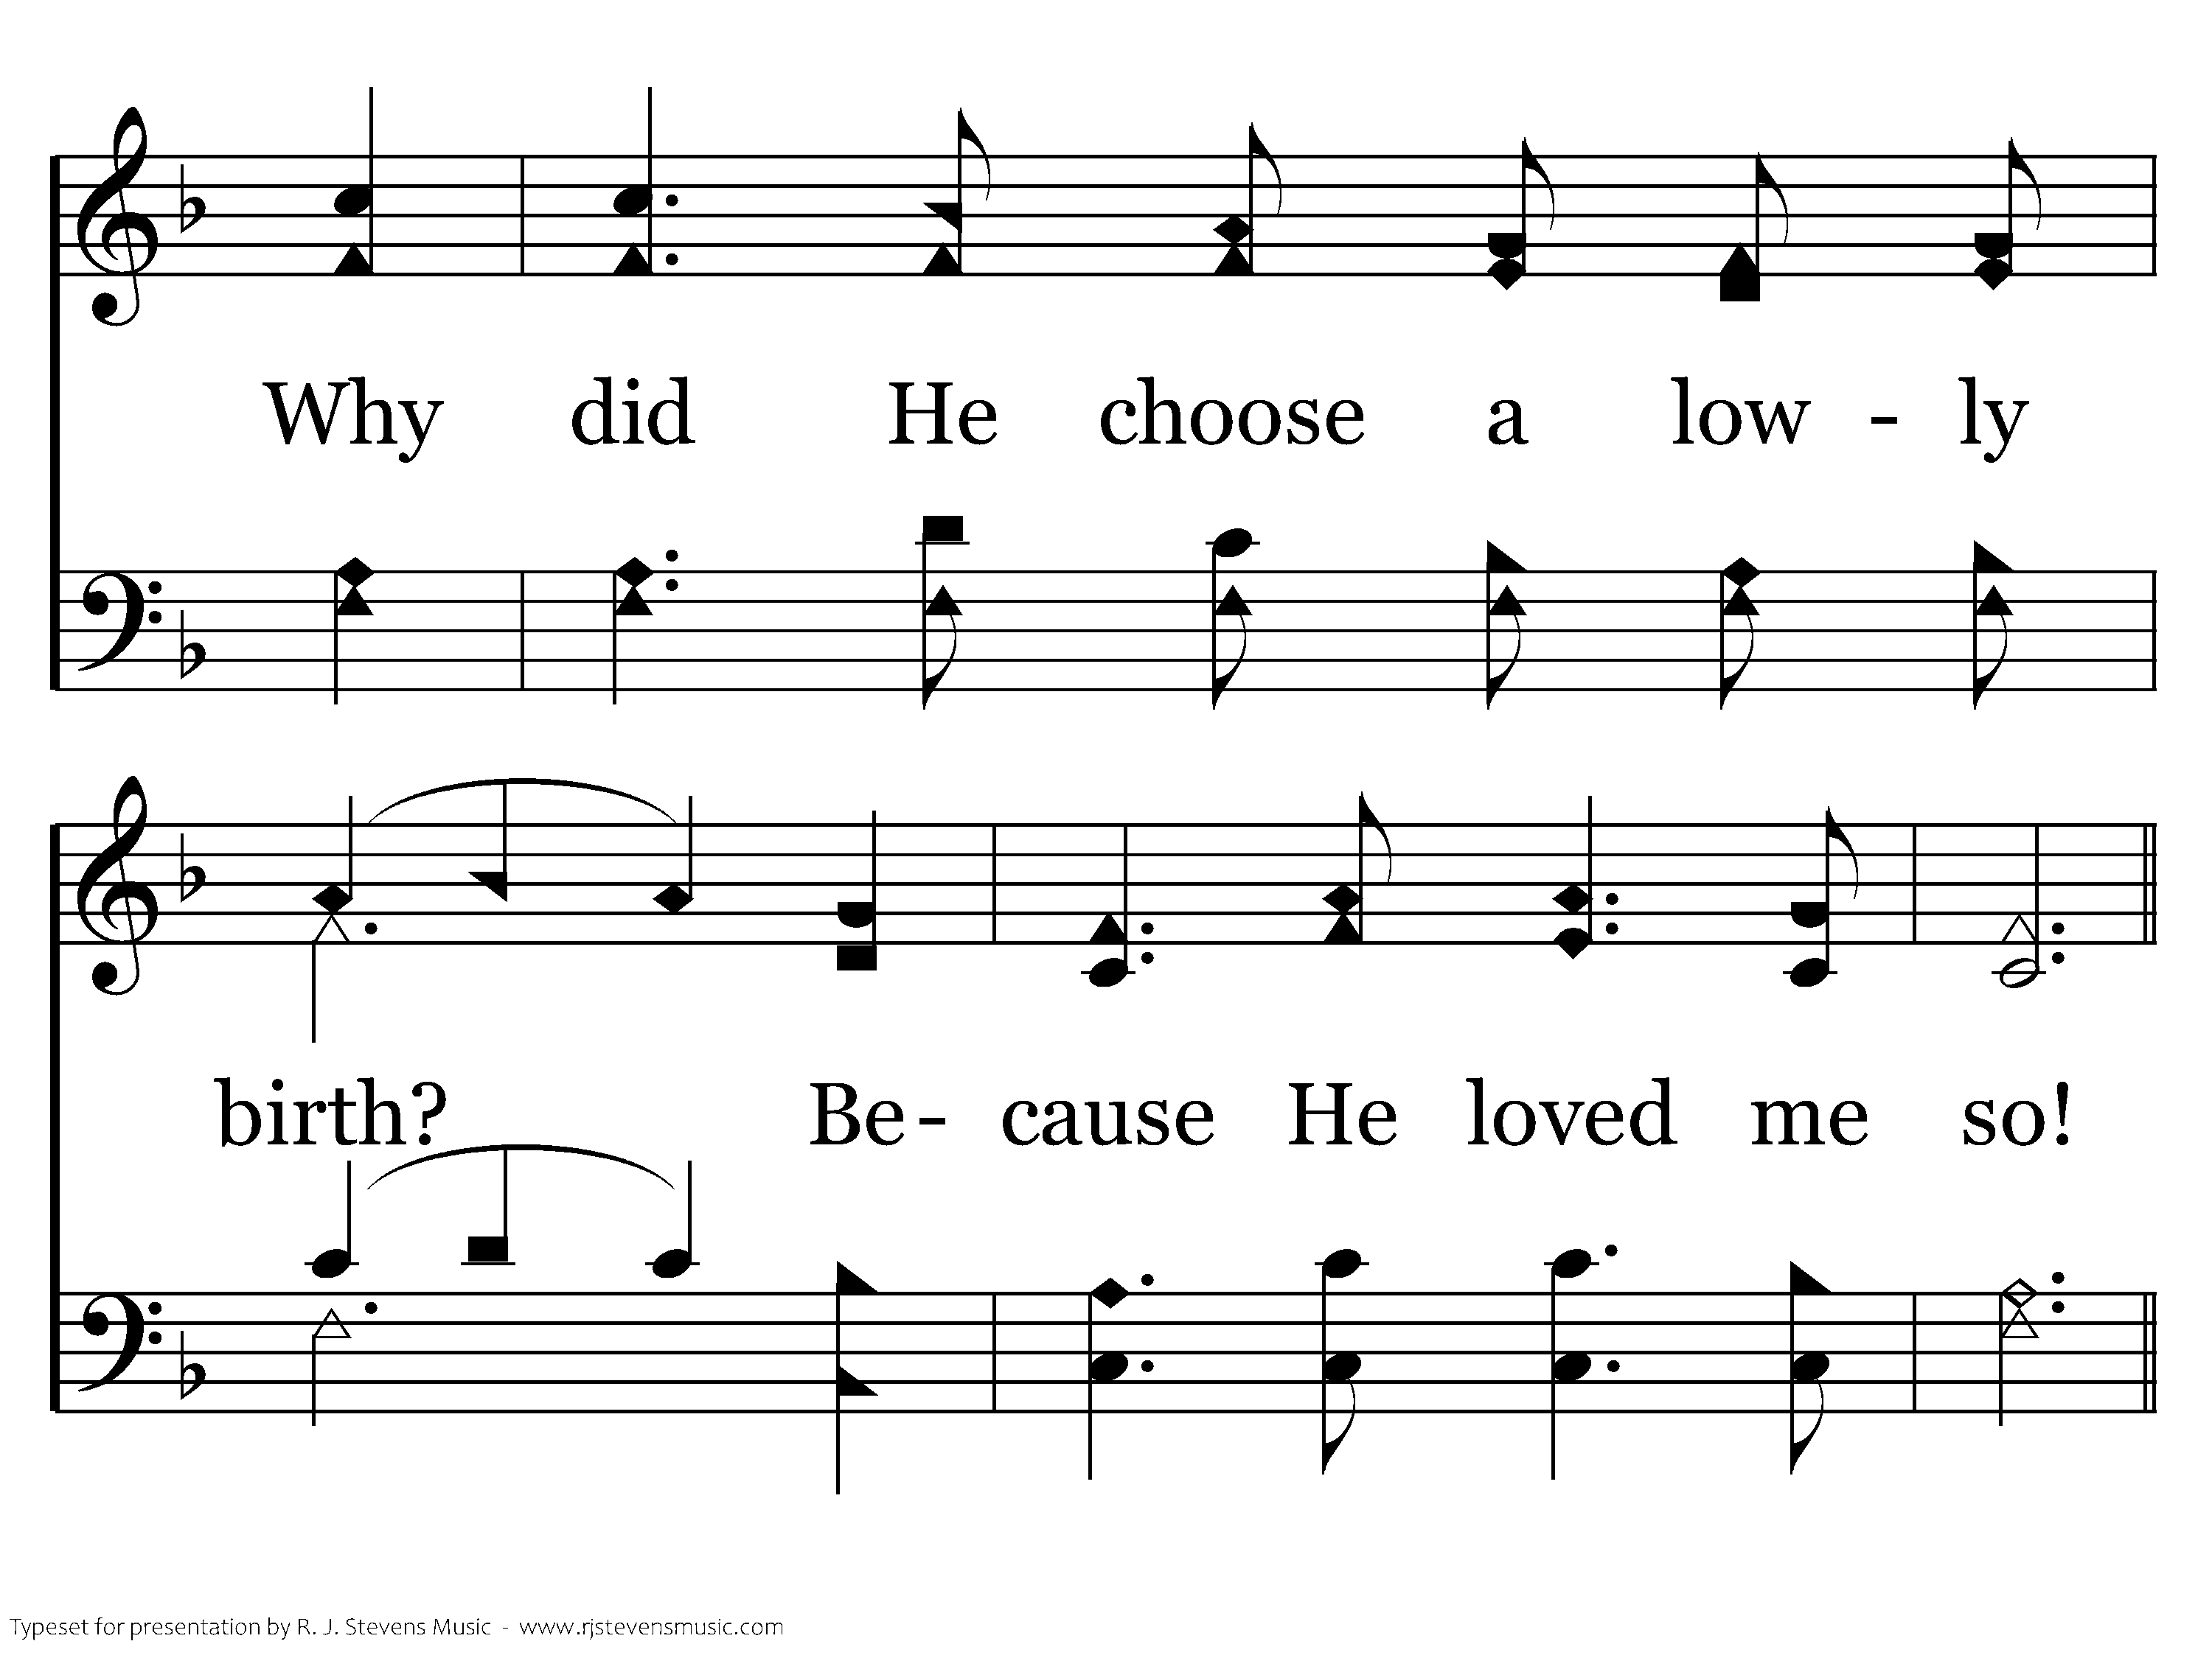
166 - He Loved Me So - 1.2

Slide 58

166 - He Loved Me So - C.1

Slide 59

166 - He Loved Me So - C.2
End of Verse 1

Slide 60

166 - He Loved Me So - 2.1

Slide 61

166 - He Loved Me So - 2.2

Slide 62
166 - He Loved Me So - C.1

Slide 63
166 - He Loved Me So - C.2
End of Verse 2

Slide 64

166 - He Loved Me So - 3.1

Slide 65

166 - He Loved Me So - 3.2

Slide 66
166 - He Loved Me So - C.1

Slide 67
166 - He Loved Me So - C.2
End of Song

