Slide 2
“HIS EYE IS ON THE SPARROW”
The Parable of the Sparrow and Hairs

Slide 3
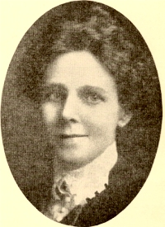
“HIS EYE IS ON THE SPARROW”
The Parable of the Sparrow and Hairs
Civilla Martin

Slide 4
Civilla Martin
1) Why should I feel discouraged, why should the shadows come, why should my heart be lonely and long for Heaven and home, when Jesus is my portion? My constant Friend is He: His eye is on the sparrow, and I know He watches me...

Slide 5
Civilla Martin
2) Let not your heart be troubled," His tender word I hear, and resting on His goodness, I lose my doubts and fears; though by the path He leadeth but one step I may see: His eye is on the sparrow, and I know He watches me...

Slide 6
Civilla Martin
3) Whenever I am tempted, whenever clouds arise, when songs give place to sighing, when hope within me dies, I draw the closer to Him; from care He sets me free; His eye is on the sparrow, and I know He watches me...

Slide 7
Matthew 10:26-33 | 26“So have no fear of them, for nothing is covered that will not be revealed, or hidden that will not be known. 27 What I tell you in the dark, say in the light, and what you hear whispered, proclaim on the housetops. 28 And do not fear those who kill the body but cannot kill the soul. Rather fear him who can destroy both soul and body in hell. 29 Are not two sparrows sold for a penny? And not one of them will fall to the ground apart from your Father.

Slide 8
Matthew 10:26-33 | 30 But even the hairs of your head are all numbered. 31 Fear not, therefore; you are of more value than many sparrows. 32 So everyone who acknowledges me before men, I also will acknowledge before my Father who is in heaven, 33 but whoever denies me before men, I also will deny before my Father who is in heaven.

Slide 9
“HIS EYE IS ON THE SPARROW”
The Parable of the Sparrow and Hairs

Slide 10
Psalm 84:3|Even the sparrow finds a home, and the swallow a nest for herself, where she may lay her young, at your alters, O Lord of hosts, my King and My God.

Slide 11
Psalm 102:7|I lie awake; I am like a lonely sparrow on the housetop.

Slide 12
Matthew 10:29|Are not two sparrows sold for a penny? And not one of them will fall to the ground apart from your Father.

Slide 13
“If God is concerned about the tiny sparrow and makes note of its fate, how much greater must His concern be for man!”

Slide 14
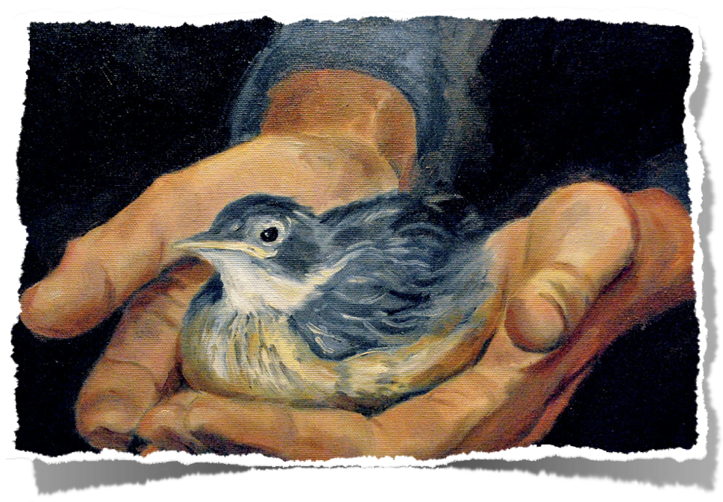
I. WHAT Could we BE AFRAID OF?
“HIS EYE IS ON THE SPARROW”

Slide 15
Mark 4:35-41| On that day, when evening had come, he said to them, “Let us go across to the other side.” 36 And leaving the crowd, they took him with them in the boat, just as he was. And other boats were with him. 37 And a great windstorm arose, and the waves were breaking into the boat, so that the boat was already filling. 38 But he was in the stern, asleep on the cushion. And they woke him and said to him, “Teacher, do you not care that we are perishing?”

Slide 16
Mark 4:35-41|39 And he awoke and rebuked the wind and said to the sea, “Peace! Be still!” And the wind ceased, and there was a great calm. 40 He said to them, “Why are you so afraid? Have you still no faith?” 41 And they were filled with great fear and said to one another, “Who then is this, that even the wind and the sea obey him?”

Slide 17
I. CONSIDERING HIS CARE AND CONCERN FOR US, WHAT DO WE NEED TO BE AFRAID OF?
Mark 4:35-41
On that day, when evening had come, he said to them, “Let us go across to the other side.” 36 And leaving the crowd, they took him with them in the boat, just as he was. And other boats were with him. 37 And a great windstorm arose, and the waves were breaking into the boat, so that the boat was already filling. 38 But he was in the stern, asleep on the cushion. And they woke him and said to him, “Teacher, do you not care that we are perishing?” 39 And he awoke and rebuked the wind and said to the sea, “Peace! Be still!” And the wind ceased, and there was a great calm. 40 He said to them, “Why are you so afraid? Have you still no faith?” 41 And they were filled with great fear and said to one another, “Who then is this, that even the wind and the sea obey him?”

Slide 18
I. WHAT Could we BE AFRAID OF?
Are we afraid that God won’t forgive our sins?
1 John 1:9| If we confess our sins, he is faithful and just to forgive us our sins and to cleanse us from all unrighteousness.
“HIS EYE IS ON THE SPARROW”

Slide 19
I. WHAT Could we BE AFRAID OF?
Have I forgotten to trust in the Word?
“HIS EYE IS ON THE SPARROW”

Slide 20
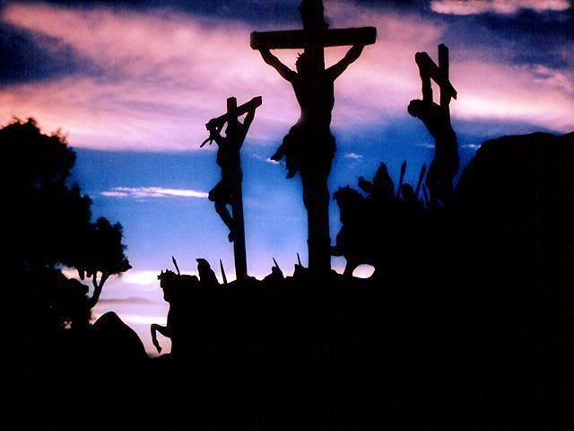

Slide 21
I. WHAT Could we BE AFRAID OF?
Why are you afraid of friends?
Matthew 10:28| And do not fear those who kill the body but cannot kill the soul. Rather fear him who can destroy both soul and body in hell.
“HIS EYE IS ON THE SPARROW”

Slide 22
I. WHAT Could we BE AFRAID OF?
Why are you afraid of life?
Matthew 6:25-31
“HIS EYE IS ON THE SPARROW”

Slide 23
Matthew 6:25-31|“Therefore I tell you, do not be anxious about your life, what you will eat or what you will drink, nor about your body, what you will put on. Is not life more than food, and the body more than clothing? 26 Look at the birds of the air: they neither sow nor reap nor gather into barns, and yet your heavenly Father feeds them. Are you not of more value than they? 27 And which of you by being anxious can add a single hour to his span of life?

Slide 24
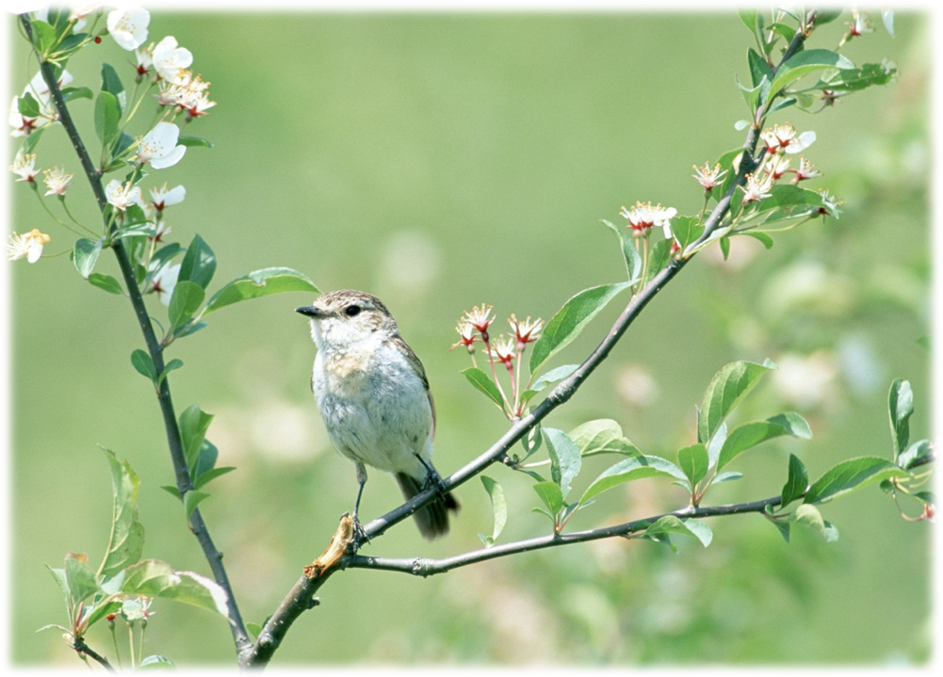
Matthew 6:25-31|28 And why are you anxious about clothing? Consider the lilies of the field, how they grow: they neither toil nor spin, 29 yet I tell you, even Solomon in all his glory was not arrayed like one of these. 30 But if God so clothes the grass of the field, which today is alive and tomorrow is thrown into the oven, will he not much more clothe you, O you of little faith? 31 "Therefore do not worry, saying, 'What shall we eat?' or 'What shall we drink?' or 'What shall we wear?'

Slide 25
Philippians 4:11-13|Not that I speak in regard to need, for I have learned in whatever state I am, to be content: 12 I know how to be abased, and I know how to abound. Everywhere and in all things I have learned both to be full and to be hungry, both to abound and to suffer need. 13 I can do all things through Christ who strengthens me.

Slide 26
“Why are you so afraid?”

Slide 27
II. WHY WOULD WE STILL LIVE IN SIN?
Romans 6:1-4 | What shall we say then? Are we to continue in sin that grace may abound? 2 By no means! How can we who died to sin still live in it? 3 Do you not know that all of us who have been baptized into Christ Jesus were baptized into his death? 4 We were buried therefore with him by baptism into death, in order that, just as Christ was raised from the dead by the glory of the Father, we too might walk in newness of life.
“HIS EYE IS ON THE SPARROW”

Slide 28
II. WHY WOULD WE STILL LIVE IN SIN?
Mark 8:34-36| And calling the crowd to him with his disciples, he said to them, “If anyone would come after me, let him deny himself and take up his cross and follow me. 35 For whoever would save his life will lose it, but whoever loses his life for my sake and the gospel’s will save it. 36 For what does it profit a man to gain the whole world and forfeit his soul?
“HIS EYE IS ON THE SPARROW”

Slide 29
“HIS EYE IS ON THE SPARROW”
The Parable of the Sparrow and Hairs
Civilla Martin

Slide 30
Civilla Martin
1) Why should I feel discouraged, why should the shadows come, why should my heart be lonely and long for Heaven and home, when Jesus is my portion? My constant Friend is He: His eye is on the sparrow, and I know He watches me...

Slide 31
Civilla Martin
2) Let not your heart be troubled," His tender word I hear, and resting on His goodness, I lose my doubts and fears; though by the path He leadeth but one step I may see: His eye is on the sparrow, and I know He watches me...

Slide 32
Civilla Martin
3) Whenever I am tempted, whenever clouds arise, when songs give place to sighing, when hope within me dies, I draw the closer to Him; from care He sets me free; His eye is on the sparrow, and I know He watches me...

Slide 33
“HIS EYE IS ON THE SPARROW”
The Parable of the Sparrow and Hairs

