Slide 1
Apologetics lesson 2 & 3

Slide 5
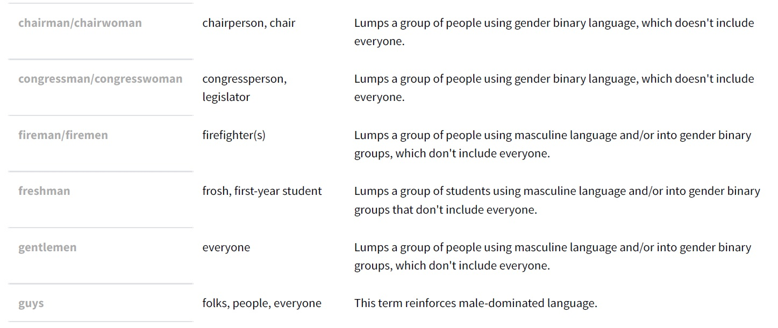

Slide 7
Verses where the word meaning has changed since the publication of the King James Bible.
Heb 11:9 By faith he sojourned in the land of promise, as in a strange country, dwelling in tabernacles with Isaac and Jacob, the heirs with him of the same promise:
James 2:3 And ye have respect to him that weareth the gay clothing, and say unto him, Sit thou here in a good place; and say to the poor, Stand thou there, or sit here under my footstool:
1 Pet 2:12 Having your conversation honest among the Gentiles: that, whereas they speak against you as evildoers, they may by your good works, which they shall behold, glorify God in the day of visitation

Slide 9
