Slide 1
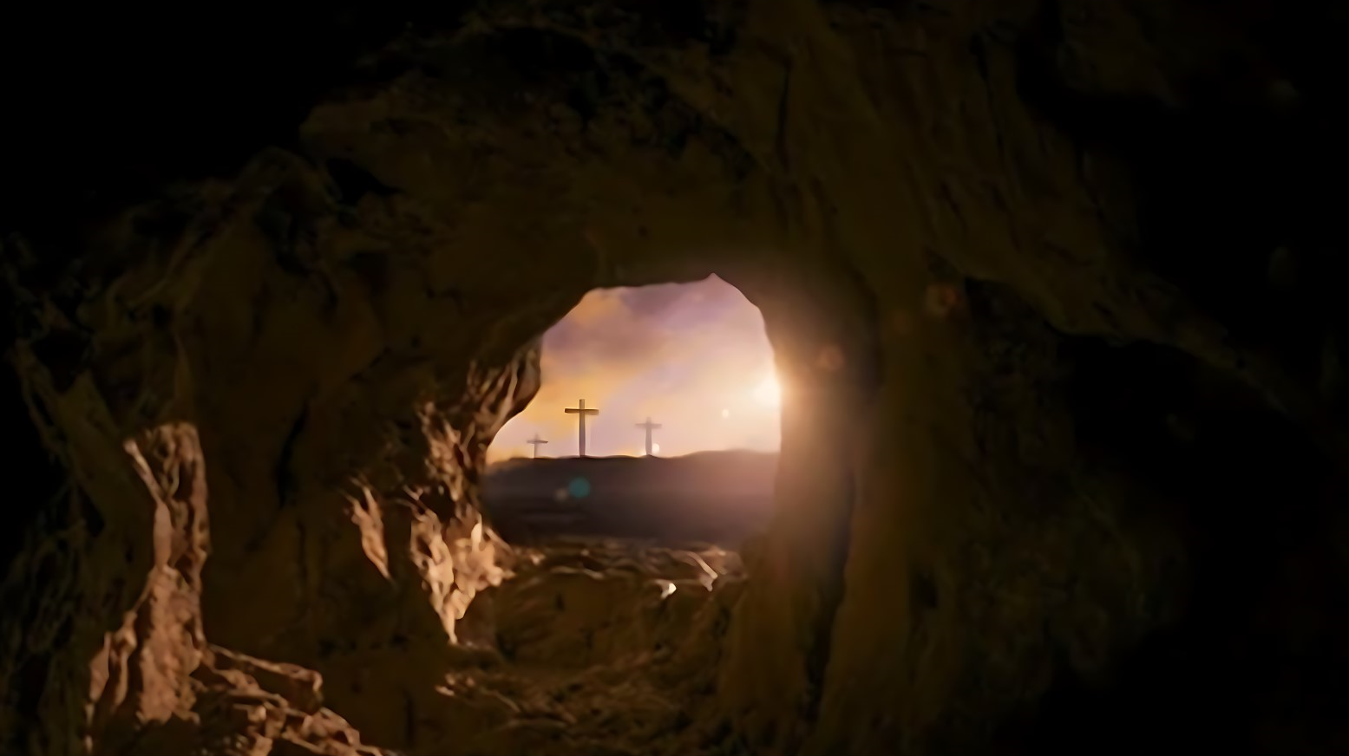
The Importance of the Resurrection

Slide 2
The Fundamentals of the Gospel (15:1-11)
Jesus died for our sins, was buried and rose again the third day (v3-4)
Many witnesses attest to this fact (v5-8)
This is what the Corinthians had believed (v11)

Slide 3
If There Is No Resurrection (15:12-19)
-Christ is not risen (v13)
-Preaching the gospel is meaningless (v14)
-Faith is worthless (v14)
-Witnesses are liars (v15) (v29-32)
-All men are still in their sins (v17)
-Christians who have died have perished eternally (v18)
-We are of all men most pitiable (v19)

Slide 4
Truths About The Resurrection (15:20-44)
•Christ is the first fruits (v20-23)
•The resurrection is a set process (v35-44)
-A death is necessary (v36-37)
-Each individual will have an individual body (v38)
-Bodies can be differentiated one from another (v38-41)
-The resurrected body will be different in several important respects (v42-44)

